Slide 1
Biblical World News
365 Days a Year
http://watch.org

Slide 2
Israeli Embassy in Brasilia, Brazil, September 2022 President and Mrs. Bolsonaro, Michele Bachmann, Tania

Slide 3
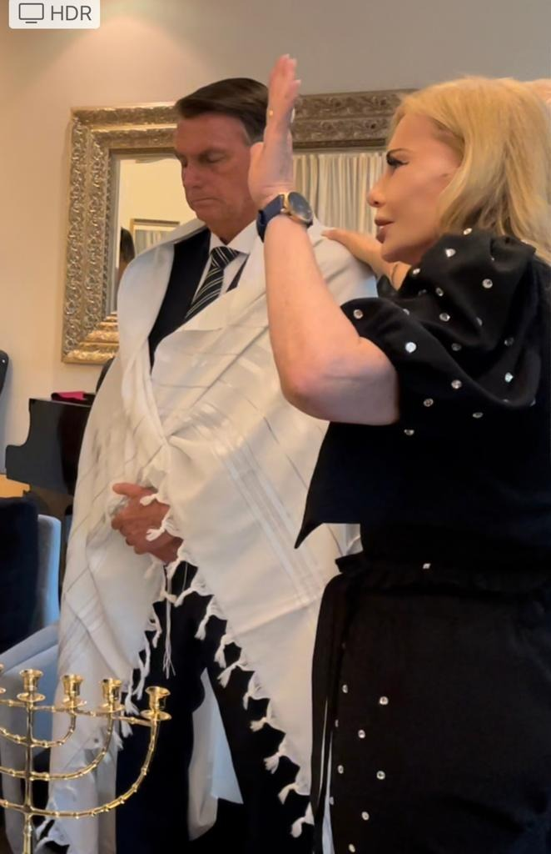
Tania praying for President Bolsonaro on
Yom Kippur, October 4, 2022

Slide 4
Jerusalem Prayer Breakfast – Brasilia, Brazil October 27 -28 , 2022

Slide 5
Brazil’s First Lady Michelle Bolsonaro, October 29, 2022

Slide 7
Tania and I met with the Bolsonaros at Presidential Palace in Brasilia, Brazil, November 20, 2022

Slide 8
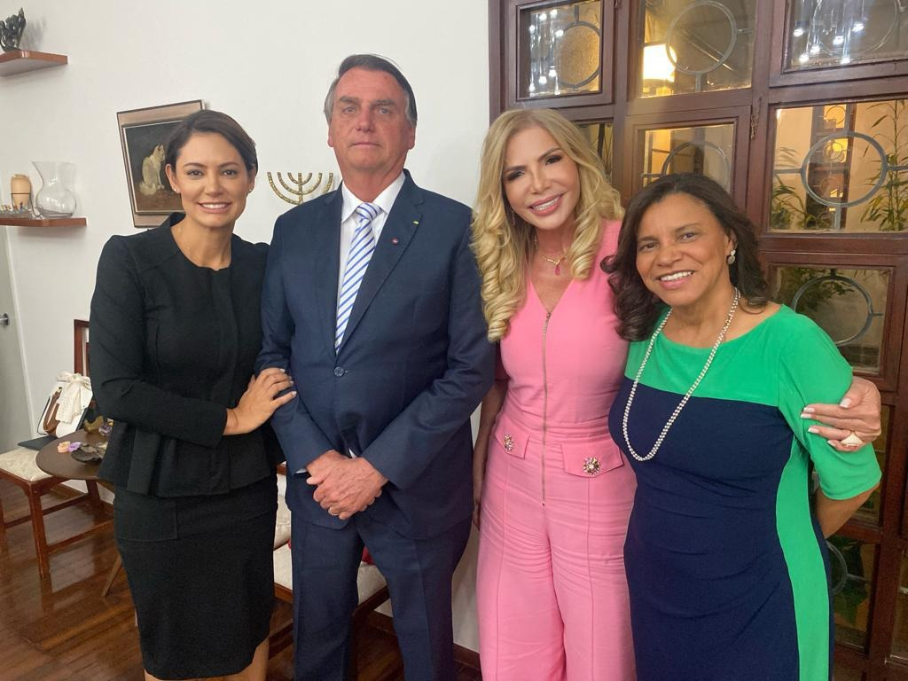
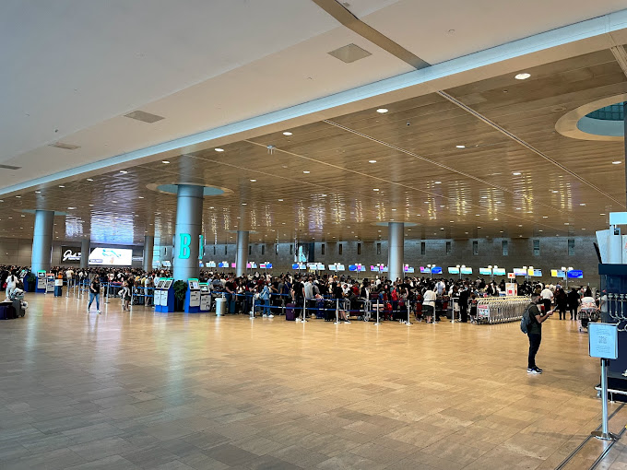
Ezenete Rodrigues - October 7, 2023

Slide 11
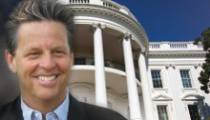

Slide 12
Replacement Theology – led to 18 centuries of anti-Semitism and Jewish persecution
Origin and Clement
Augustine, King Constantine and the Catholic Church
Martin Luther, John Calvin, John Wesley
-----------
Crusades
Spanish Inquisition
Holocaust
Iran, Hamas, Hezbollah

Slide 13
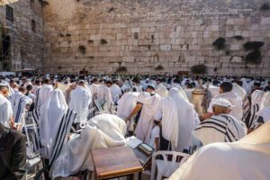
AllIsraelShallbeSaved.com
Zechariah 12:10: And I will pour upon the house of David, and upon the inhabitants of Jerusalem, the spirit of grace and of supplications: and they shall look upon me whom they have pierced, and they shall mourn for him, as one mourneth for his only son, and shall be in bitterness for him, as one that is in bitterness for his firstborn.
Romans 11:26: And so all Israel shall be saved: as it is written, There shall come out of Sion the Deliverer, and shall turn away ungodliness from Jacob:

Slide 14
Reach1billion.com
100 million church attendees in the US and 1 billion worldwide do not know:
The biblical significance of the modern state of Israel.
That the God of Israel will judge the world for its sins and unbelief.
That God will remove those “born again” prior to Yeshua’s return. Joining Him in His victorious return.
That Yeshua will reign from the New Jerusalem for 1000 years.

Slide 15
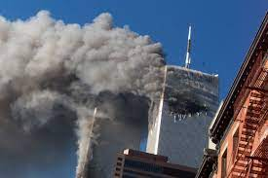
Land of Israel: Corresponding events of 9-11 and coronavirus have cost U.S. govt./ Federal Reserve $15.7 trillion
When the covenant land of Israel is negotiated or compromised, you can observe an atmospheric and/or disruptive response in the country responsible (Joel 3:2).
The two largest catastrophes in U.S. history corresponded to direct White House role in establishing an Arab state in Judea and Samaria.

Slide 16
Bush – Abdullah two state plan - 9-11-2001 Trump-Kushner – Peace to Prosperity Plan – 1-28-2020
Those two events have cost the United States just under $15 trillion
and growing for the war on terror in the Middle East totaling $6.4 trillion and lawmakers enacted six major coronavirus bills totaling $5.3 trillion and the Federal Reserve has committed/disbursed $4.0 trillion out of $6.2 trillion allowed. These major events have dramatically changed life as we know it in America, Israel, and the world. These figures do not include the enormous costs to businesses and individuals. On a positive note, this has accelerated final-day events.

Slide 17
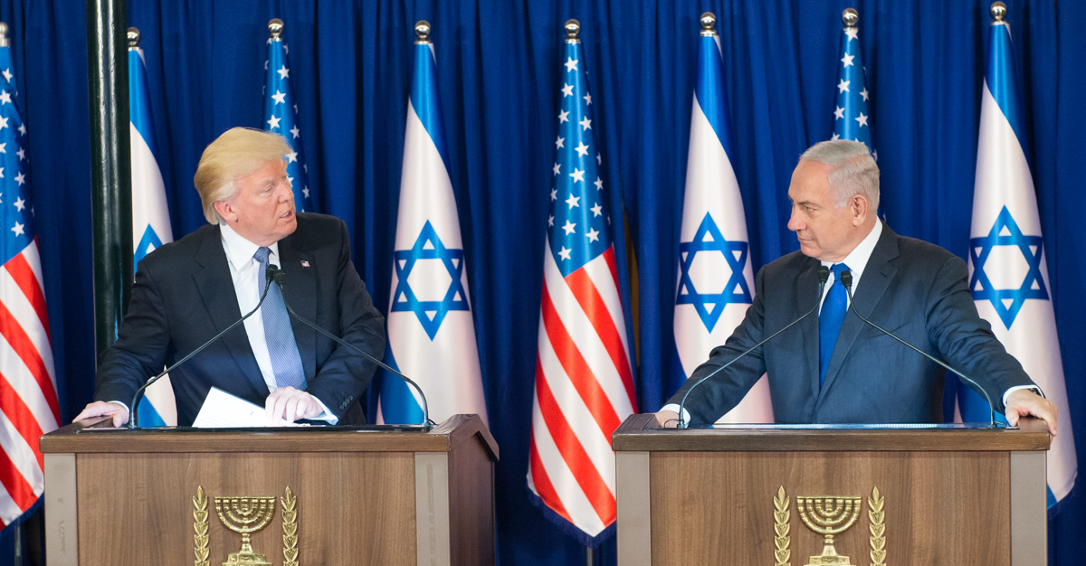
US - Israel Acceleration of Final Day Events Spoken of in the Book of Revelation

Slide 18
Trump’s ‘deal of the century’ presented with
map at White House - January 28, 2020

Slide 19
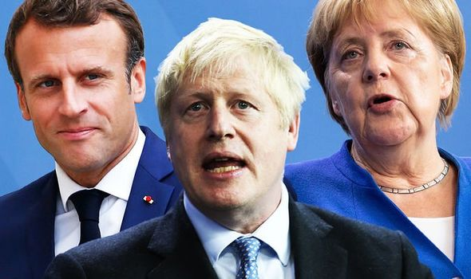
Trump Peace to Prosperity Plan and the Global Peace Plan Accelerated Final Day Events – Jan. 28 – Feb 4. 2020

Slide 20
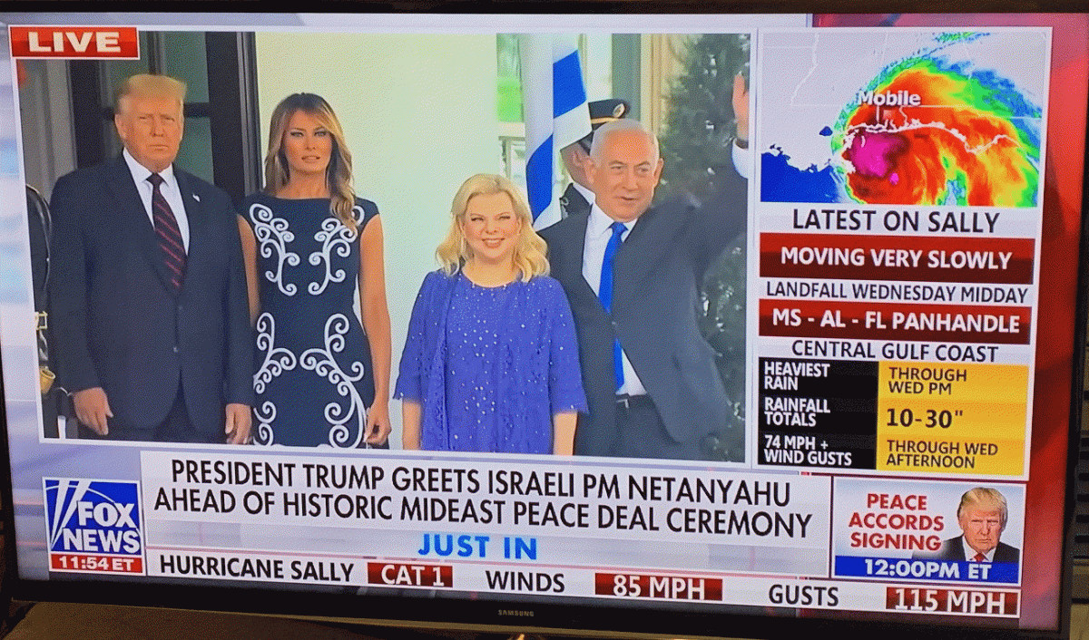
Abraham Accords signing, September 15, 2020
Sally derives from the Hebrew 'Saray/Sarah' name: Was Hurricane Sally/Sarah a response to the Abraham Accords?

Slide 21
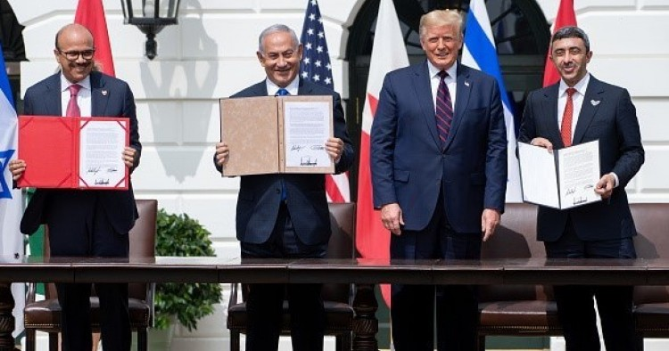
Abraham Accord Signing at White House September 15, 2020

Slide 22
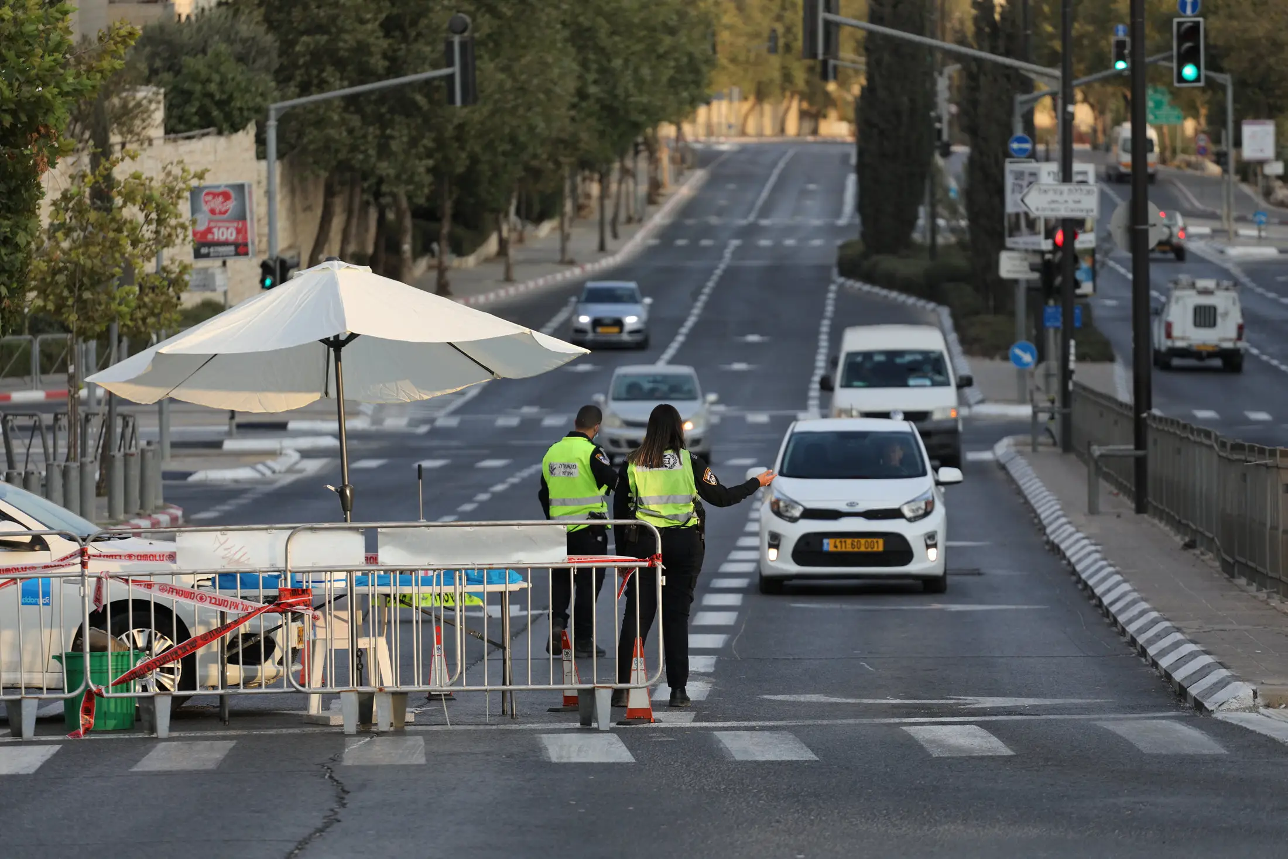
Israel goes into national lockdown beginning on Rosh Hashanah, through Yom Kippur and Sukkoth 72 hours after Abraham Accord Signing
The three-week national lockdown was timed to coincide with the Rosh Hashana and Yom Kippur holy days and the festival of Sukkot, in the hope of causing less economic damage because business slows down in any case around the holidays. It was also aimed at preventing large family meals that could become petri dishes for the virus.
September 18, 2020

Slide 23
The Abraham Accord is Cursed
Stopped the extended sovereignity of 134 Jewish communities in Judea and Samaria.
Continued the ‘two-state’ false narrative.
Continues the UN Resolutions 242 and 338.
Resolutions which call for Israel to give back land to 1967 lines with swaps and the division of Jerusalem.
Mentions the Arab peace plan of 2002.

Slide 24
The Abraham Accord is Cursed
Abrahamic covenant and land covenant applies only to Isaac and his seed. Genesis 17:19-21
The land which I gave Abraham and Isaac. Genesis. 35:11-12
The Land as an everlasting possession. Genesis 48:3-4
Israel’s land not to be sold or exchanged. Ezekiel 36:24, Ezekiel 48:14, Ezekiel 48:29
Isaac and his seed is the heir, not Ishmael. Galatians 4:22-31

Slide 25
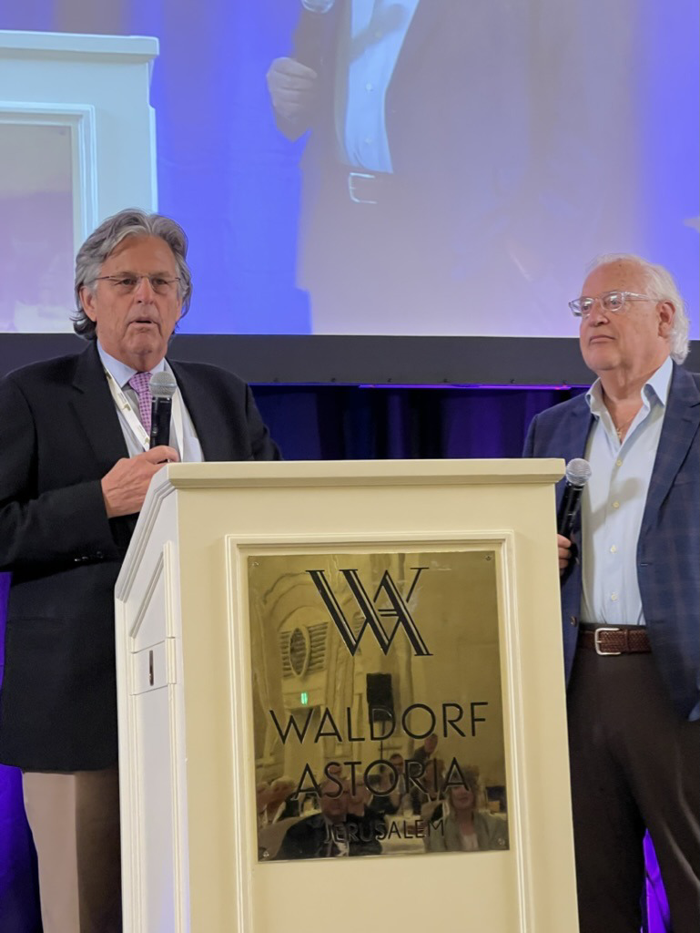
Ambassador David Friedman, June 2, 2022

Slide 26
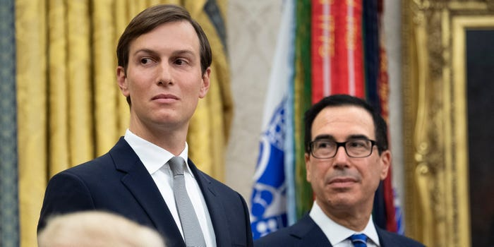
Jared Kushner and Steve Mnuchin cashed in fast on their Trump-era work, raising $3.5 billion from Arab states for private funds, report says
Kushner and Mnuchin have reportedly raised $3.5 billion from Arab states since leaving office.
Saudi Arabia put a combined $3 billion into Kushner's and Mnuchin's funds, The New York Times said.
The Times reported both men held meetings with their investors while working in the White House.

Slide 27
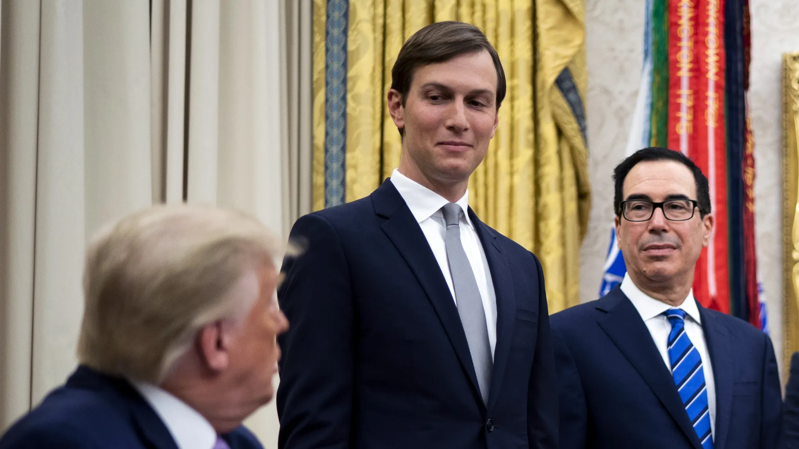
Kushner’s raised $2 billion from Saudis
Driving the news: Jared Kushner's firm, Affinity Equity, scored a $2 billion commitment from Saudi Arabia's Public Investment Fund, while former Treasury Secretary Steven Mnuchin's Liberty Strategic Capital secured $1 billion.

Slide 28
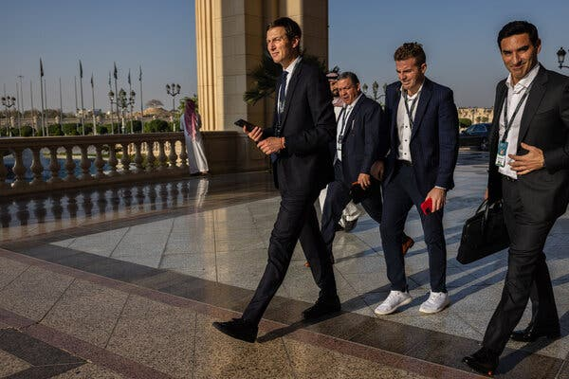
Kushner raised hundreds of millions from UAE and Qatar
Wealth funds in the United Arab Emirates and Qatar have invested hundreds of millions of dollars with Jared Kushner’s private equity firm, according to people with knowledge of the transactions, joining Saudi Arabia in backing the venture launched by former President Donald J. Trump’s son-in-law as he left the White House.

Slide 29
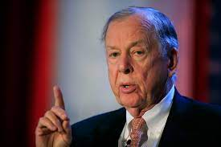
T Boone Pickens: $500 billion a year sent to the Middle East for oil; that money should stay in the US

Slide 30
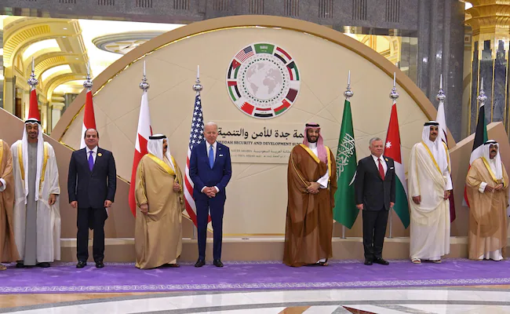
Ezekiel 38-39 alignment: July 16, 2022
Biden at summit in Jeddah, on the Red Sea coast of Saudi Arabia. July 16, 2022

Slide 31
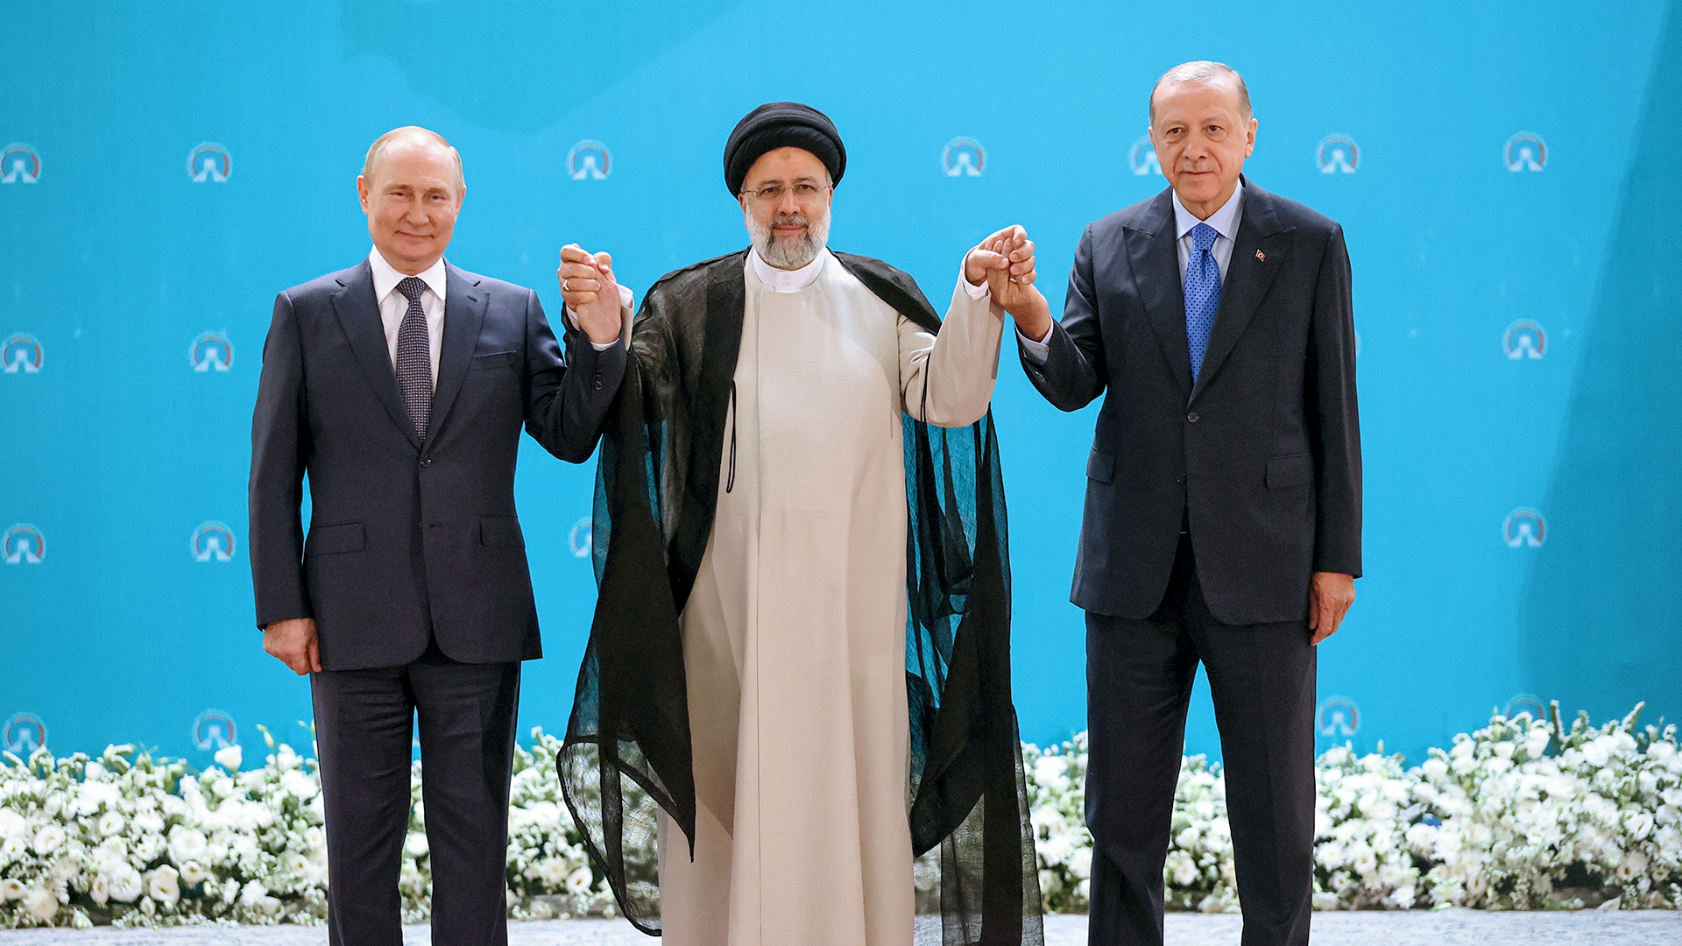
Ezekiel 38-39 alignment
Putin, Raisi and Erdogan, July 19, 2022

Slide 32
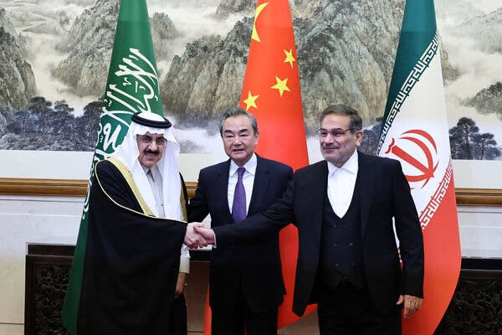
Chinese-Brokered Deal Upends Mideast Diplomacy and Challenges U.S. – March 10, 2023
The Chinese, who for years played only a secondary role in the region, have suddenly transformed themselves into the new power player.
And the Israelis, who have been courting the Saudis against their mutual adversaries in Tehran, now wonder where it leaves them.
China’s top foreign policy official, with Ali Shamkhani, right, the secretary of Iran’s security council, and Musaad bin Mohammed Al Aiban, Saudi Arabia’s minister of state, in Beijing, on Friday.

Slide 33
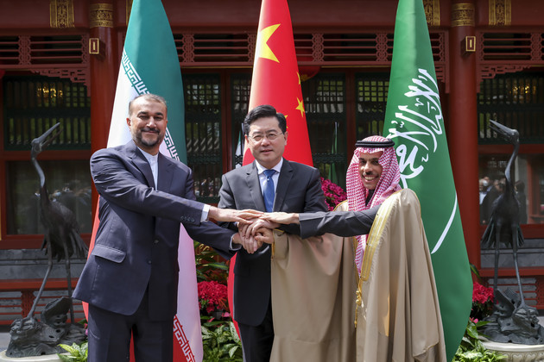
China-brokered Saudi-Iran deal – April 6, 2023
Top diplomats for Saudi Arabia and Iran were in Beijing to finalize a deal that would reopen embassies, resume direct flights between their two nations and restart security and trade agreements.
It’s the latest sign that Beijing is not content with being solely a regional behemoth, but rather a major global power.

Slide 34
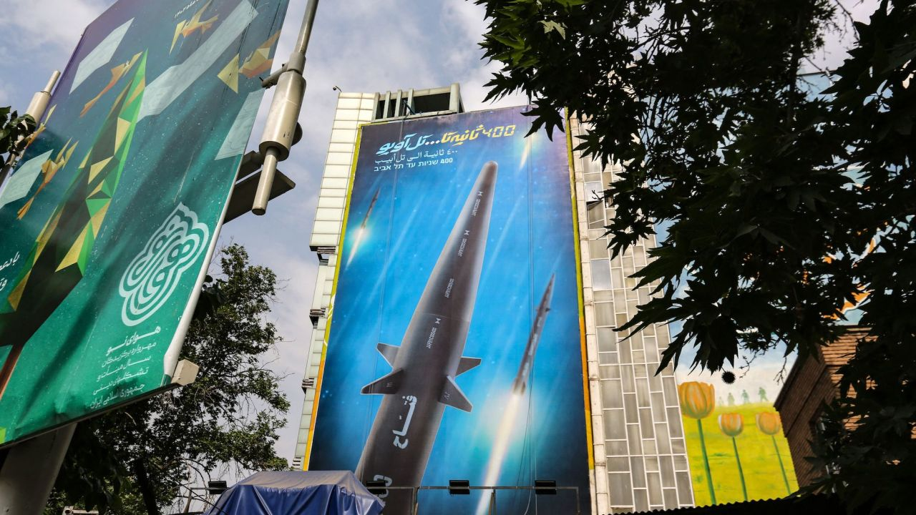
Iran has a new hypersonic missile June 9, 2023
It’s not every day that you see billboards in Hebrew on the streets of Tehran.
This one, posted across the Iranian capital this week, reads: “400 seconds to Tel Aviv” in Persian, Arabic and Hebrew. It is an announcement of the latest missile in Iran’s fast expanding arsenal of weapons – one that Iran’s military says can travel up to 15 times the speed of sound.

Slide 35
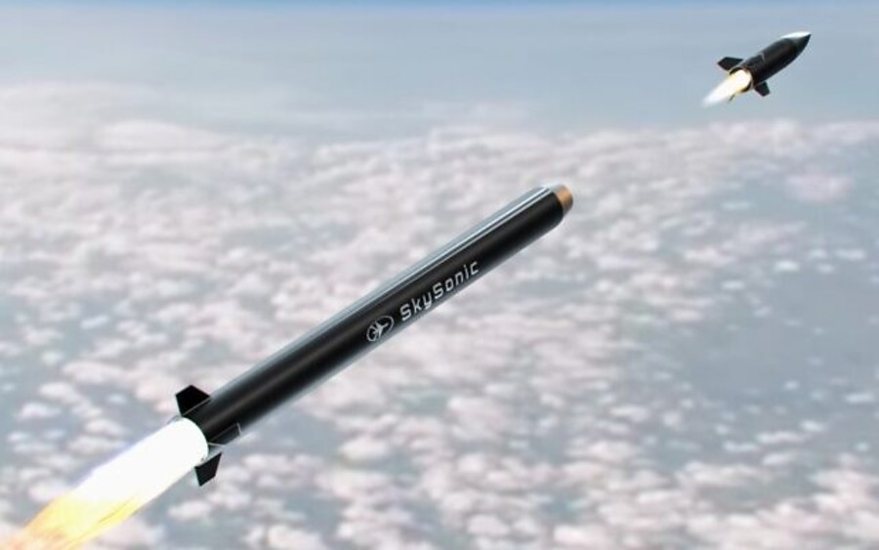
'Sky Sonic' will be Israel's first anti-hypersonic missile system – June 14, 2023
Israel is in the process of developing an anti-hypersonic missile system, known as the “Sky Sonic” system, that will reportedly be able to shoot down hypersonic missiles, according to an announcement made by Israel's Rafael Advanced Defense Systems on Wednesday.
(Photo courtesy Rafael)

Slide 36
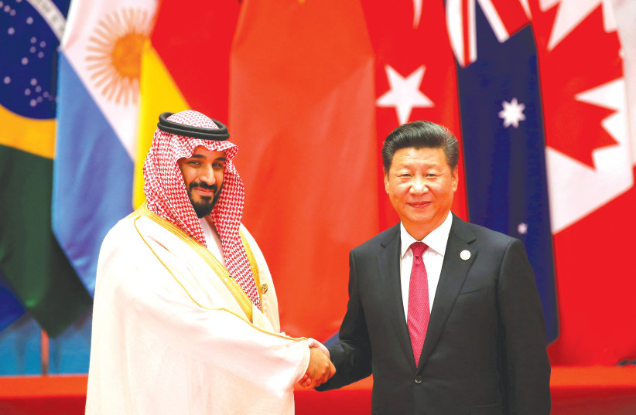
Saudi Arabia, China undermine US influence in Middle East – analysis – June 14, 2023
But after years of US military intervention in the region and an ongoing cold war-like relationship between Saudi Arabia’s de facto ruler Crown Prince Mohammed bin Salman (known as MBS) and the Biden Administration, China is stepping in to fill the regional diplomatic role that was once the exclusive domain of United States.

Slide 37
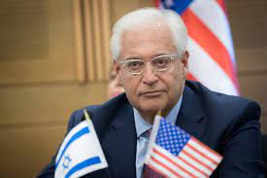
David Friedman, June 14, 2023: Not meeting with Netanyahu is ‘despicable’
Former U.S. Ambassador to Israel David Friedman blamed the American Jewish leadership for “koshering” President Joe Biden’s refusal to meet with Prime Minister Benjamin Netanyahu. Friedman warned that the American Jewish leadership is playing with the future of the community by delegitimizing Israel’s democratically elected leaders.

Slide 38
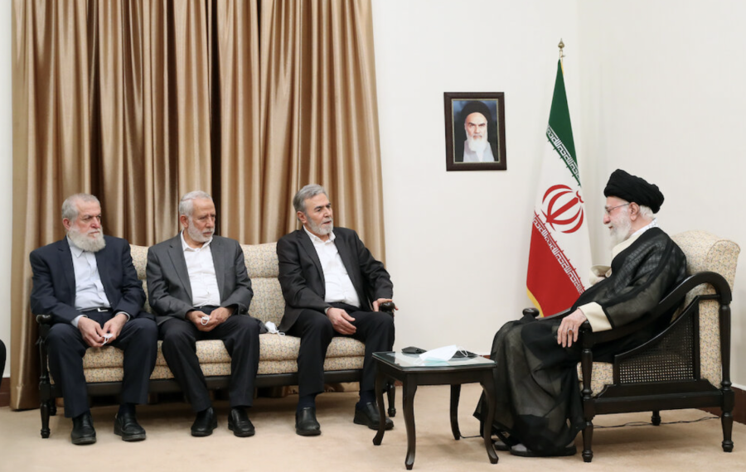
Palestinian Islamic Jihad leaders claim plans to establish new West Bank terror cells – July 2, 2023
“The most important thing is that we strengthen the resistance,” PIJ head Ziad Nakhaleh told the Iranian Arabic-language paper Al-Vefagh on Saturday.
“During our visit to Iran, during the meeting with His Eminence, the Leader, His Eminence reaffirmed [his desire] to advance arming the West Bank and resistance action in the West Bank,” Nakhaleh added.

Slide 39
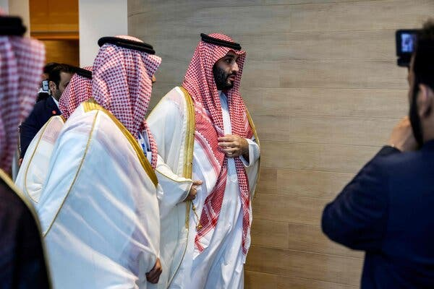
Saudi Arabia Offers Its Price to Normalize Relations With Israel
Saudi Arabia is seeking security guarantees from the United States, help with developing a civilian nuclear program and fewer restrictions on U.S. arms sales as its price for normalizing relations with Israel, people familiar with the exchanges say.

Slide 40
EU envoy: ‘No such thing as Area A and B, it’s all Palestine’ – May 25, 2023
German diplomat Sven Kühn von Burgsdorff, who represents the European Union in Judea, Samaria and Gaza, said on Wednesday during a visit to Samaria, “There is no such thing as Area B and C, it’s all Palestine.”
E.U. Representative Sven Kühn von Burgsdorff

Slide 41
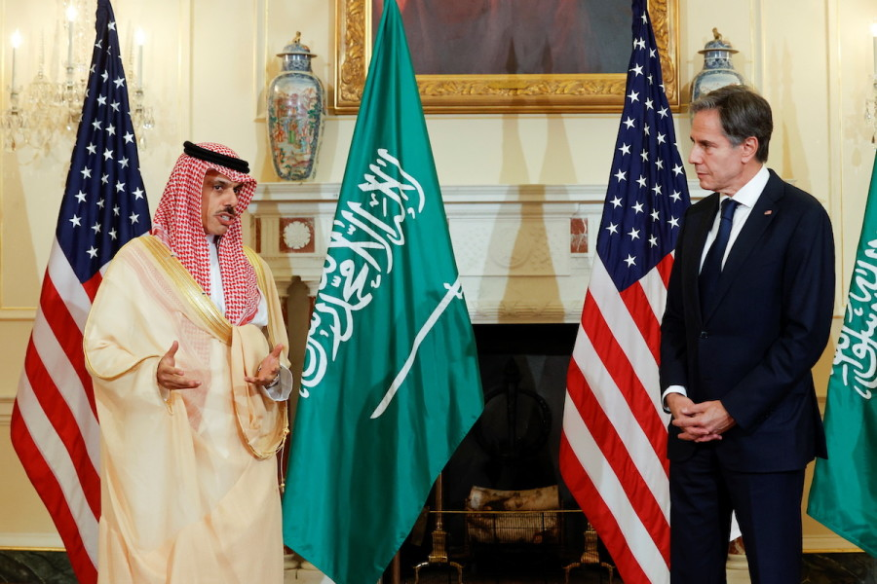
Blinken says West Bank tensions complicate potential Saudi-Israeli normalization – June 29, 2023
“We’ve told our friends and allies in Israel that if there’s a fire burning in their backyard, it’s going to be a lot tougher, if not impossible, to actually both deepen the existing agreements, as well as to expand them to include potentially Saudi Arabia,” Blinken said.

Slide 42
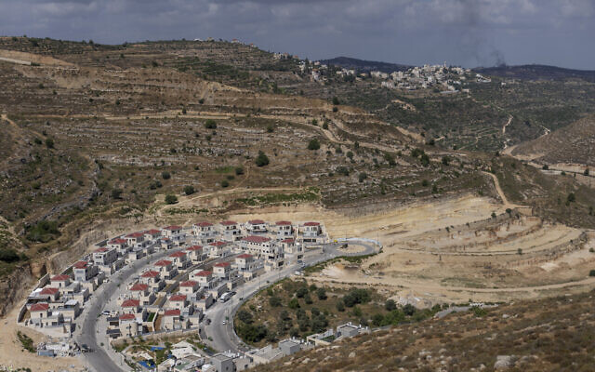
UK, Canada, Australia call on Israel to reverse approvals for settlement expansion – June 30, 2023
The United Kingdom, Canada, and Australia called on Israel to reverse recent decisions to approve more settlement construction in the West Bank, and said they were “gravely concerned” by Jerusalem’s green light to advance plans for some 5,700 new settlement homes. They are part of the 13,082 settlement homes that have been advanced through a pair of major planning stages so far in 2023.

Slide 43
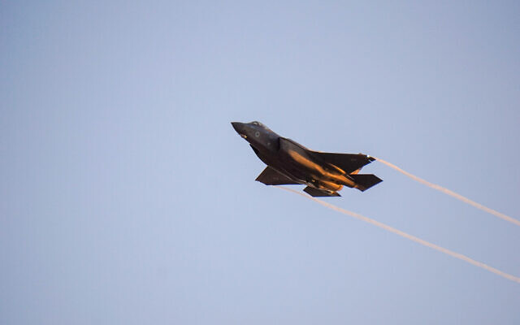
Israel to procure third F-35 squadron, eventually bringing fleet to 75 – July 2, 2023
The Defense Ministry and military on Sunday said Israel would be procuring a third squadron of advanced F-35 stealth fighter jets from the United States.
The additional 25 aircraft would bring the Israeli Air Force’s F-35i fleet to 75 in the coming years.

Slide 44
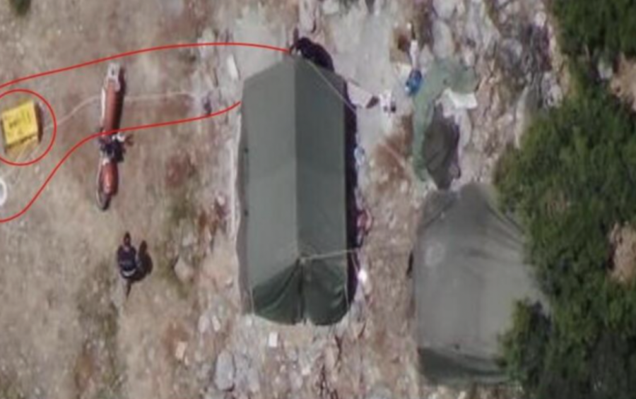
Hezbollah vows to maintain its military posts in Israeli territory, rejects UN diplomacy
A senior political official of the Iranian-backed Lebanese terrorist group Hezbollah vowed that the powerful organization would not dismantle the two tents it set up on the Israeli side of the Blue Line.

Slide 45
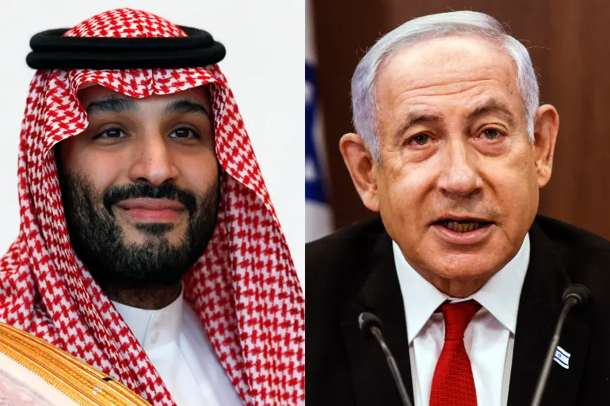
Turning point in the Middle East; Israel-Saudi deal nearing completion

Slide 46
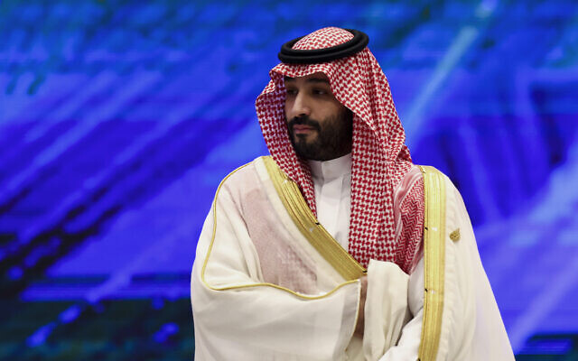
Saudi crown prince: Israel and Saudi Arabia moving closer to normalization ‘every day’ – September 20, 2023
“Now, we don’t have a relation with Israel, but if the Biden administration succeeded in making, I believe, the biggest historical deal since the end of the Cold War, then we’re going to start a relationship and that relationship continues regardless of who’s running Israel,” the crown prince said.
““If we have a breakthrough [toward] reaching a deal that gives the Palestinians their needs and makes the region calm, we’re going to work with whoever’s there.”

Slide 47
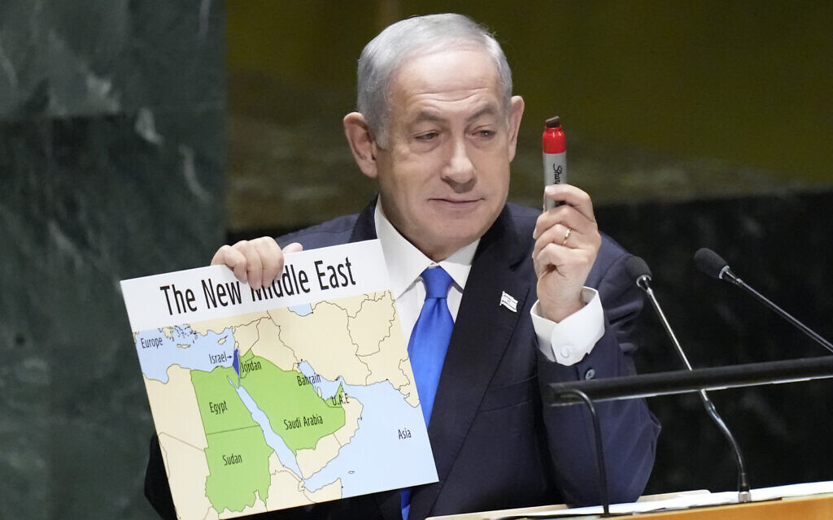
Netanyahu at the UN – September 22, 2023
“Such a peace will go a long way to ending the Arab-Israeli conflict,” said Netanyahu, addressing the gathering for the 12th time.
“It will encourage other Arab states to normalize their relations with Israel. It will enhance the prospects of peace with the Palestinians. It will encourage a broader reconciliation between Judaism and Islam, between Jerusalem and Mecca, between the descendants of Isaac and the descendants of Ishmael.”

Slide 48
What was Netanyahu willing to give the Saudis and the US? – September 22, 2023
A greater role in the Temple Mount and the Holy sites in Jerusalem?
Possible land arrangement with Jordan’s involvement?
Kept his political party, IDF and the security establishment in the dark about details of a deal.

Slide 49
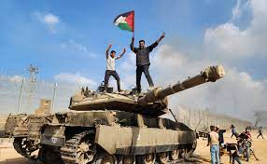
Hamas attacks Israel – October 7, 2023
50th anniversary of the Yom Kippur war
Day after the end of Sukkoth
Shabbat Saturday

Slide 50
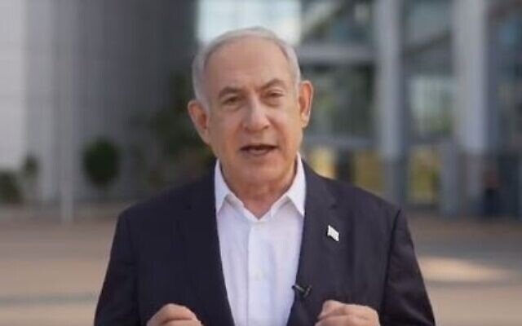
‘We are at war,’ Netanyahu says, after Hamas launches devastating surprise attack – October 7, 2023
“Citizens of Israel, we are at war. Not an operation, not a round [of fighting,] at war! This morning Hamas initiated a murderous surprise attack against the state of Israel and its citizens,” Netanyahu said in his filmed statement in Hebrew.

Slide 51
Over 1200 dead in Israel – October 7, 2023
Over 1,200 people in Israel have been killed, and another 6,900 have been injured in the war.
371 Israeli soldiers have been killed.
55 IDF soldiers have been killed during ground combat in Gaza so far.

Slide 52
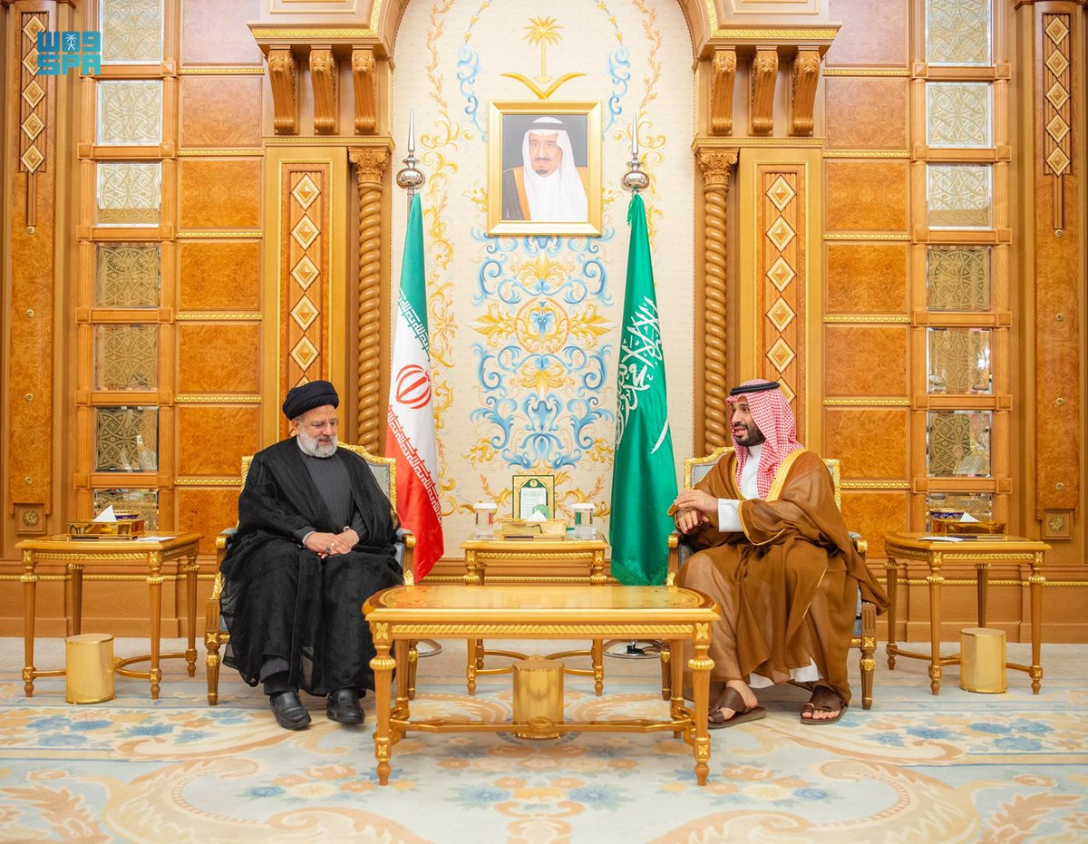
Iranian president calls to eliminate the Jewish state - November 11, 2023
Iranian President Ebrahim Raisi called for the creation of a Palestinian state “from the river to the sea,” a genocidal rallying cry necessitating the destruction of Israel.

Slide 53
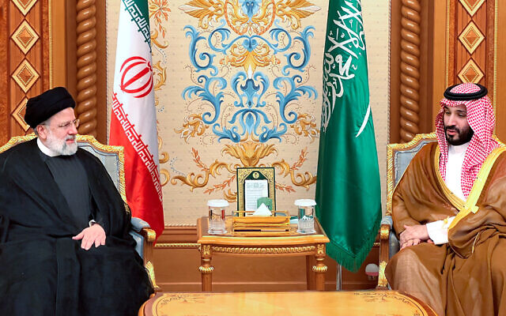
Bitter Rivals: Shia Iran and Sunni Saudi Arabia
Intense rivalry between Shia Iran and its Sunni neighbor, Saudi Arabia. It’s been nearly 40 years since Ayatollah Ruhollah Khomeini led a revolution that toppled the U.S.-backed monarchy.
Ever since, relations with the outside world have been strained.

Slide 54
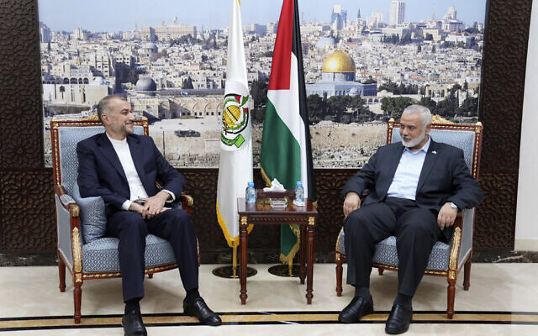
Khamenei told Hamas chief Iran will not directly enter war – report – Nov. 15, 2023
In a report citing “three senior officials,” Reuters said Khamenei had told Haniyeh that, while Iran would offer political support to Hamas, it would not “intervene directly” in the fight.
The Iranian leader also reportedly asked Haniyeh to “silence those voices” in Hamas calling for Iran and its proxy terror group Hezbollah to directly join the war against Israel “in full force.”

Slide 55
Iran will do “whatever it takes” to ensure a Hamas victory in the war. November 16, 2023
On November 16, Iranian state media reported that Iranian Quds Force commander Esmail Qaani wrote a letter to senior Hamas leader Mohammed Deif saying Iran will do “whatever it takes” to ensure a Hamas victory in the war.
The letter reportedly states, “your brothers in the resistance axis stand united with you and will not allow the enemy to reach its dirty goals in Gaza and Palestine. We stand by our fraternal pledge that unites us and we assure you that we will do whatever it takes in this historic battle.”

Slide 56
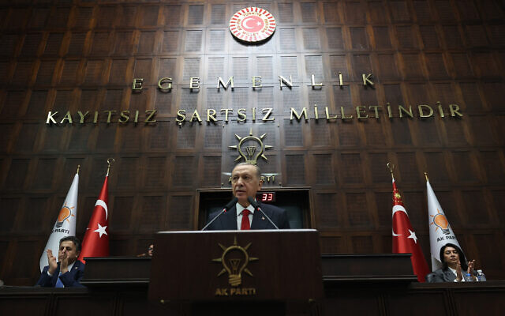
Erdogan blasts Israel as a ‘terrorist state’ intent on ‘total destruction’ of Gaza – November 16, 2023
Turkish President Recap Tayyip Erdogan accused Israel of being “a terrorist state” and of implementing a strategy to wipe out the population of Gaza, during a parliamentary address in which he vowed to bring Israel’s political and military leaders to trial in international courts.

Slide 57
Erdogan blasts Israel as a ‘terrorist state’ intent on ‘total destruction’ of Gaza – November 16, 2023
Turkish President Recap Tayyip Erdogan accused Israel of being “a terrorist state” and of implementing a strategy to wipe out the population of Gaza, during a parliamentary address in which he vowed to bring Israel’s political and military leaders to trial in international courts.

Slide 58
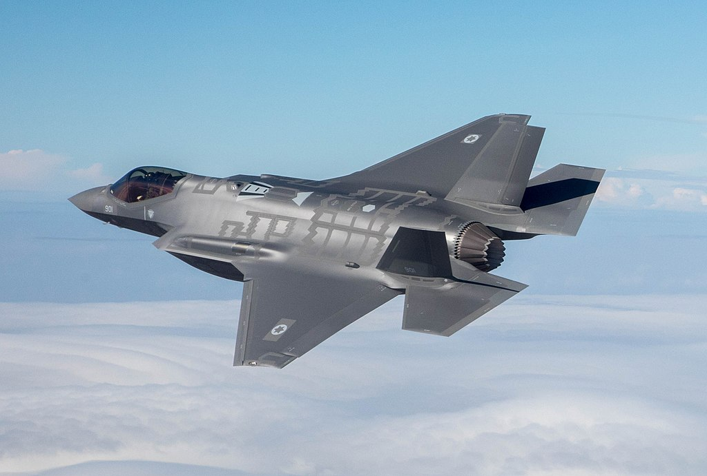
US strikes Iranian assets in Syria for third time in weeks

Slide 59
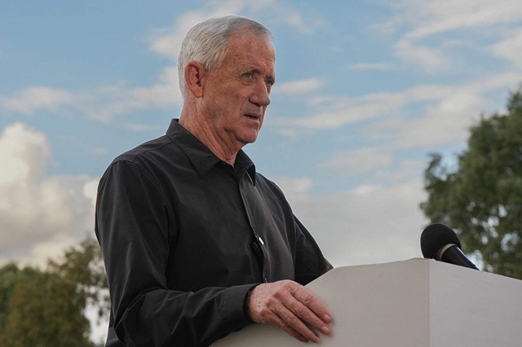
Gantz: We will kill Hamas leaders ‘in Gaza and around the world’

Slide 60
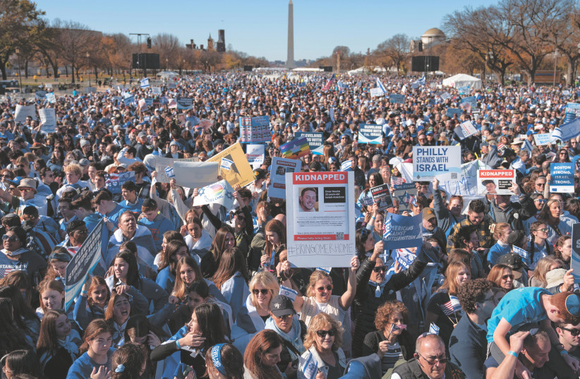
Close to 300,000 march for Israel in Washington, decry antisemitism – November 14, 2023

Slide 61
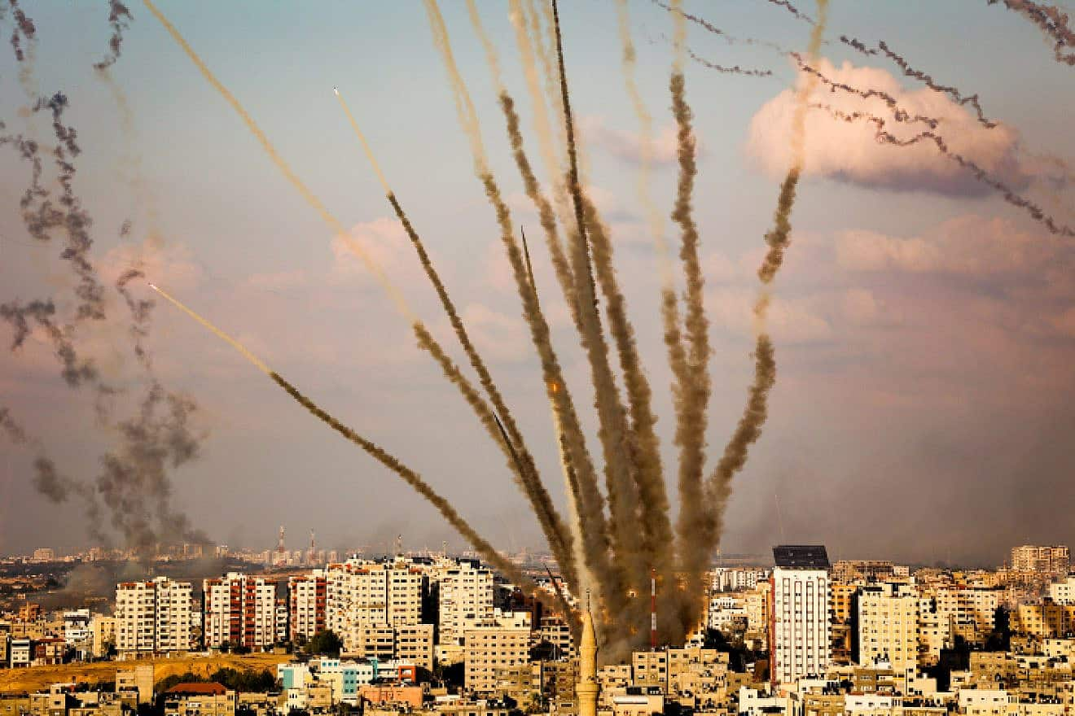
‘More than 11,500 rockets launched at Israel since Oct. 7’ - December 4, 2023

Slide 62
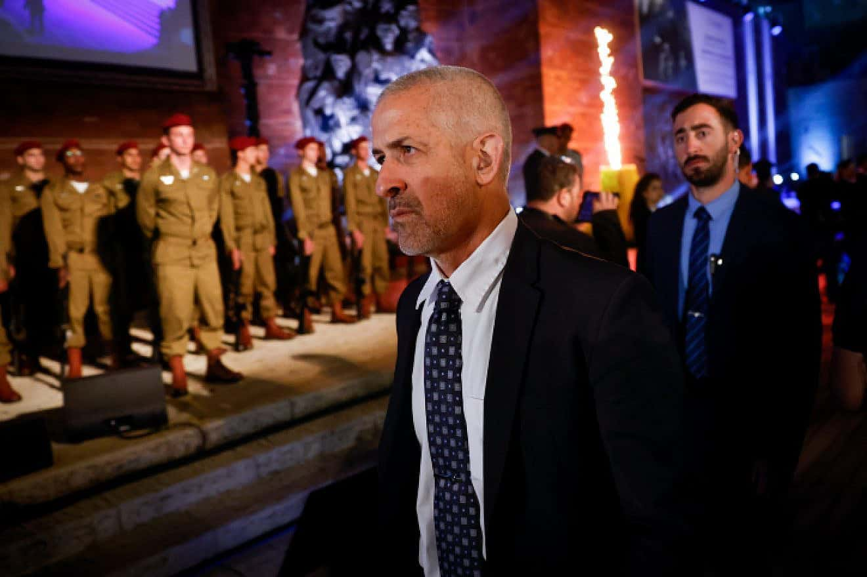
Shin Bet head: ‘We’ll kill Hamas leaders in Qatar, Turkey’ – December 4, 2023

Slide 63
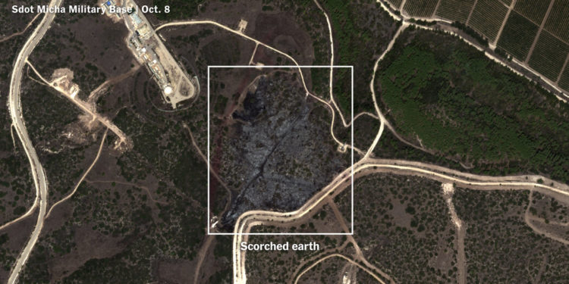
Militant Rocket Hit Base Linked to Israeli Nuclear Missile Program – Dec. 4, 2023
A rocket most likely fired by Hamas militants during their Oct. 7 attack on Israel struck an Israeli military base where, experts say, many of the country’s nuclear-capable missiles are based, according to a visual analysis of the attack’s aftermath by The New York Times.
While the missiles themselves weren’t hit, the rocket’s impact, at the Sdot Micha base in central Israel, sparked a fire that approached missile storage facilities and other sensitive weaponry.

Slide 64
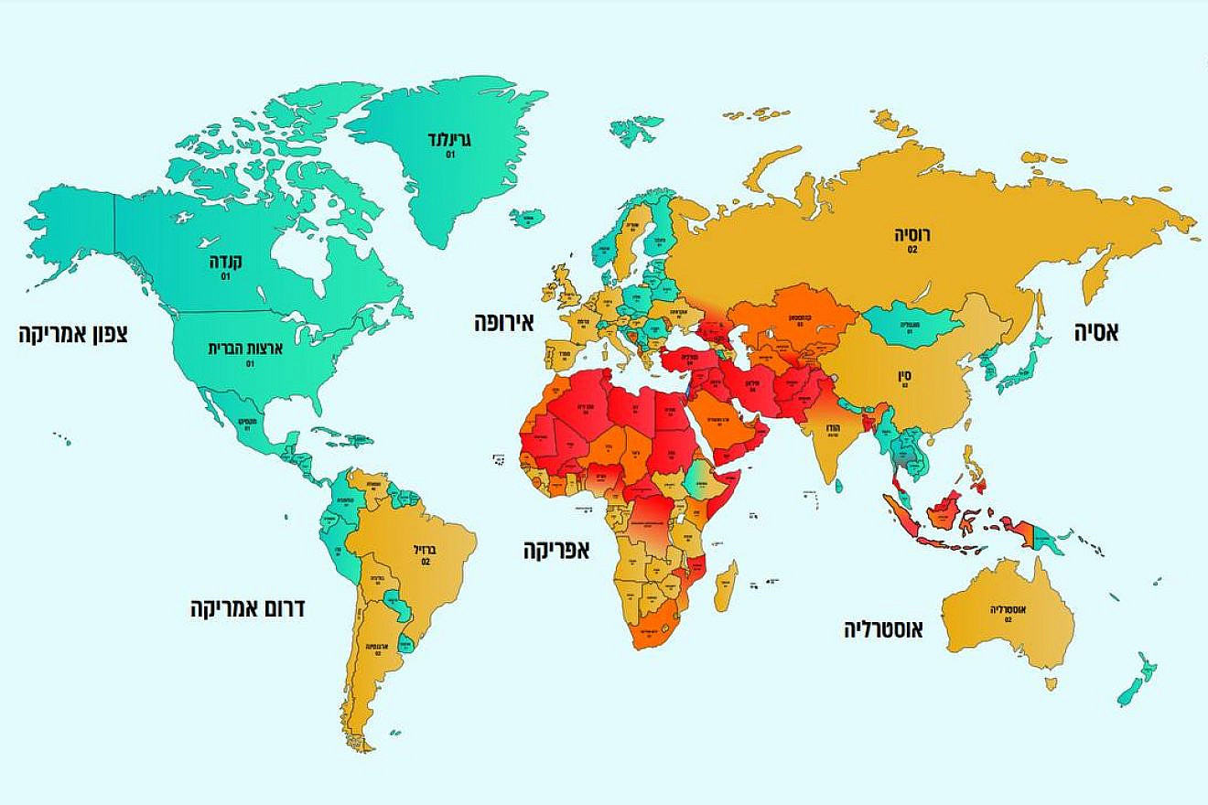
Israel raises travel alert for Western Europe, other regions
Great Britain, France, Germany, Brazil, Argentina, Australia, and Russia are among the countries where the travel warning was raised to level 2.

Slide 65
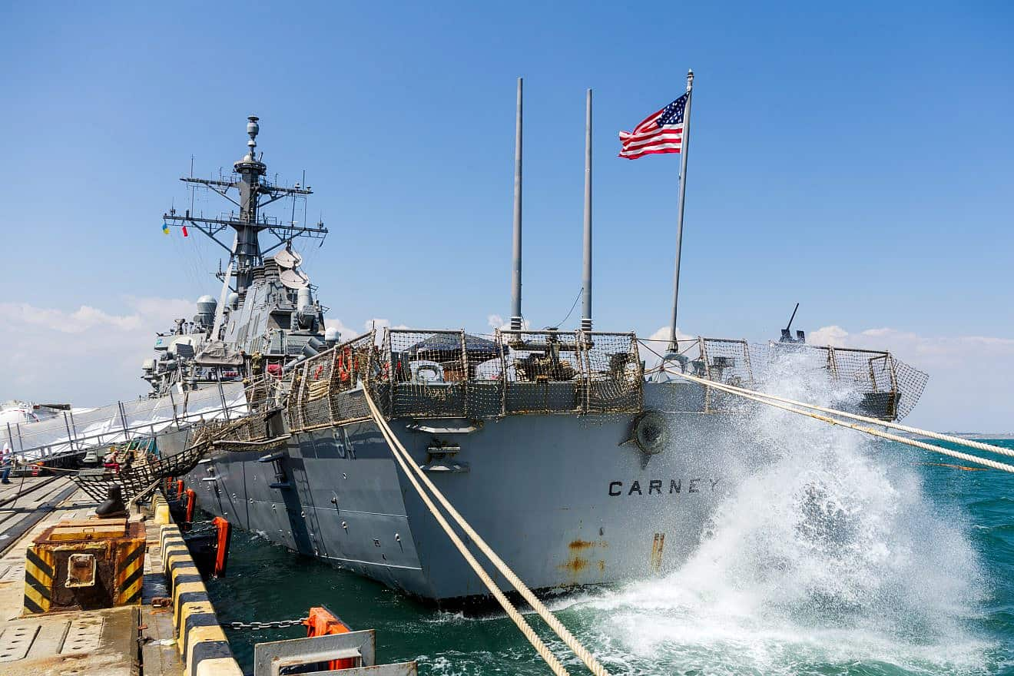
3 commercial ships hit by missiles in Houthi attack in Red Sea, US warship downs 3 drones – Dec. 4, 2023
Ballistic missiles fired by Yemen’s Houthi rebels struck three commercial ships Sunday in the Red Sea, while a U.S. warship shot down three drones in self-defense during the hourslong assault, the U.S. military said. The Iranian-backed Houthis claimed two of the attacks.

Slide 66
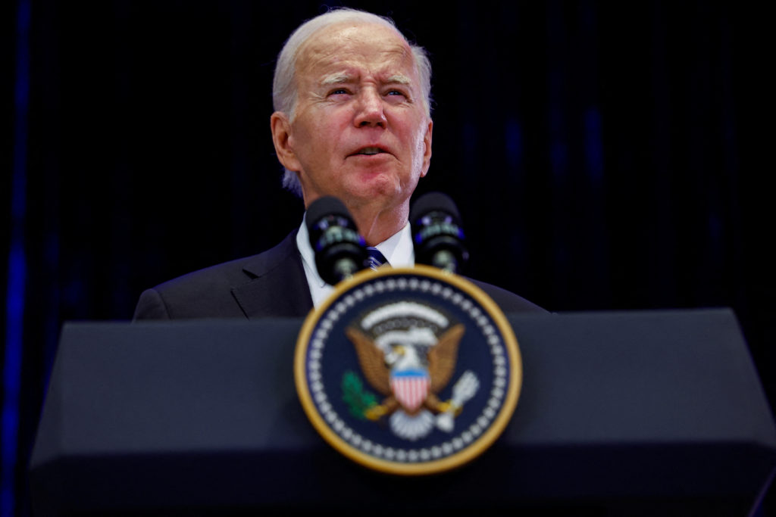
Biden pushes Mideast leaders to consider two-state solution after Israel-Hamas war ends
President Joe Biden is calling on Israeli and Arab leaders to think hard about their eventual postwar reality.
It’s one, he argues, where finally finding agreement on a long-sought two-state solution to the Israel-Palestinian conflict should be a priority.
“There’s no going back to the status quo as it stood on Oct. 6,”

Slide 67
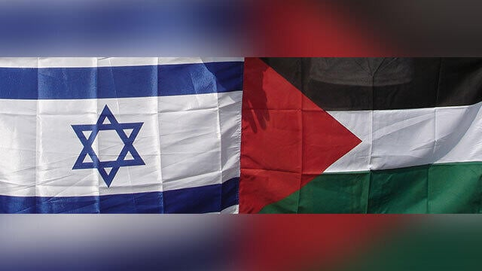
One state plan threat
Palestinian Authority head Mahmoud Abbas recently issued a warning that if Israel continues to enforce a reality of a single “apartheid” state, circumstances in the region will necessarily compel equal and full political rights for Palestinians.

Slide 68
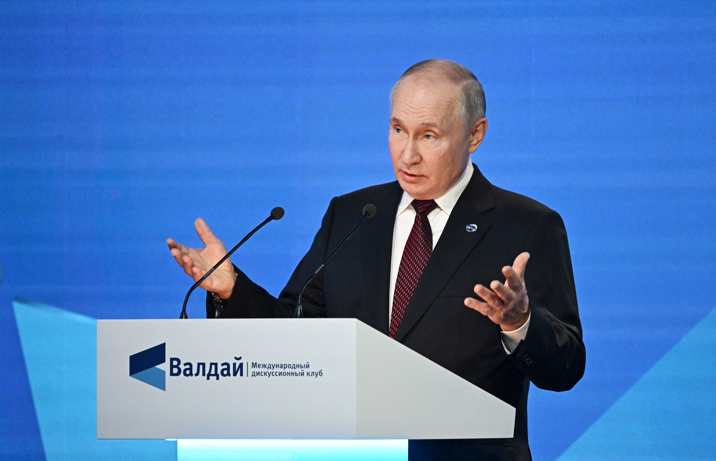
Putin says Russia has tested next-generation nuclear weapon – Oct. 5, 2023
President Vladimir Putin said that Russia had successfully tested a potent new strategic missile and declined to rule out the possibility it could carry out weapons tests involving nuclear explosions for the first time in more than three decades.

Slide 69
Xi hails ‘deepening trust’ between China and Russia as he meets Putin – Oct. 18, 2023
Chinese president notes that he and Putin have met 42 times in the past decade and developed a ‘deep friendship’.

Slide 70
US Navy ship ‘intruded’ in South China Sea waters, China says – Dec. 4, 2023
The Chinese military said that an American naval ship had “illegally intruded” on Monday into waters near the Second Thomas Shoal, the site of a hot territorial dispute between China and the Philippines in the South China Sea.
The U.S. Navy’s 7th Fleet said the ship “was conducting routine operations in international waters ... consistent with international law.”

