Slide 1
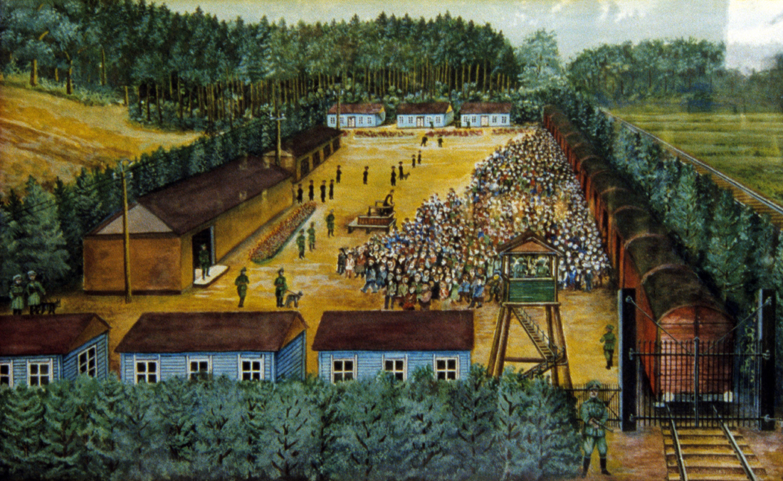
The Final Solution as Nazi Eschatology
The Holocaust:
Redemptive Anti-Semitism as an Eschatology of Death

Slide 2
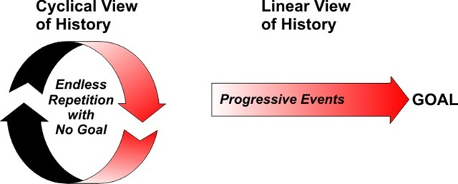
Biblical View of Prophecy/Eschatology vs. Modern Millenarianism/Progressivism
Communism
Social Darwinism/Eugenics
Technocracy
Environmentalism
Postmodern Socialism
New Age Paganism
How does Progressivism or Secular Millenarianism transcend the Sins of the Past to obtain Social Justice?

Slide 3
Biblical Revelation in History is the Foundation for all Prophecy

Slide 4
History & Progressive Eschatology in Galatians 3-4
Even though the Abrahamic Covenant was promised, Israel in the OT was held in custody under the Law (3:15-26).
The OT Heir is a Child who is under the Guardians & Masters of the Law until the Date of Maturity is reached (4:1-2).
The Law was given as a Tutor to lead them to Christ (3:24).
At the Fullness of the Times God granted His Son & the Holy Spirit in place of the Law (3:23-4:7).
Life Under the Spirit in the Church Age is Characterized as Sonship & Spiritual Liberty (4:21-5:18).

Slide 5
The Biblical Epochs in History/Eschatology

Slide 6
Modern Historiography’s Biblical Epochal/Dispensational Basis
“Any history written on Christian principles will be of necessity universal, providential, apocalyptic, periodized ... Having divided the past, it will then naturally tend to subdivide it again: and thus to distinguish other events, not so important as the birth of Christ but important in their own way, which make everything after them different in quality from what went before. Thus history is divided into epochs or periods, each with peculiar characteristics of its own, and each marked off from the one before it by an event which in the technical language of this kind of historiography is called epoch making … The apocalyptic idea became a commonplace, although historians have placed their apocalyptic movement at all sorts of times: the Renaissance, the invention of printing, the scientific movement of the 17th century, the Enlightenment of the 18th, the French Revolution, the Liberal movement of the 19th century, or even, as with Marxist historians, in the future. All these elements, so familiar in modern historical thought are totally absent from Greco-Roman historiography and were consciously and laboriously worked out by the early Christians.” R.G. Collingwood – The Idea of History, pp. 50-52.

Slide 7
Kant’s Periodization of History in the Enlightenment & His Progressivist Eschatology
“In its most rationalistic form the most consistent ‘spiritualization’ of the New Testament ‘letter’ is Kant’s Religion Within the Limits of Reason Alone. Distinguishing the “pure religion of reason” or “moral faith” from “ecclesiastical faith” based on historical revelation, Kant interprets the whole of Christianity as a gradual advance from a religion of revelation to a religion of reason, by which the Kingdom of God becomes realized as an “ethical state on earth.” Thus, Kant has no scruples in asserting that in the entire known history of the church the present period, i.e., the Enlightenment, is the best one.” Karl Lowith, Meaning in History.

Slide 8
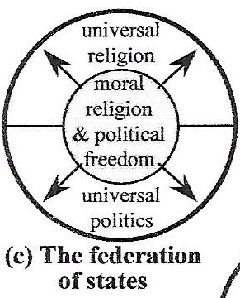
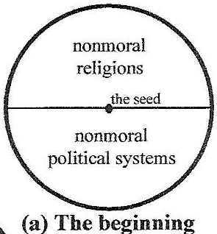
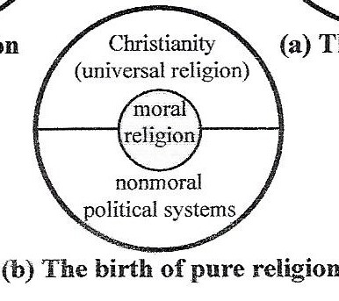
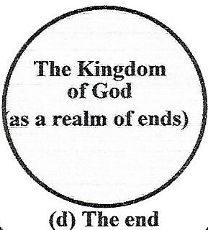
Kantian Secularized Eschatology is at the Heart of Modern Progressivism
“A systematic union of different rational beings under common laws” or a “kingdom of ends” where no one is used as merely a means to an end, but where a community of persons are treated as ends in themselves to fulfill the categorical imperative.

Slide 9
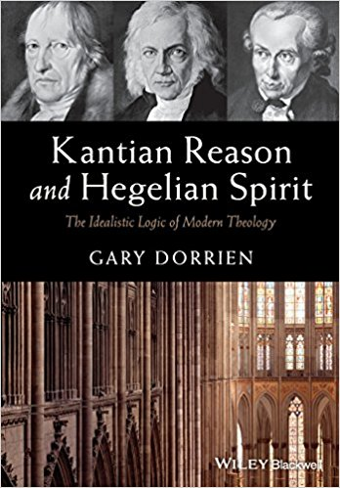
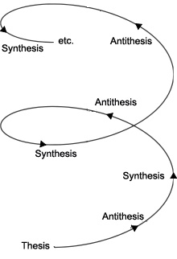
German Progressivism/Millenarianism from late 1700’s until early 1900’s
Immanuel Kant propounded a Secularized Progressivism based on Autonomous Reason & that the principled Application of his Transcendentalist Philosophy will lead to a Moral & Peaceful Kingdom of Ends on this Earth in which all will inwardly learn to obey God’s Moral Law by His Grace without any outside Political or Religious Coercion or Enslaving Interference that was at the very Heart of German Theological Liberalism for well over 100 Years.
Hegel taught the German Eschaton had already arrived with His all-encompassing Holistic Philosophy of Historical Dialectics as the World Spirit was progressing through the Reconciliation of Opposites.
German Romanticism emphasized Holism, Oneness, Subjectivity & Feelings was to be the Progressive Goal.
Karl Marx taught a Communist Eschaton in which the Industrial Revolution will progress through Dialectical Materialism & hence destroy all Class Divisions.
Social Darwinism based on Biology & Race emphasized Progressivism through Science & Eugenics.
Nietzsche’s Existentialism propagated an Eschatology where Future Supermen rooted in an Earth based Transvaluation of all Values will convert Modern Nihilism into New Meaning.

Slide 10
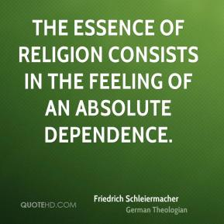
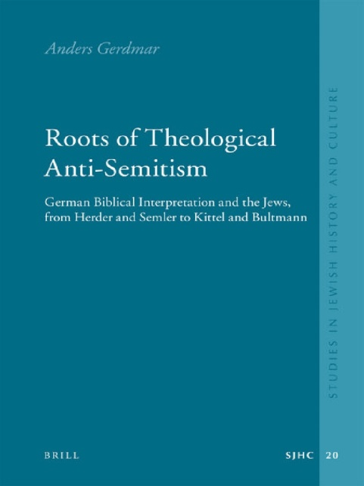
German Theological Liberalism’s Anti-Semitic Progressivist Eschatological Social Gospel
Kant was Extremely Anti-Semitic as he viewed the Jews as an Empirical Obstacle that needed to be ‘euthanized’ in order to establish a Rational European Order in which its Biblical Heteronomy would be overcome through Natural Theology.
Theological Liberalism invested much Scholarship in the Rabid Attempt to de-Judaize the New Testament as they believed Jewish Historical Particularism & Exclusivism derived from the Old Testament was keeping German Christianity from becoming Progressive, Liberal & Universal.
They believed Protestantism’s Social Gospel surpassed Ecclesiastical Christianity to now enter an Ethical-Political Spiritual Age functioning as a Spiritual Power in Germany.
Leading Liberal Protestants opposed what they considered to be Jewish Segregation, Backward Legalism & Restrictive Ceremonialism as they hindered their Freedoms.
The Second Reich was an Anti-Semitic State under the Spiritual Power of Liberal Protestantism where Romanticism & Nationalism and Socialism all mixed together through the Propagation of the Social Gospel.
Many Conservative Theologians were also steeped in Lutheranism’s Traditional Anti-Semitism & Replacement Theology – which German Pietism often reinforced.
Yet there were some German Theologians like Franz Delitzsch, who were not Anti-Semitic but even had successful Ministry Outreaches to Jews.
And there were early Dispensationalists/Darbyites that also rejected the growing Tide of Anti-Semitism in Germany.

Slide 11
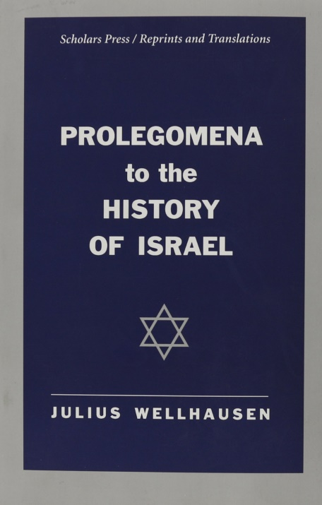
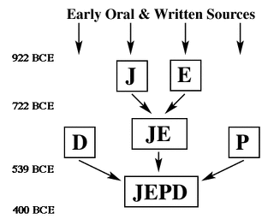
Julius Wellhausen’s Anti-Semitic JEPD Theory
Wellhausen’s JEPD Theory was developed in 1878 to explain the Origins of the Old Testament – which was a more Complex Synthesis than Hegel’s Triad.
J = Jahvistic Document dates to Solomon; E = Elohistic Document dates to Northern Kingdom; P = Priestly Document codified Rituals & Formalistic Religion in Leviticus around 500 B.C.; D = Deuteronomic Document which was compiled during Josiah’s Reign before the Exile (1 Kings 22:1-20) in 620 B.C.
Wellhausen studied under Ewald, but attributes His JEPD Theory to Romantic & Nationalist Theologian Leberecht de Wette (1780-1849) –who was a German Theological Liberal.
De Wette characterized Judaism as Degenerate that devolved from the Pure & Simple Original Hebraism in the Beginning into Deuteronomic Legalism.
Jews thus devolved & became less Spiritual & More Materialistic in their History.

Slide 12
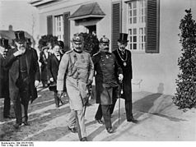
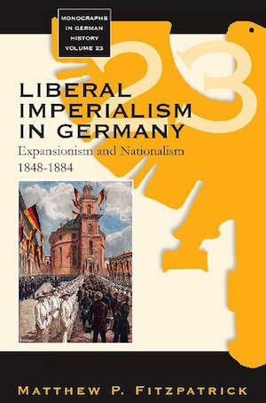
Harnack’s Imperialist German Theological Social Gospel
Adolf Harnack (1851-1930) was essentially in Charge of the German Academia & the Sciences.
He said Old Judaism was a Relic of the Past that needs to be abandoned for Modern Christianity to prosper in the 20th Century as those who held onto the Old Testament were having a Paralyzing Effect on the Progress of Religion & the Church.
The very History of the Bible starring the Jews upset the Aesthetic Idealism of both German Philosophy and Religion – particularly Harnack.
Harnack wrote the War Speech for the Kaiser that Kicked off WW I in the name of German Christian Civilization & Modernity.
German Theological Liberalism died in the Trenches of WW I leaving a Vacuum that Secular Social Darwinism & Volkisch Nature Mysticism/Apocalypticism filled in behind.
German Liberal Nationalism was eclipsed by Volkism & Racism & Eugenics after WW I.

Slide 13
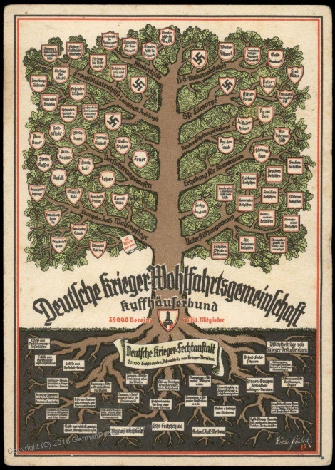
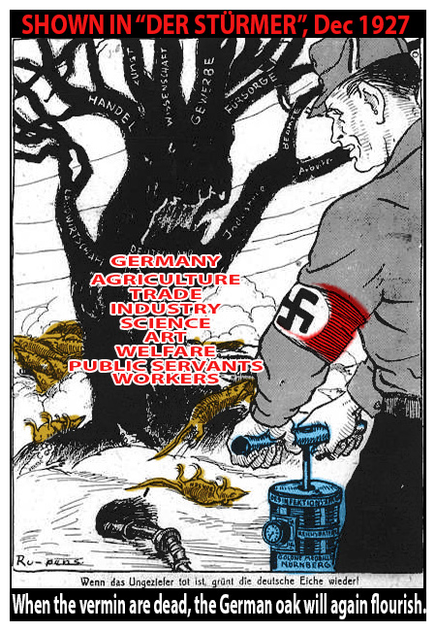
Kaiser Wilhelm II, German Emperor
“Let no German ever forget this, nor rest until these parasites (tribe of Juda) have been wiped out from German soil and been exterminated. This poisonous mush-room on the German Oak-Tree!”

Slide 14
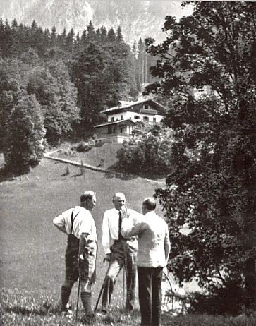
German Salvation/Eschatology was Secularized
Philosophically, Nazism was based on German Idealism & Romanticism & Hegelianism & Existentialism.
Politically, Nazism was a Socialism based on Biological Racial Science with Ecological Predilections.
Progressively, Nazism was based on Social Darwinism & Eugenics.
Eschatologically, Nazism was based on a Mixture of False Chiliasm & Volkisch Apocalypticism & Eastern Mysticism

Slide 15
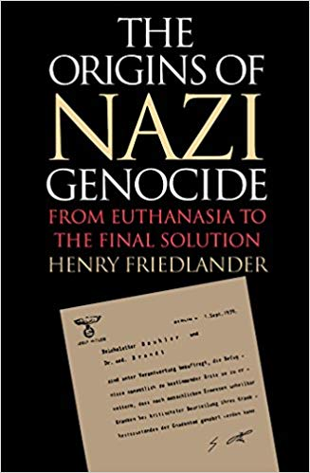
Nazi Biological-Existentialist Eschatology of Death
Morality & Moral Traits like Honesty, Hard Work, etc. were biologically ingrained & Eugenically determined & the German Race was the most Cultivated.
Whatever advanced the Human Race Biologically was Good & whatever led to Biological Degeneration was bad – an Evolutionary Ethic from which the Master Race evolves into Fruition.
The Destruction of Degenerate Races – particularly the Jews – is therefore necessary for the Progress of Mankind that the Aryan Race of Europe will lead into a Sunny Victorious Future.
And if the Aryan Blood is cleaned up Biologically, then the Morality - based on Romanticism & Existentialism & Scientific Eugenics - will also be cleaned up as the Aryan Race will supplant the Degenerate Races into Supermen as Nietzsche prophesied.
The Euthanasia of the of the Weak & Retarded & Invalids was later extended to Jews during the Holocaust – all based on Laws of Nature.
Since Nature was Cruel, acting in accordance with Nature demanded Cruelty – but such Actions led to Biological Progress & Racial Utopia.
Getting back to Nature & Her Existential Laws of Social Darwinism & Eugenics will lead to Racial Utopia in a Future Romantic Aryan Garden of Eden.

Slide 16
Pseudo-Science & the Nazi Biological State led to a False Political Eschatology
“The Jew …. is and remains a parasite, a sponger who, like a pernicious bacillus, spreads over wider and wider areas according as some favorable area attracts him. The effect produced by his presence is also like that of the vampire; for wherever he establishes himself the people who grant him hospitality are bound to be bled to death sooner or later,” Mein Kampf.
“For if even just one state for whatever reasons tolerates one Jewish family in it, then this will become the bacillus source for a new decomposition. If there were no more Jews in Europe, then the unity of the European states would no longer be destroyed,” July 1941.
“The discovery of the Jewish virus is one of the greatest revolutions that have taken place in the world. The battle in which we are engaged to-day is of the same sort as the battle waged, during the last century, by Pasteur and Koch. How many diseases have their origin in the Jewish virus! We shall regain our health only by eliminating the Jew,” February 1942.

Slide 17
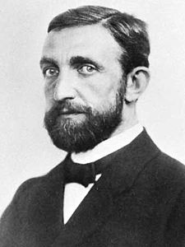
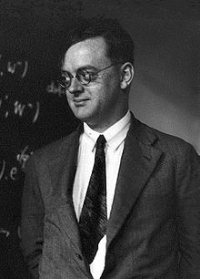
Philipp Lenard (1862-1947) Nobel Prize Winner & Nazi Physicist vs. Jewish Physics
In the 1920’s Lenard began to criticize what he considered to be a Jewish Way of doing Science that was too Abstract without any Roots in the Reality of Nature where True Experimental Work is accomplished scientifically with Aryan Values.
Against the Jews, he said, “It was precisely the yearning of Nordic man to investigate a hypothetical interconnectedness in nature which was the origin of natural science.”
Lenard was deeply rooted in German Romanticism that presumed a Semi-Pantheistic Spirit animated all of Nature.
Lenard was very Critical of the Modern Materialistic Sciences that he perceived to be rooted in Jewish Materialism & not the True Life Sciences that is so important to the German Sciences.
Lenard believed such Jewish influenced Sciences desired to master Nature with Materialistic Technology & Universalism.
Pascual Jordan, the Father of Quantum Mechanics inserted Nietzschean Will to Power & the Fuhrer Principle into His Physics as he advocated certain Microscopic Molecules were endowed with Dictatorial Authority over Entire Organisms.
The Concept of Will to Power in Physics for Jordan overturns the original scientific dictum that began the Scientific Revolution, “Knowledge is Power.”

Slide 18
Hitler on the Source of Mental Illnesses in Finland, June 1942
“It is a great pity that this tendency towards religious thought can find no better outlet than the Jewish pettifoggery of the Old Testament. For religious people who, in the solitude of winter, continually seek ultimate light on their religious problems with the assistance of the Bible, must eventually become spiritually deformed. The wretched people strive to extract truths from these Jewish chicaneries, where in fact no truths exist. As a result they become embedded in some rut of thought or other and, unless they possess an exceptionally commonsense mind, degenerate into religious maniacs. It is deplorable that the Bible should have been translated into German, and that the whole of the German people should have thus become exposed to the whole of this Jewish mumbo jumbo.”

Slide 19
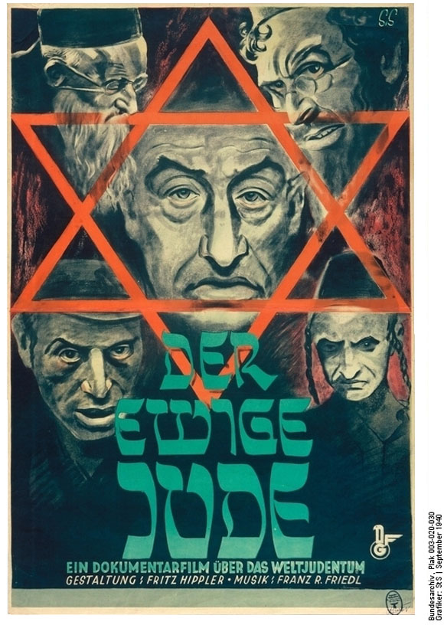
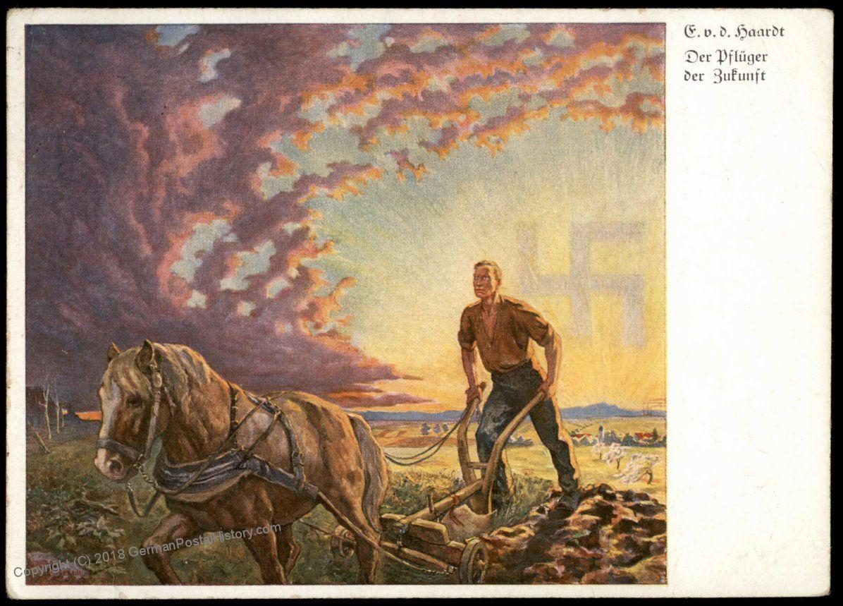
Nazi Blood & Soil vs. Eternal Jew
In a speech given on Sept. 6, 1938, Hitler declared that Germany “must be cleansed of all parasites and that, in the process of the struggle against the ‘international Jewish world enemy,’ ‘eternal values of blood and soil’ had to be elevated to the ‘ruling laws of life.’”

Slide 20
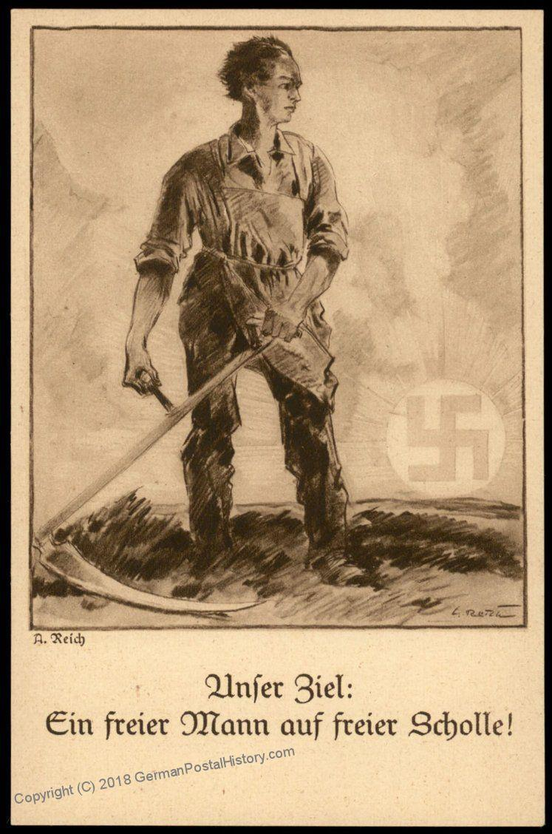
Meaning of Nazi Blood & Soil
“What it implied most strongly to its supporters at this time was the link between those who held and farmed the land and whose generations of blood, sweat, and tears had made the soil part of their being, and their being integral to the soil. It meant to them the unwritten history of Europe, a history unconnected with trade, the banditry of the aristocracy, and the infinite duplicity of the church and monarchy. It was the antithesis of the mercantile spirit, and still appeals to some basic instinct as a critique of up-rootedness,” Dr. Anna Bramwell, Blood and Soil: Walther Darre and Hitler’s Green Party.

Slide 21
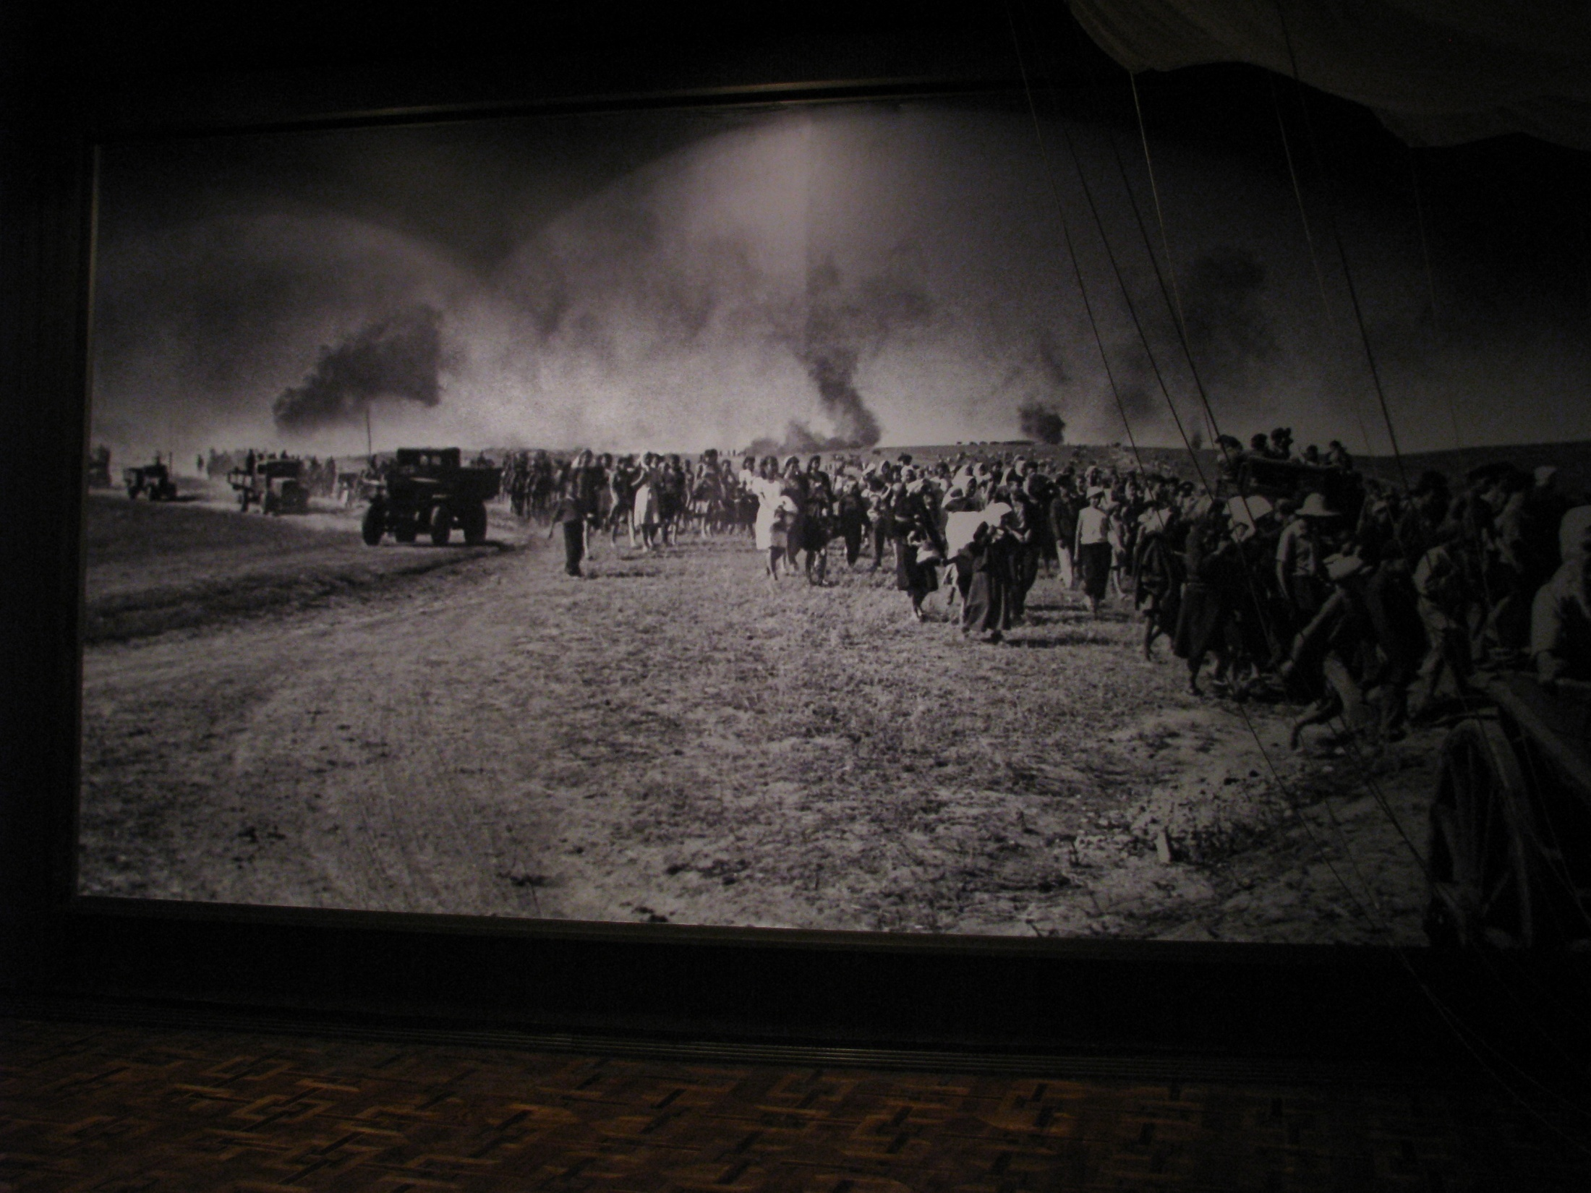
Green Nazi Lebensraum in the East
The Conflicts between the Nazi Regime’s ‘Progressive’ Eugenics Plan for Racial Superiority & Environmental Goals was Holistically resolved along Fascist Lines by emphasizing Sustainable Development.
Nazi Germany was not only the Greenest Regime on the Planet in the 1930’s – but also emphasized Green Sustainable Development Plans in order to blend Modern Life into a more harmonious Relationship with Nature.
Even the Economic Four Year War Plan was to be governed by Sustainable Development.
Goebbels characterized Nazi Germany as a ‘Steely’ Form of Romanticism.
The Nazis believed Aryan Technology indigenous to Germany was good, but soulless technology of International Capitalism was Evil.
During the War, the Eastern Occupied Territories were to be governed by the SS’s Green Sustainable Development Plans including Green Building & Master Planned Communities & Renewable Energy & Recycling – as they wanted to create a Garden of Eden in the East.
Lebensraum meant Environmental ‘Living Space’ for Sustainable Development that would become a Future Garden of Eden to Alleviate Germany’s Presumed Overpopulation Problem that targeted primarily the Jews - but also the Slavs as well.
The SS Master Plan for East involved Massive Population Transfers, Displacements & Reorganization.
Hitler believed the Future belonged to the Wind, Hydrogen & to the Tides.

Slide 22
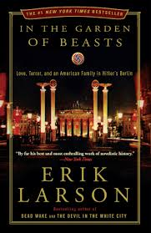
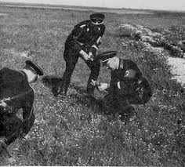
Gardening Principles of the Fuhrer
“Nothing upsets Jewry more than a gardener who is intent on keeping his garden neat and healthy. Nothing is more inimical to Jewry than order! It needs the smell of decay, the stench of cadavers, weakness, lack of resistance, submission of the personal self, illness, degeneracy! And wherever it takes root, it continues the process of decomposition! It must! For only under those conditions can it lead to its parasitic existence,” Hitler to Otto Wagener.

Slide 23
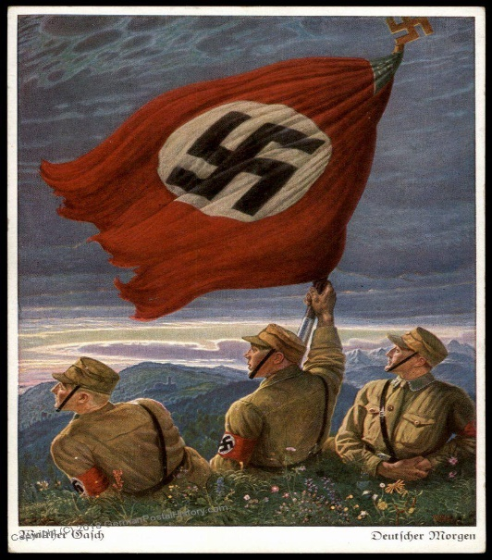
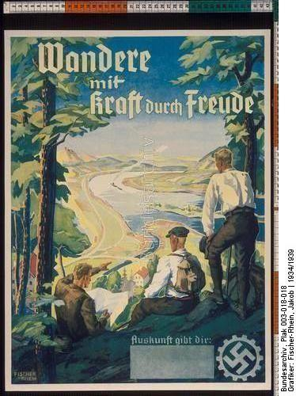
The Triumph of Nature & Her Natural Racist Laws vs. Jewish False Eternalities
“We, for our part, confine ourselves to asking man to fashion life worthily. For this, it is sufficient for him to conform to the laws of nature. Let’s seek inspiration in these principles, and in the long run we’ll triumph over religion.”
“It was necessary for the Jew to appear on the scene and introduce that mad conception of a life that continues into an alleged Beyond! It enables one to regard life as a thing that is negligible here below.”
“The Jew plays in nature the role of a catalyzing element. A people that is rid of its Jews returns spontaneously to the natural order.”

Slide 24
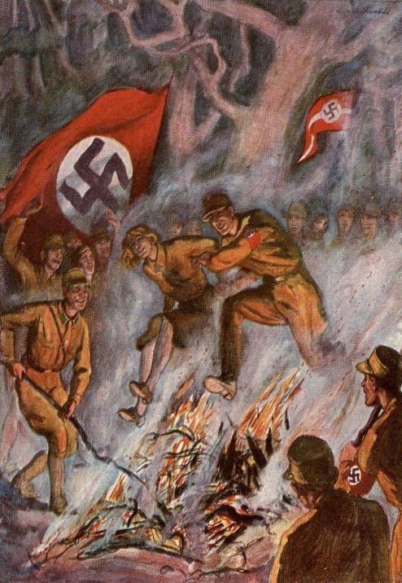
Nazi Academia & Burning Books
Goebbels said at a book burning rally, “The era of extreme Jewish intellectualism has come to an end. The German of the future will no longer be a man of books, but a man of character.”
In 1933, Heidegger said at another rally, “Flame announce to us, light for us, show the path from which there is no turning back.”
In 1939, Heidegger said, “Contemporary Jewry’s . . . increase in power finds its basis in the fact that Western metaphysics—above all, in its modern incarnation—offers fertile ground for the dissemination of an empty rationality and calculability, which in this way gains a foothold in ‘spirit,’ without ever being able to grasp from within the hidden realms of decision.”
In 1941, Heidegger said, “World Judaism is ungraspable everywhere and doesn't need to get involved in military action while continuing to unfurl its influence, whereas we are left to sacrifice the best blood of the best of our people.“
Heidegger’s ‘World Jewry’ remarks are inspired by the Protocols of the Elders of Zion.

Slide 25
Hitler’s Legalism & Existentialist Eschatology Against Jews
In 1933, the Nazi passed a Strong Animal Rights Law that forbid Kosher Slaughter – the First Attack on their Food Supply.
In September 1935 Hitler spoke of the recently passed Anti-Semitic Nuremberg Law(s) that stripped the Jews of their Citizenship “as an attempt to find a solution. If we don’t succeed, we will let the National Socialist Party find a Final Solution to save the German People.”
In many speeches Hitler spoke of a glorious German Destiny based on Will Power, Struggle, Hard Work, and Faith in the German Volk that will all spring up from within the German Community itself since nothing will come down from Heaven to help them.
Thus, if the laws fail to resolve the Jewish Question, the Nazis will use their Willpower to resolve it anyway.
The “Final Solution” is what distinguishes the Holocaust from other Genocides.

Slide 26
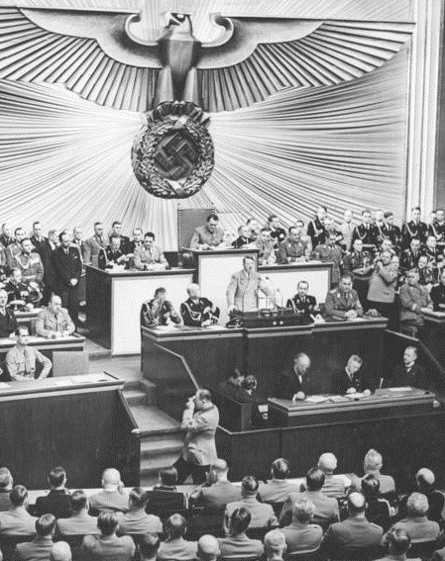
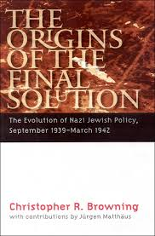
Hitler’s Prophecy at Infamous Reichstag Speech – January 1939
“Today I want to be a prophet. If international Jewry within Europe and elsewhere should succeed in plunging the nations into a world war then the consequence will not be the Bolshevization of the world and a victory of the Jews but the extermination of the Jewish race in Europe.”

Slide 27
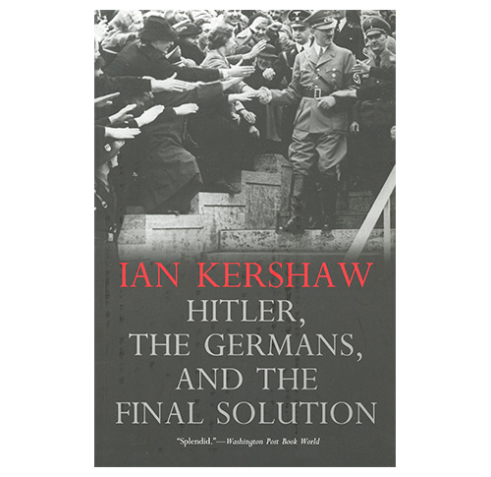
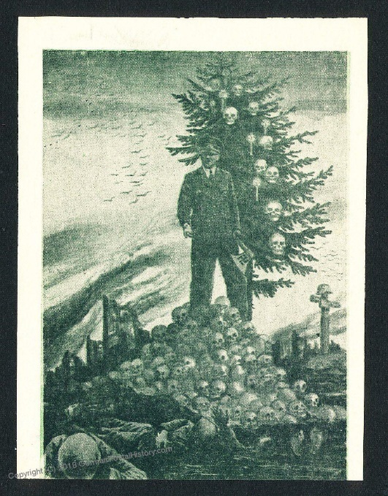
Nazi Apocalypticism & the Final Solution
“The elimination of the Jews became essential to the salvation of the German nation and there was an apocalyptic dimension to the vision that Hitler had,” Michael Berenbaum.
“I have used the term Redemptive Antisemitism - to save the world the Jew had to wiped out, “Saul Friedlander.
“The embodiment in Hitler of a dynamic, revolutionary thrust, unachievable without war and a colossal gamble for world power and demanding national salvation through racial purification – a chiliastic goal that became institutionalized in every facet of political organization in the Third Reich – distinguishes the Third Reich from every other known political dictatorship …” Ian Kershaw.

Slide 28
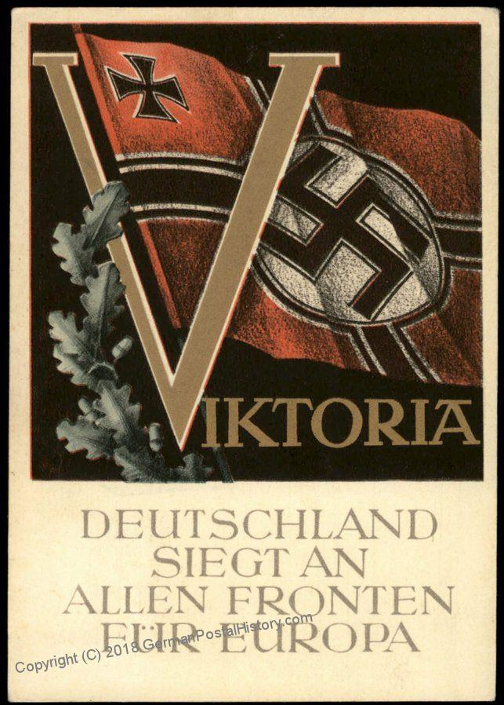
Nazism’s Soteriological Eschatology of Race
“Nazi Millennialism was rooted in a peculiar mix of eugenic, volkisch, and occult apocalyptic ideas of the time,” David Redles.
“The Aryan-Jewish conflict was, quite literally, interpreted as an eschatological war. Hitler defined Marxism was a ‘poison’ deliberately produced by the Jewish ‘prophet’ Karl Marx ‘in the service of his race’ to bring about the ‘swifter annihilation of the independence existence of free nations on this earth.’ The final battle would come in a fight to the death with the Jewish Bolsheviks,” David Redles.
“World War I was but one phase of an evolving eschatological war,” David Redles.
“Hitler viewed the Aryan Race as the true chosen people” of God & compared the Jews to the “Red Dragon” of the book of Revelation.
“In Hitler’s apocalyptic cosmology, this mission required Aryans to purify themselves in order to reach a stage of biospiritual perfection, thereby achieving a state of godlike capabilities, ruling the earth as god-men as in ancient times,” David Redles
“The Nazis hoped to stop the decomposing effects of chaos, renew the spiritual health of the Volk, and usher in the Millennial Reich,’ David Redles.

Slide 29
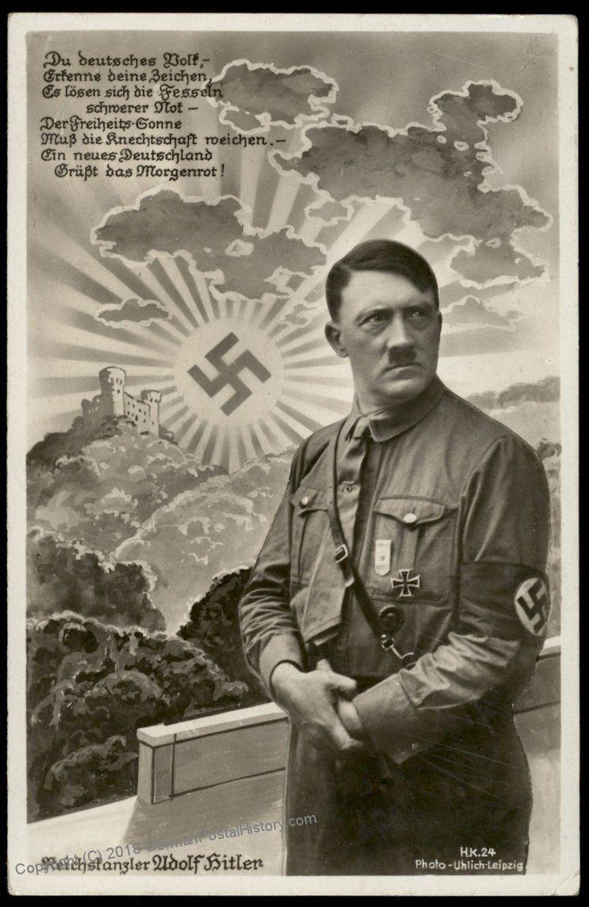
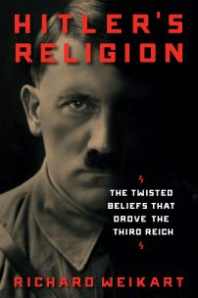
Hitler’s Millenarianism was Based on German Pantheism & Natural Theology of the 1800’s
Hitler was not an Atheist.
When He did Speak of the Lord or Creator, he meant Nature as god, or Pantheism.
The Pantheistic god of Nature was the Inspiration of Social Darwinian Laws of Nature that imbued the Aryan Race with Special Qualities that need to be enhanced through Eugenics.
German Natural Theology had a Peculiar Form of Pantheism that allowed for some Element of Transcendence – but certainly not like the Judeo-Christian God of the Bible who stands completely Transcendent and Outside of History.
Ernst Haeckel, the Scientific Father of German Social Darwinism and Ecology, said that Pantheism was a Quiet Form of Atheism.

Slide 30
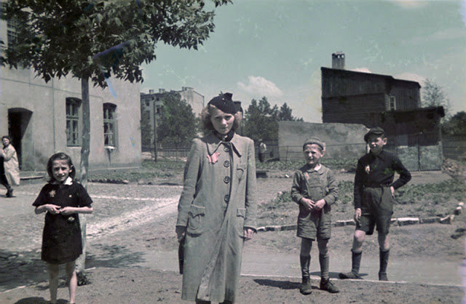
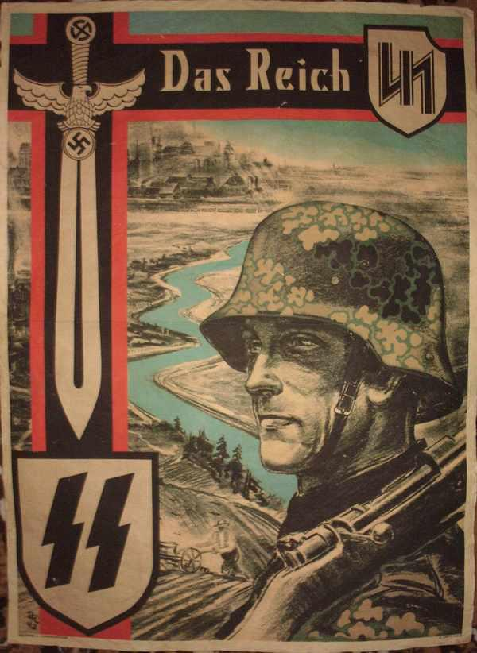
Hitler’s Warning Against Jews on Eve of Holocaust
“On the eve of war, I gave the Jews one final warning. I told them that, if they precipitated another war, they would not be spared and that I would exterminate the vermin throughout Europe, and this time once and for all. Well, we have lanced the Jewish abscess; and the world of the future will be eternally grateful to us.”

Slide 31
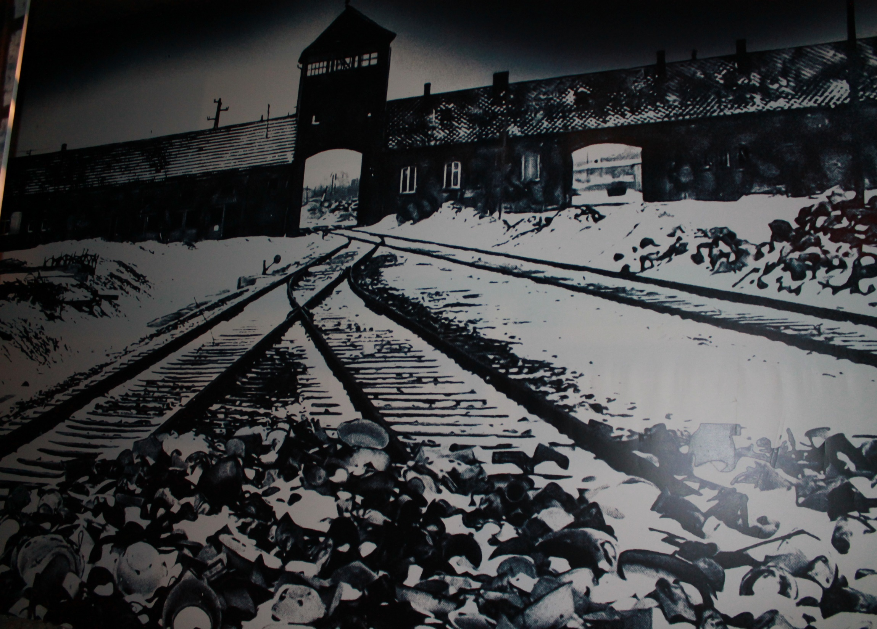
The Mad Nazi Road to the Final Solution & the Death Camps was Crooked
The Final Solution came out of many Twists & Turns & previously failed Plans.
The Outside World did not want any Jews when the Nazis originally wanted to Expel them – yet the Immigration Laws of Germany were Contradictory.
The Nazis stripped the Jews of their Possessions/Property so they could not afford to go anywhere anyway.
Such Impoverishment further guaranteed the Jews would later become a Great Liability to Host Countries to the East who were having their own Financial Difficulties.
As Germany conquered more and more of Europe, they inherited more & more Jews – which they impoverished all over again & which further intensified the Problems mentioned above.
Massive SS Population Transfers in Poland interfered with Jewish Displacement & Ghettoization.
The Plan to allow Jews go to Palestine was short lived because of Muslim Opposition.
The Plan to send the European Jews to Madagascar finally failed.
Poland had a Higher Jewish Population than Other European Countries, which became very conspicuous.
German Leadership in Poland fought over what to do with the Jews as Many wanted to Expel them to the East somewhere, including trying to use Poland was what they called a Catch Basin – particularly in SE Poland today – which was strongly opposed by Nazi Governor Hans Frank who did not want any more Jews.
The Original Plan then became to expel the Jews after the War.
Before Operation Barbarossa, the Soviet Union stopped taking more Jews being expelled from or running away from Europe.
The Ghettos became increasingly filled with Starving Diseased Jews that they first tried to subsidize a little bit, but then forced them to earn their own keep through Slave Labor through working for the War Effort, which in some Ghettos began to work relieving them to some extent – at which time the Nazis finally decided to start liquidating them as the ‘Humane’ thing to do anyway.
Operation Barbarossa and the War Effort became the primary Excuse to start liquidating the Jews in the Summer of 1941 – starting East & working West – as Hitler presumed the War was virtually over at that Early Time.
Once the Bloodletting began in the Summer of 1941 on the Great Battlefields of WW II, the Stage for the Holocaust was increasingly Set-up - but became more calculated & bloodless in order to alleviate the consciences of the Shooters.
By the Fall of 1941 the Nazis were already experimenting with Carbon Monoxide Killings in Mogilev & Gas Vans in Minsk – knowledge from which was later used to develop the Death Camps in Poland.

Slide 32
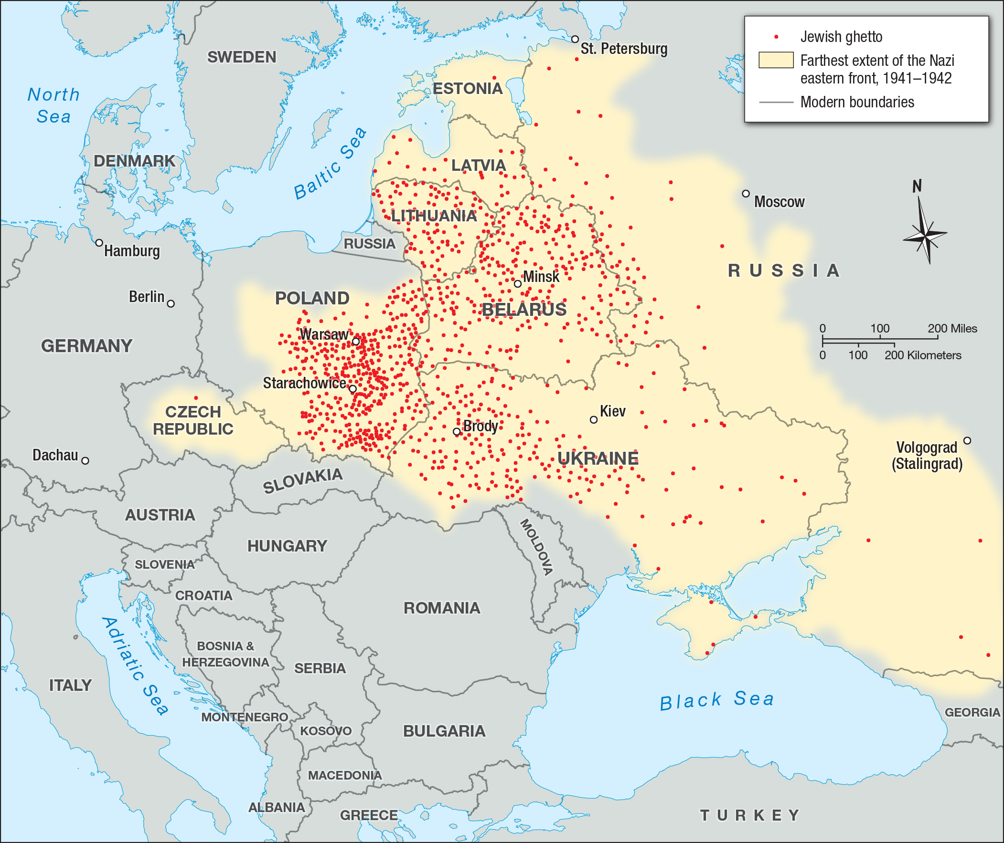
The Logistical Obstacles in Face of the Final Solution were virtually Apocalyptic

Slide 33
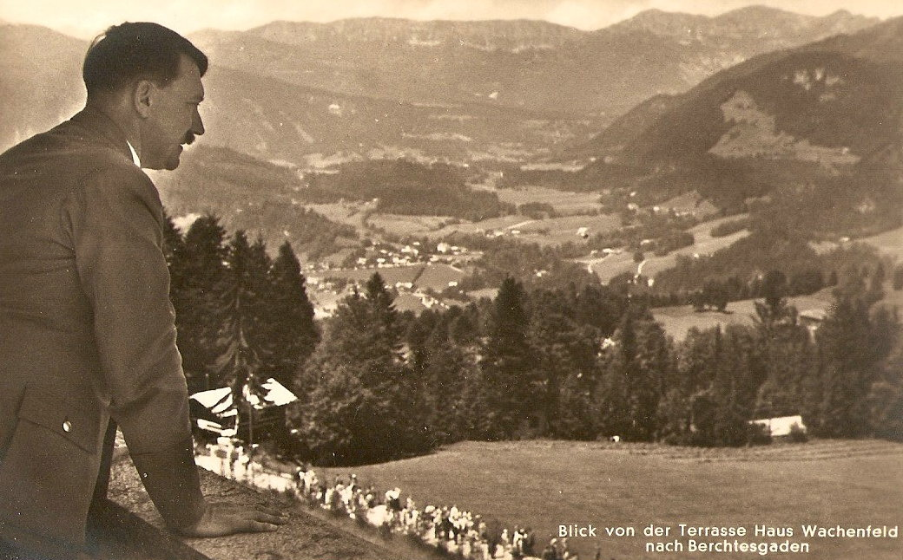
Intentionalism in Holocaust Studies: Was the Murderous Destruction of the Holocaust Preplanned?

Slide 34
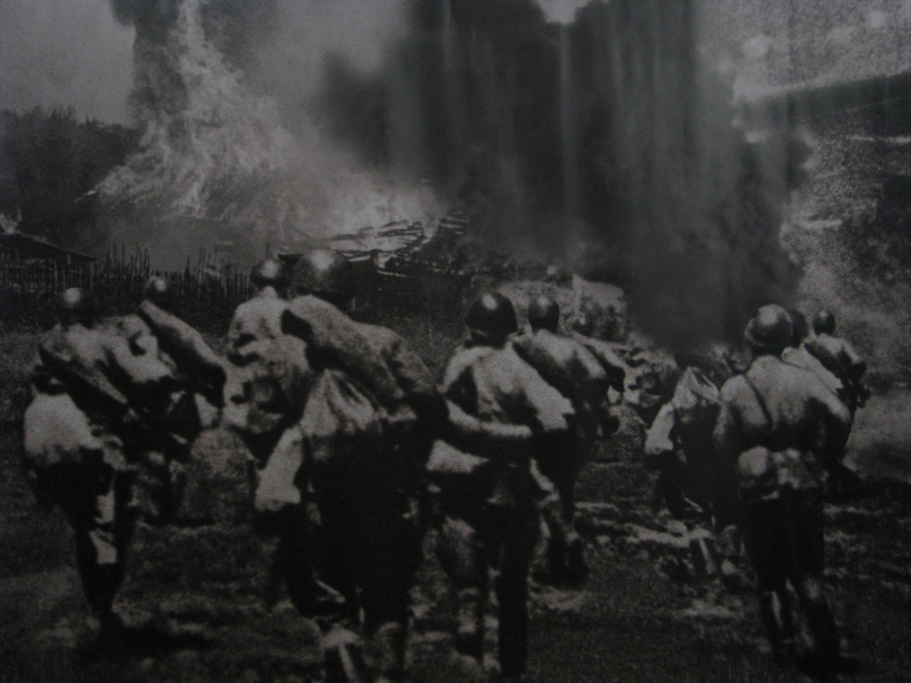
Functionalism in Holocaust Studies
“Functionalists argue that there rather than a straight line from anti-semitism to the Holocaust, there was instead 'a twisted road' to the Holocaust. In other words, the Holocaust was very much the result of the immediate circumstances that the Nazis found themselves in. In his work ‘The Origins of the Final Solution,' the American historian Christopher Browning (following German Scholar Hans Mommsen) argues that the Final Solution only took shape when Nazi Germany invaded the Soviet Union. It wasn't that the extermination centers simply formed without the knowledge or intents of Hitler and other leaders. It was simply that the Final Solution changed from simply removing the Jews from Europe (i.e. deporting, perhaps to Madagascar, but not necessarily exterminating them, which Browning claims was Hitler's plan up until 1939), to an actual plan for physical extermination. Even though Hitler's racial ideology played a driving role in the Holocaust, changing circumstances did as well. As the Nazis prepared to invade the Soviet Union in 1941, the Nazis felt that they were invincible as they destroyed Jewish communities in the Soviet Union. Experiencing so many victories, Hitler came to believe that the atrocities he committed against Soviet Jews could be expanded to all of Europe,” – Michelle Penn.

Slide 35
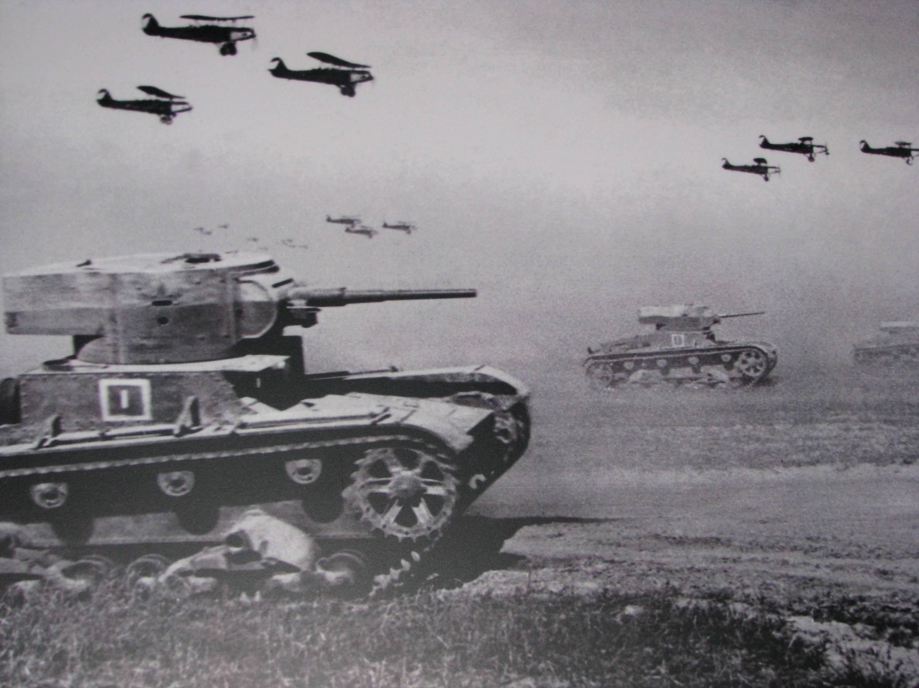
The Destructive Nazi Mindset During World War II
“The war against the Soviet Union would be something else completely different from any previous campaign,” Hitler said to his generals.
“Communism represents a terrible threat to our future. This war is a war of extermination. If we do not accept this, we may win, but the problem will resurface in 30 years. We are not waging war to spare the enemy.”
“This should be carried out with unequaled brutality” Heydrich to Einsatzgruppen leaders in July 1941 speaking of shooting the Jews in Ukraine, Belarus, the Baltics and Western Russia.
Many German soldiers knew of the “Final Solution” to murder all the Jews as they reported it to their friends and families when they were on leave, recorded in their diaries, and with letters sent home.
Jews were considered to be Communists & Partisans & thus were destroyed as First Order of Business.

Slide 36
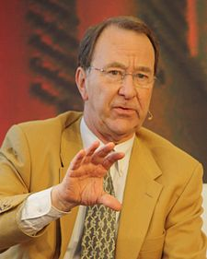
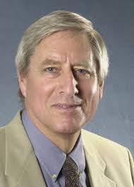
The Motive of Holocaustic Murder Purposefully Fades in the Background Under Functionalism
Most Holocaust Studies focus primarily on the Machinery of the Destruction, i.e., the”how” of the Holocaust, but not the “why” – which hides the Motive of Murder.
This by itself reflects the Materialism & Existentialism & Postmodernism that has infected Modern Historiography – the Lion’s Share of which is founded upon strong German Influences from the 1800’s and early 1900’s.
Some adamantly refuse to ask the Question “Why” because there can be no Meaning to such Nazi Madness.
German Scholars prefer Functionalism which protects German Academia from Culpability.
The Same Hermeneutical Struggles that are seen in all Biblical Studies also show up in the Historiography of the Holocaust.
In spite of all the Logistical Difficulties & Bureaucratic Infighting the Nazis still carried out the Holocaust in spite of all the Massive ‘Functional’ Barriers that interfered with their Plans.

Slide 37
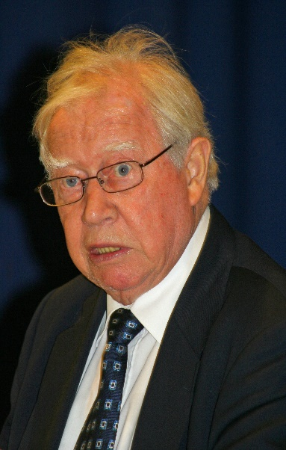
David Hirsch & the Deconstruction of Literature: Criticism After Auschwitz
Hirsch demonstrates how Postmodernism infiltrated the Ivy League through Former SS Scholars & Pro-Nazis via Martin Heidegger in the 1960’s & 70’s.
“It is misleading to disengage contemporary anti-humanism from Nazi dehumanization, for they share (the same) philosophical and cultural origins.”
Hirsch defines Postmodernism as Post-Auschwitz, “In brief, the post-Auschwitz age is one in which the 19th century prophecies of Marx & Nietzsche have been realized in the Soviet gulag, on the one hand, and in the Nazi death camps, on the other. Whatever post-modernism may be, the post-Auschwitz age is one of total war, mass murder, and genocide; an age of the death of God and of the eclipse of western culture and Judeo-Christian values.”

Slide 38
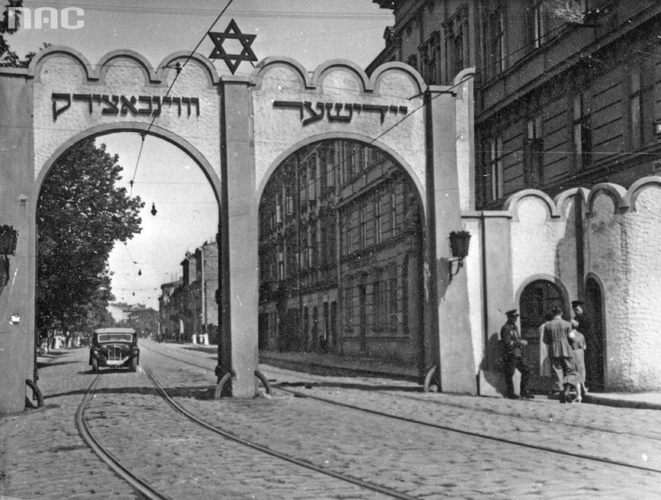
Almost One Million Jews died in Ghettos from Abuse/Starvation/Disease

Slide 39
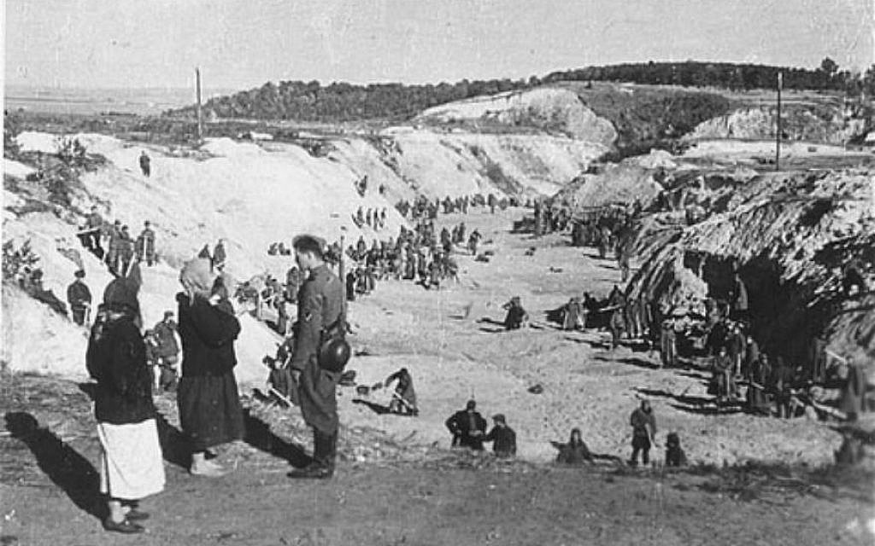
Mobile Death Squads in Poland, the Baltics, Belorussia, Russia & Ukraine
Nazi Einsatzgruppen Murdered some 1.7 Million Jews behind the German Army Front starting from 1939

Slide 40
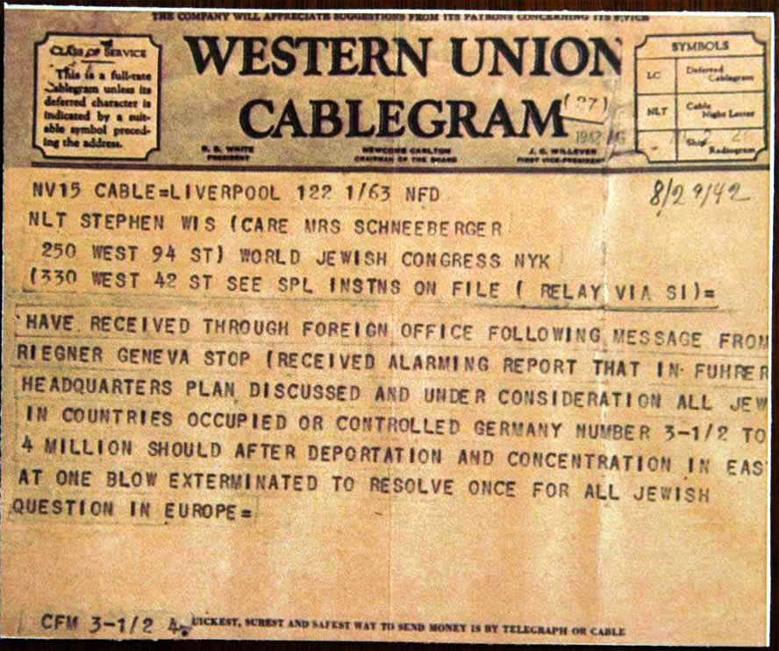
The ‘Jewish Question’ Finally Has a Final Solution – Riegner Telegram

Slide 41
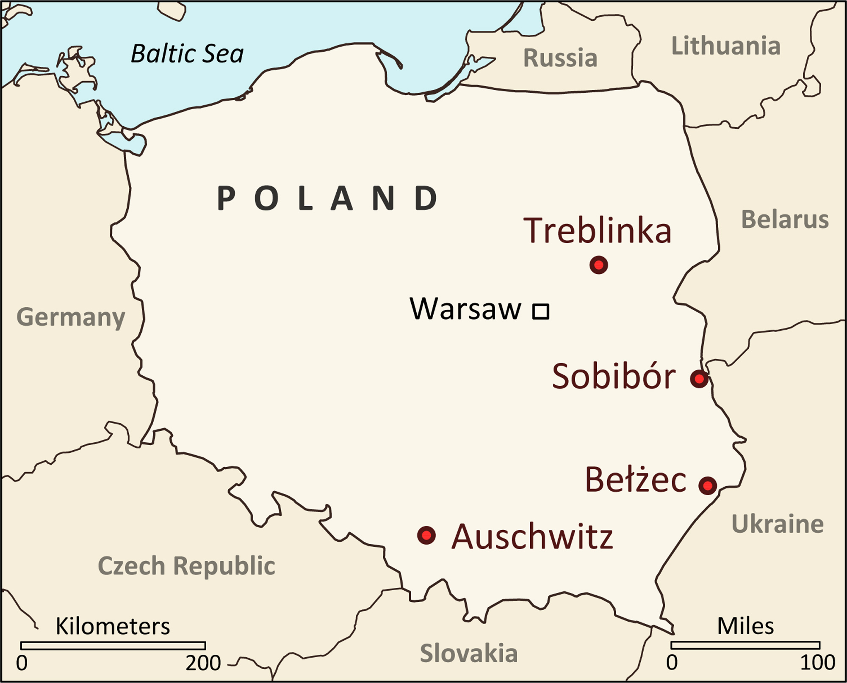
Operation Reinhardt – 1942-43
The Nazi Concentration/Death Camps of Treblinka, Sobibor, Belzec & Majdanek ‘evacuated’ almost Two Million Jews to their Deaths – most of whom were Polish Jews.

Slide 42
Aktion Erntefest Harvest Festival November 1943
This Aktion brought to an end Operation Reinhardt in which 43,000 Jews were murdered to clean out Lublin of its Jews. It was the single greatest massacre of the Jews carried out throughout the entire war.

Slide 43
During the War, Auschwitz Murdered More Jews than any other Camp
Auschwitz was a Gigantic Concentration & Work & Death Camp in Southwestern Poland that exterminated/euthanized well over One Million Jews – particularly the Hungarian Jews in 1944.

Slide 44
About 50,000 Jews were Murdered in the Balkans

Slide 45
Nazi Hardness of Heart
“The war against Russia is a fundamental part of the German people’s struggle for existence. It is the old struggle of the Germans against the Slavs, the defence of European culture against the Muscovite, Asiatic deluge, the defence against Jewish Bolshevism. This struggle must aim to smash the Russia of today into rubble, and as a consequence it must be carried out with unprecedented harshness,” - May 1941, German General Erich Hoepner

Slide 46
Nazi Animalism During the War
Major General Gerhard Fischer admitted, “We acted like wild beasts” on the Russian Front.
Lieutenant General Otto Elfedt recognized that much of the conduct carried out by the army was like that of a “Wild Animal.”
Lieutenant General Dietrich von Choltitz considered the Nazi Leaders “uneducated animals.”

Slide 47
Nazi Concentration Camps Purposefully Placed in Beautiful Locations
Ravensbrück, 50 miles north of Berlin, on the southern edge of the Mecklenburg lake district, was, as Himmler identified in 1938, a good location for a concentration camp. Rail and water connections were good. Fürstenberg, cradled by three lakes, the Röblinsee, Baalensee and Schwedtsee, sits astride the River Havel, which divides into several channels as it flows through the town.
Another factor that influenced Himmler’s choice was the siting in an area of natural beauty. Himmler believed that the cleansing of German blood should begin close to nature, and the invigorating forces of the German forests played a central role in the mythology of the Heimat – German soil. Buchenwald – meaning Beech Forest – was sited in a famous wooded area close to Weimar and several other camps were deliberately located in beauty spots. Just weeks before Ravensbrück was opened a stretch of water here was declared an ‘organic source for the Aryan race’. Fürstenberg had always been popular with nature lovers who came to boat on the lakes, or visit the baroque Palace of Fürstenberg
Nearby an aviary was being constructed. Heinrich Himmler, head of the SS, which ran the concentration camps and much else in Nazi Germany, wanted his camps to be self-sufficient as far as possible. There was to be a rabbit hutch, chicken coop and vegetable garden, as well as an orchard and flower garden. Gooseberry bushes, dug up from the Lichtenburg gardens and transported in the trucks, were already being replanted here. The contents of the Lichtenburg latrines had been brought to Ravensbrück too, to be spread as fertilizer.
Red flowers – salvias – had been planted outside the first block; linden tree saplings stood at regular intervals in between the rest. – Sarah Helm, RAVENSBRÜCK: Life and Death in Hitler’s Concentration Camp for Women.

Slide 48
Theodore Eicke – Mr. Oak – Original Designer of Concentration Camps
The style of the Nazi camps, however, would be set by Himmler, who personally identified the site for the prototype at Dachau. He also selected the Dachau commandant, Theodor Eicke, who became head of the ‘Death’s Head’ units, as the SS concentration-camp guard squads were called – they wore a skull and crossbones badge on their caps to denote loyalty to death. Himmler charged Eicke with devising a blueprint for terrorizing all ‘enemies of the state’.
At Dachau Eicke did just that, creating a school for SS men who called him ‘Papa Eicke’ and whom he ‘hardened’ before they were sent off to other camps. Hardening meant the men should learn never to show weakness to the enemy and should only ‘show their teeth’ – in other words, they should hate. Amongst Eicke’s early recruits was Max Koegel, the future commandant of Ravensbrück, who came to Dachau looking for work after a short spell in jail for embezzlement.
Born in the south Bavarian mountain town of Füssen, famous for lute making and for Gothic castles, Koegel was the son of a mountain shepherd. Orphaned at the age of twelve, he spent his early years shepherding on the Alps before seeking other work in Munich, where he fell in with far-right ‘völkische’ societies and joined the Nazi Party in 1932. ‘Papa Eicke’ quickly found a use for Koegel, now thirty-eight, his hardness already deeply chiselled.
At Dachau Koegel mixed with other SS men like Rudolf Höss, another early recruit, who went on to become commandant of Auschwitz and who also played a role at Ravensbrück. Höss would later remember his Dachau days with affection, talking of an entire cadre of SS men who learned to ‘love’ Eicke and never forgot his rules, ‘which stayed fast and became part of their flesh and blood’.
Such was Eicke’s success that several more camps were soon set up on the Dachau model - Sarah Helm Inside Ravensbruck.

Slide 49
End of War Primitivism
Lieutenant General Dietrich von Choltitz said all he had to flatten Paris according to Hitler’s Order was a “useless bow and arrow” when the Allies retook France toward the end of the War.

Slide 50
Darbyites - True Millennialists saved Thousands of Jews During the War
The mostly Protestant villagers of this tiny mountain plateau didn't talk about it at the time. Today, they still mostly don't talk about it. But during World War II, in defiance of the Vichy and Nazi regimes, they hid some 4,000 Jews, many of them children. Ordinary French farmers and shopkeepers risked their lives to rescue Jews from the Holocaust in the largest communal effort of its kind in Europe. What they did has been largely ignored or forgotten in France, experts say. Yet in Israel, Chambon is one of two European towns honored at Yad Vashem, the official Holocaust memorial in Jerusalem. Opposite a stone Protestant church in this French hamlet sits a plaque presented by Jews to "the righteous,” – by Robert Marquand, “A Protestant town's 'conspiracy of good' in Vichy France,” CS Monitor, May 15, 2008.

