Slide 1
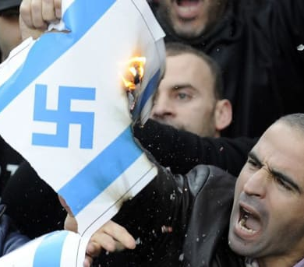
MODERN ANTI-SEMITISM
FROM “NEVER AGAIN”
OLIVIER MELNICK
CHOSEN
PEOPLE
MINISTRIES
TO “OVER AGAIN!”

Slide 2
4 REASONS TO STUDY ANTI-SEMITISM
1. Anti-Semitism focuses on the destruction of the people of the Book, the Jewish people.
2. Anti-Semitism is strongly connected to Replacement Theology.
3. Anti-Semitism is an inseparable part of the fabric of Jewish history. It must be studied if we want to understand the Jewish people.
4. Anti-Semitism CAN be used in outreach to Jewish people.

Slide 3
DEFINING
ANTI-SEMITISM
“Anti-Semitism is the irrational hatred of the Jewish people characterized by destructive thoughts, words and/or actions against them .”

Slide 4
A CONTEMPORARY CHALLENGE:
The Road to Auschwitz was built by hate
but paved with indifference. Ian Kershaw
The Road to another Holocaust is being rebuilt by hate but paved with political correctness and apathy. Olivier Melnick
Anti-Semitism builds an unlikely bridge and creates unexpected bonds between us and the rest of the Jewish community.

Slide 5
A genuine follower of Yeshua cannot hate the Jews.
ANTI-SEMITISM
IS NOT BIBLICAL
Psalm 83:3-5 They make shrewd plans against Your people, And conspire together against Your treasured ones. They have said,“Come, and let us wipe them out as a nation,That the name of Israel be remembered no more.” For they have conspired together with one mind;
Against You they make a covenant.

Slide 6
MODERN ANTI-SEMITISM
DIDN’T HAPPEN IN A VACUUM
YOU MUST KNOW WHAT YOU BRING TO THE TABLE!

Slide 7
• CLASSICAL ANTI-SEMITISM • THEOLOGICAL ANTI-JUDAISM • RACIAL ANTI-SEMITISM FROM THE BIBLICAL ACCOUNT TO THE HOLOCAUST • MODERN ANTI-SEMITISM • NEW ANTI-SEMITISM • END-TIMES ANTI-SEMITISM POST-HOLOCAUST TO TODAY
THE MORPHING OF ANTI-SEMITISM

Slide 8
• Theological anti-Judaism paved the way for racial Anti-Semitism. • The Exegetical deviation of some of the early Church Fathers was a catalyst. • Anti-Semitism progressively grew, widening the chasm between the Church and the Jews and starting the “Us and Them!” syndrome.
CLASSICAL
ANTI-SEMITISM
FROM THE BIBLICAL ACCOUNT TO THE HOLOCAUST

Slide 9
The Church Fathers • Ignatius Bishop of Antioch (c. AD 35 – c.108) • Origen of Alexandria (AD 185-254) • John Chrysostom (AD 344-407) • Augustine (AD 354-430) • Jerome (AD 347-420) A deviation of one degree (New York-Seattle -1º = 50 miles) The Church’s exegetical deviation took many far away from biblical truth, leading to diatribes and eventually the death of millions.
CLASSICAL
ANTI-SEMITISM
FROM THE BIBLICAL ACCOUNT TO THE HOLOCAUST

Slide 10
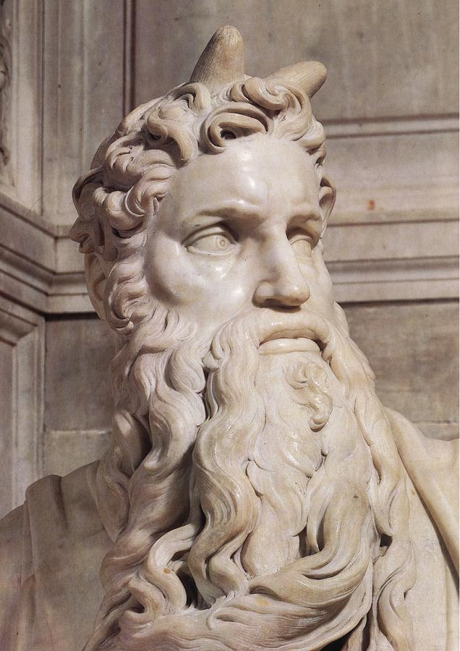
CLASSICAL
ANTI-SEMITISM
FROM THE BIBLICAL ACCOUNT TO THE HOLOCAUST
Context is everything!
In his monumental 4th Century work “The Vulgate” Jerome translated the Bible in Latin. He mistakenly translated the word קָרַן “karan” from the Hebrew “keren” that can mean “ray of light” or “horn” into horn.
Michelangelo’s “Moses” commissioned in 1505 by the Pope, ended up with horns on Moses’ forehead.

Slide 11
CLASSICAL
ANTI-SEMITISM
FROM THE BIBLICAL ACCOUNT TO THE HOLOCAUST
Context is everything!
Exodus 34:29 It came about when Moses was coming down from Mount Sinai (and the two tablets of the testimony were in Moses’ hand as he was coming down from the mountain), that Moses did not know that the skin of his face shone because of his speaking with Him.

Slide 12
CLASSICAL
ANTI-SEMITISM
FROM THE BIBLICAL ACCOUNT TO THE HOLOCAUST
Exodus 34:34-35 But whenever Moses went in before the Lord to speak with Him, he would take off the veil until he came out; and whenever he came out and spoke to the sons of Israel what he had been commanded, the sons of Israel would see the face of Moses, that the skin of Moses’ face shone. So Moses would replace the veil over his face until he went in to speak with Him.

Slide 13
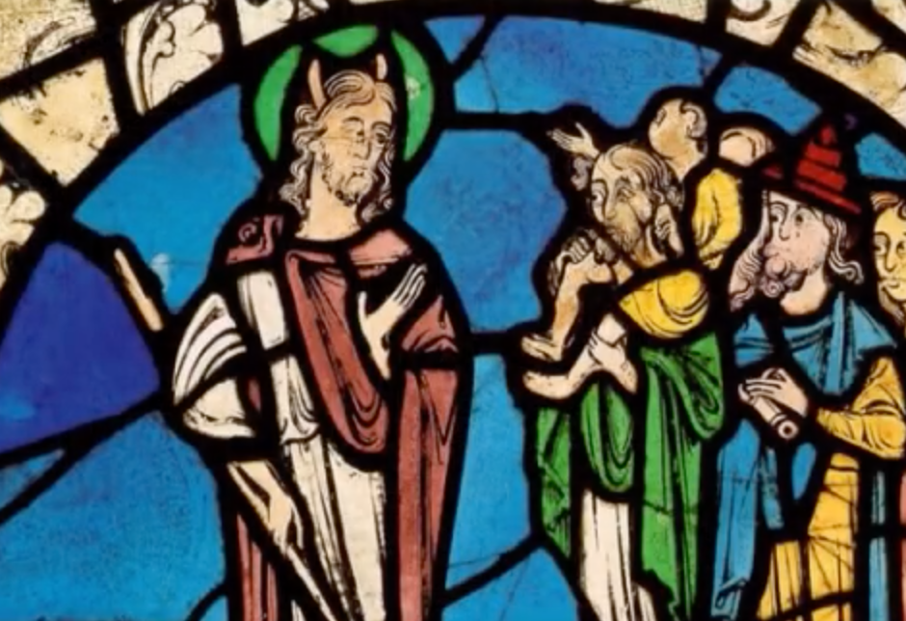
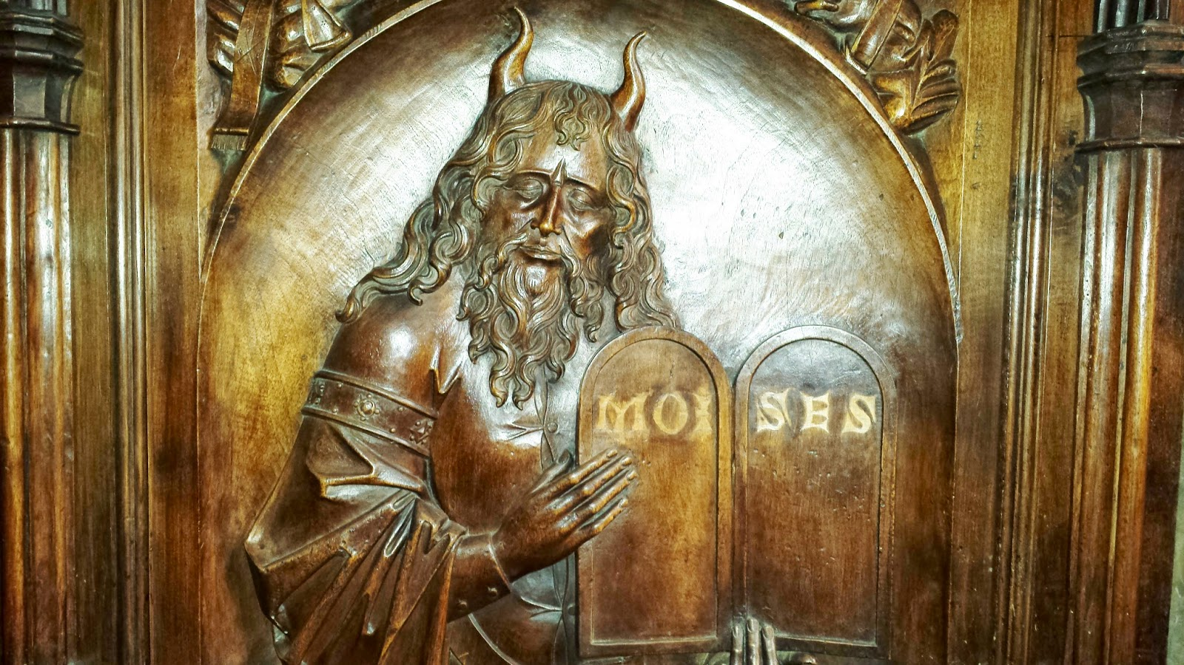
CLASSICAL
ANTI-SEMITISM
FROM THE BIBLICAL ACCOUNT TO THE HOLOCAUST

Slide 14
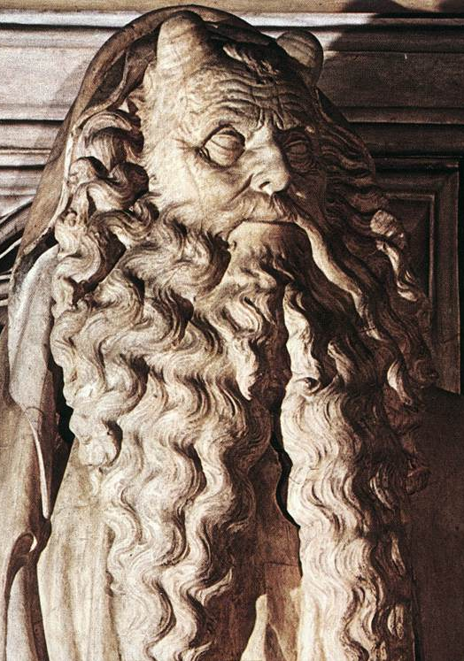
CLASSICAL
ANTI-SEMITISM
FROM THE BIBLICAL ACCOUNT TO THE HOLOCAUST

Slide 15
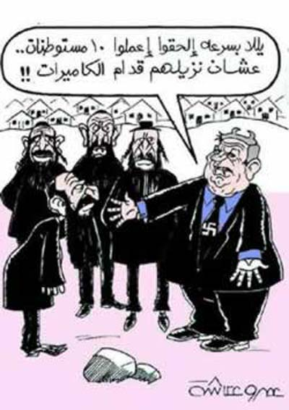
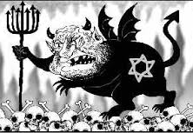
CLASSICAL
ANTI-SEMITISM
FROM THE BIBLICAL ACCOUNT TO THE HOLOCAUST

Slide 16
CLASSICAL
ANTI-SEMITISM
FROM THE BIBLICAL ACCOUNT TO THE HOLOCAUST
What’s in a name?
MURDERERS (Origen)
CHRIST KILLERS (St Hyppolitus) POSSESSED BY THE DEVIL (Chrysostom)
DEGENERATE(Chrysostom)
CURSED BY GOD (Hilary of Poitiers)
DEMONS (Gregory of Nyssa)
REJECTED AND CONDEMNED (Martin Luther)

Slide 17
CLASSICAL
ANTI-SEMITISM
FROM THE BIBLICAL ACCOUNT TO THE HOLOCAUST
VERMIN (Hitler)
SUB-HUMANS (Hitler)
(Today’s enemies)
OCCUPIERS COLONIZERS
APARTHEID PEOPLE
BLOOD SUCKERS
HUMAN RIGHTS VIOLATORS
MURDERERS OF PALESTINIANS
NEW NAZIS OF THE MIDDLE EAST

Slide 18
CLASSICAL
ANTI-SEMITISM
FROM THE BIBLICAL ACCOUNT TO THE HOLOCAUST
What’s does the Bible have to say?
The apple of God’s eye (Zechariah 2:8)
Daughter of Zion (Zephaniah 3:14)
God’s chosen people (1 Kings 3:8)
A treasured possession (Deuteronomy 7:6)
A holy people (Deuteronomy 7:6)
God’s hidden ones (Psalm 83:3) A great nation (Genesis 12:2) Beloved (Romans 11:28)

Slide 19
CLASSICAL
ANTI-SEMITISM
FROM THE BIBLICAL ACCOUNT TO THE HOLOCAUST
• The Middle Ages (c. AD 500-1500)
• THE THEODISIAN CODE – AD 438
• THE JUSTINIAN CODE – AD 529
• THE START OF A JEWISH/CHRISTIAN POLARIZATION
• FORCED BAPTISMS AND FORCED
CONVERSIONS

Slide 20
CLASSICAL
ANTI-SEMITISM
FROM THE BIBLICAL ACCOUNT TO THE HOLOCAUST
• The Crusades (AD 1096-1291)
• 1096: The Crusaders marched throughout Europe raping Jewish women, looting Jewish villages and killing Jewish men claiming that “God wills it!”
• 1099: Led by Godffroy de Bouillon they arrived in Jerusalem and set its synagogue ablaze with 1000 Jewish people inside, as they marched around it singing “Christ, We Adore Thee! Thee are our light, our direction, our love”.

Slide 21
CLASSICAL
ANTI-SEMITISM
FROM THE BIBLICAL ACCOUNT TO THE HOLOCAUST
Money Lending (1200s – 1300s)
• Christians were allowed to borrow money
ONLY from Jews who were becoming increasingly limited in what they could
own or do as a business.
• Leaders of Europe started taxing the Jewish
moneylenders on their profit. Taxes kept
increasing, Jewish lenders had to increase
their interest rates.The process eventually
gave birth to the myth of the “greedy Jew.”

Slide 22
CLASSICAL
ANTI-SEMITISM
FROM THE BIBLICAL ACCOUNT TO THE HOLOCAUST
The Ritual Murder Libel (1141 forward)
• First case was recorded in Norwich, England in 1141. The dead body of a boy was found on Good Friday. The testimony of a monk was the only record of the event.
• Re-emerged in Poland in the 18th century
• 19th century in France, Germany & Russia
• New York in 1928.
• Nazi propaganda during WWII
• Birmingham, Alabama in 1962.
Anti-Semites are still propagating it around the world and especially in the Middle East.

Slide 23
CLASSICAL
ANTI-SEMITISM
FROM THE BIBLICAL ACCOUNT TO THE HOLOCAUST
The Badge of Shame (1215)
• After the 4th Lateran Council in 1215, Jews had to start wearing a badge known as “La rouelle” on their garments. It became known as “the badge of shame” and later became the yellow
star used in the Holocaust.
• The reason given was the
prevention of sexual relation
and/or marriage between
Jews and Christians.

Slide 24
CLASSICAL
ANTI-SEMITISM
FROM THE BIBLICAL ACCOUNT TO THE HOLOCAUST
Host Desecration (1215)
• Also during the 4th Lateran Council, Pope
Innocent III made the doctrine of transubstantiation an official part of the Catholic Church.
• Jews became accused of desecrating communion wafers by piercing them. The blood of Yeshua would pour again as they reenacted the crucifixion for which they had originally been found guilty.
• As a result, about 100,000 Jews from over 140 different European communities were massacred.

Slide 25
CLASSICAL
ANTI-SEMITISM
FROM THE BIBLICAL ACCOUNT TO THE HOLOCAUST
The Jews as “Christ Killers”
• The Bible claims that Yeshua gave His own life so
that He could take it back. If anything we all share in the guilt.
John 10:17-18
17 For this reason the Father loves Me, because I lay
down My life so that I may take it again.
18 No one has taken it away from Me, but I lay it down on My own initiative. I have authority to lay it down, and I have authority to take it up again.This
commandment I received from My Father.”

Slide 26
CLASSICAL
ANTI-SEMITISM
FROM THE BIBLICAL ACCOUNT TO THE HOLOCAUST
Yeshua described and predicted the conspiracy against Him.
Mark 10:33-34
“Behold, we are going up to Jerusalem, and the Son of Man will be delivered to the chief priests and the scribes; and they will condemn Him to death and will hand Him over to the Gentiles. They will mock Him and spit on Him, and scourge Him and kill Him, and three days later He will rise again.”

Slide 27
CLASSICAL
ANTI-SEMITISM
FROM THE BIBLICAL ACCOUNT TO THE HOLOCAUST
The Poisoning of the Wells of Europe
• The “ Black Death” or “Black Plague” was the most
devastating pandemic in the history of mankind from
1347 to 1350, it was responsible for the death of tens of millions of people worldwide.
• Fewer Jewish people died from it, and thus the Jewish people were accused of poisoning the wells of Europe.
• In reality, communal isolation, kosher laws and liturgical practices were responsible for fewer Jewish casualties.

Slide 28
CLASSICAL
ANTI-SEMITISM
FROM THE BIBLICAL ACCOUNT TO THE HOLOCAUST
• The Spanish Inquisition
• The first Ghetto (Italy)
• Luther and the Reformation
By the end of the 15th century, the Jew has become an undesirable agent of Satan. The terms “Jewish” and “diabolical” have become synonymous. To Jews of course, the symbol of the cross, so dear to Christians, had become such an offense and became known as “the symbol of disaster”. Medieval anti-Semitism left a mark that the 21st century is still trying to erase.

Slide 29
CLASSICAL
ANTI-SEMITISM
FROM THE BIBLICAL ACCOUNT TO THE HOLOCAUST
• The Pale of Settlement (1791-1917)
• A geographical area where Jewish people could live within the Russian Empire, similar to a large ghetto (about 1,000,000 square miles).
• The Eastern European Pogroms (1800s)
• Government sponsored riots against the Jewish People. The first one on record was in Odessa in 1821. They started after the establishment of the Pale and often as a result of the Jews refusal to convert to Eastern Christian Orthodoxy.

Slide 30
CLASSICAL
ANTI-SEMITISM
FROM THE BIBLICAL ACCOUNT TO THE HOLOCAUST
• The Holocaust (1933-1945)
• A systematic, willful attempt at exterminating all of European Jewry.
• Legislation (1933-1938): The Nuremberg Laws
• Criminalization of Jewishness (1938-1939): Kristallnacht
• Isolation (1939-1941): Ghettos
• Annihilation (1941-1945): Death Camps
The Holocaust was the culmination of 2000 years
Of anti-Semitism.

Slide 31
CLASSICAL
ANTI-SEMITISM
FROM THE BIBLICAL ACCOUNT TO THE HOLOCAUST
OUT OF THE ASHES OF THE HOLOCAUST,
A NEW JEWISH MOTTO WAS BORN:
NEVER AGAIN!

Slide 32
NEVER AGAIN!

Slide 33
MODERN
ANTI-SEMITISM
FROM THE HOLOCAUST TO THE TODAY
The Postmodern Era (c.1945 -today):
Modern Anti-Semitism has a lot in common with
Classical Anti-Semitism as far as the goal is concerned. It was, is, and always will be the complete destruction of the Jewish people just because they are Jewish.
By the mid-60s, a new Anti-Semitism was forming, or possibly classical Anti-Semitism was re-packaged and morphed into a socially acceptable ideology.
Now, It has new boundaries, a new methodology, and a new source.

Slide 34
MODERN
ANTI-SEMITISM
FROM THE HOLOCAUST TO THE TODAY
The Boundaries Are Different
• The boundaries of classical Anti-Semitism were European for the
most part. The
cancer of Jewish
hatred was a localized cancer
spreading as far
as the European
train network system.

Slide 35
MODERN
ANTI-SEMITISM
FROM THE HOLOCAUST TO THE TODAY
The Boundaries Are Different
• The new boundaries extend to the whole world. The cancer has metastasized.
• With the advent of satellite communications, the Internet and the social networks, modern Anti-Semitism now reaches to the four corners of the world and the growth of its grip is rapid and exponential.
• Outside of Eretz Yisrael, there is really no safe place for Jewish people anymore.

Slide 36
MODERN
ANTI-SEMITISM
FROM THE HOLOCAUST TO THE TODAY
The Boundaries Are Different
• The new boundaries extend to the whole world. The cancer has metastasized.
• With the advent of satellite communications, the Internet and the social networks, modern Anti-Semitism now reaches to the four corners of the world and the growth of its grip is rapid and exponential.
• Outside of Eretz Yisrael, there is really no safe place for Jewish people anymore.

Slide 37
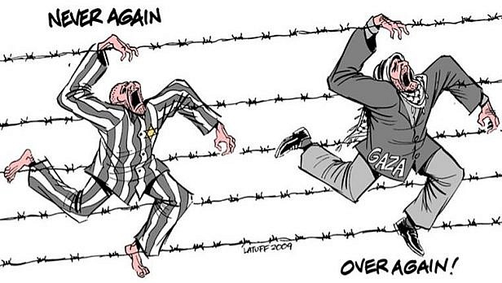
MODERN
ANTI-SEMITISM
FROM THE HOLOCAUST TO THE TODAY
The Methodology is different
• A role reversal: The new methodology has turned the victims into perpetrators and the perpetrators
into victims.
• Jews are painted as the “New Nazis of the Middle East.”

Slide 38
MODERN
ANTI-SEMITISM
FROM THE HOLOCAUST TO THE TODAY
The Methodology is different
• First, only the Jewish people were targeted.
Now Israel is also in the crosshair of modern Anti-Semitism. Additionally, any political move made in Israel might have global repercussions on Jewish communities anywhere on the planet.
Today, Jews have become known as: OCCUPIERS • COLONIZERS • APARTHEID PEOPLE • BLOOD SUCKERS • HUMAN RIGHTS VIOLATORS • MURDERERS • NEW NAZIS OF THE MIDDLE EAST

Slide 39
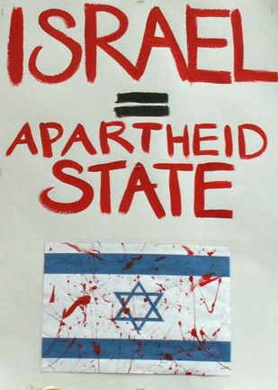
MODERN
ANTI-SEMITISM
FROM THE HOLOCAUST TO THE TODAY
ANTI-SEMITISM HAS BEEN RENAMED
ANTI-ISRAELISM OR ANTI-ZIONISM

Slide 40
MODERN
ANTI-SEMITISM
FROM THE HOLOCAUST TO THE TODAY
The Source is different
• The source of Anti-Semitism has always been the same; it is Satan who loves what God hates and hates what god loves.
• Satan also knows that when Israel calls upon Yeshua at the end of the Tribulation, his career of hatred is over, and he is in no hurry to relocate for retirement.

Slide 41
MODERN
ANTI-SEMITISM
FROM THE HOLOCAUST TO THE TODAY
Zechariah 12:10 I will pour out on the house of David and on the inhabitants of Jerusalem, the Spirit of grace and of supplication, so that they will look on Me whom they have pierced; and they will mourn for Him, as one mourns for an only son, and they will weep bitterly over Him like the bitter weeping over a firstborn.
Romans 11:26 and so all Israel will be saved; just as it is written, “The Deliverer will come from Zion, He will remove ungodliness from Jacob.”

Slide 42
MODERN
ANTI-SEMITISM
FROM THE HOLOCAUST TO THE TODAY
Revelation 20:1-3,10
1Then I saw an angel coming down from heaven, having the key to the bottomless pit and a great chain in his hand. 2 He laid hold of the dragon, that serpent of old, who is the Devil and Satan, and bound him for a thousand years; 3 and he cast him into the bottomless pit, and shut him up, and set a seal on him, so that he should deceive the nations no more till the thousand years were finished. But after these things he must be released for a little while.
10 And the devil who deceived them was thrown into the lake of fire and brimstone, where the beast and the false prophet are also; and they will be tormented day and night forever and ever.

Slide 43
MODERN
ANTI-SEMITISM
FROM THE HOLOCAUST TO THE TODAY
SATAN’S AGENDA:
• He knows he cannot change God’s program or hinder it, but he’ll try to postpone it.
• Since Israel is involved in the Second Coming of Messiah, Satan is committed to postponing the Jewish people from saying “Baruch Haba Bashem Adonai”
(Blessed is he who comes in the name of the Lord.)
WHAT BETTER WAY TO POSTPONE HIS DEMISE THAN TO CREATE ANTISEMITISM TO PUSH THE JEWISH PEOPLE AWAY FROM GOD, YESHUA AND CHRISTIANITY?

Slide 44
MODERN
ANTI-SEMITISM
FROM THE HOLOCAUST TO THE TODAY
Matthew 23:37-39
³⁷ “Jerusalem, Jerusalem, who kills the prophets and stones those who are sent to her! How often I wanted to gather your children together, the way a hen gathers her chicks under her wings, and you were unwilling. ³⁸ Behold, your house is being left to you desolate! ³⁹ For I say to you, from now on you will not see Me until you say, ‘Blessed is He who comes in the name of the Lord!’”

Slide 45
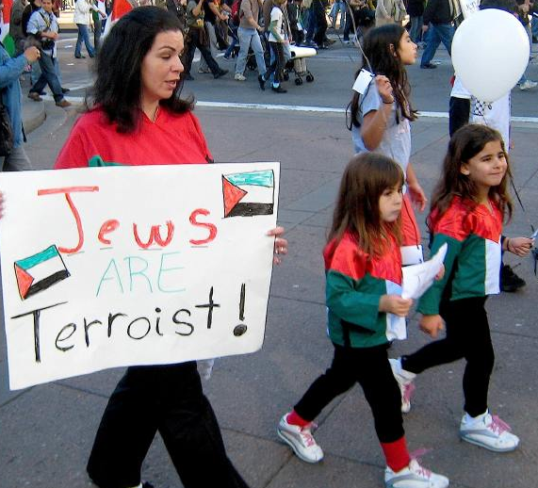
MODERN
ANTI-SEMITISM
FROM THE HOLOCAUST TO THE TODAY
SATAN IS SUB-CONTRACTING HIS HATRED ACROSS THE WIDEST SPECTRUM EVER:
• Liberalism and Secular Anti-Israelism
According to the liberal world- view, Anti-Semitism is not even on the agenda, as it has become acceptable to be anti-Israel. It is claimed that you can be anti-
Israel in the name of world peace,
all without being anti-Semitic.

Slide 46
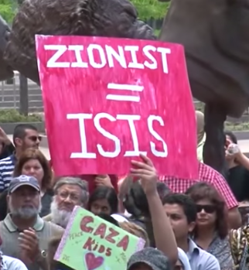
MODERN
ANTI-SEMITISM
FROM THE HOLOCAUST TO THE TODAY
• Liberal Campus Antifada
One-sided pro-Palestinian agenda gets heavily promoted by groups like Students for Justice in Palestine (SJP), Jewish Voice for Peace (JVP) or the various Muslim Student Associations (MSA),with connection to the Muslim Brotherhood.
• The Muslim Brotherhood’s motto is: “God is our objective. The Prophet is our leader. The Qur'an is our law. Jihad is our way. Dying in the way of God is our highest hope. God is greater!”

Slide 47
MODERN
ANTI-SEMITISM
FROM THE HOLOCAUST TO THE TODAY
• Columbia University, New York
• 9 Universities in California
• Ohio University
• University of New Orleans
• University of Michigan
• Loyola University, Chicago
• Northeastern University, Boston
• University of Washington
• University of Maryland
• New York University
• University of New Mexico
• York University, Toronto
• University of Minnesota
• A presence on 189 campuses in America…
and growing!

Slide 48
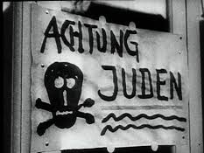
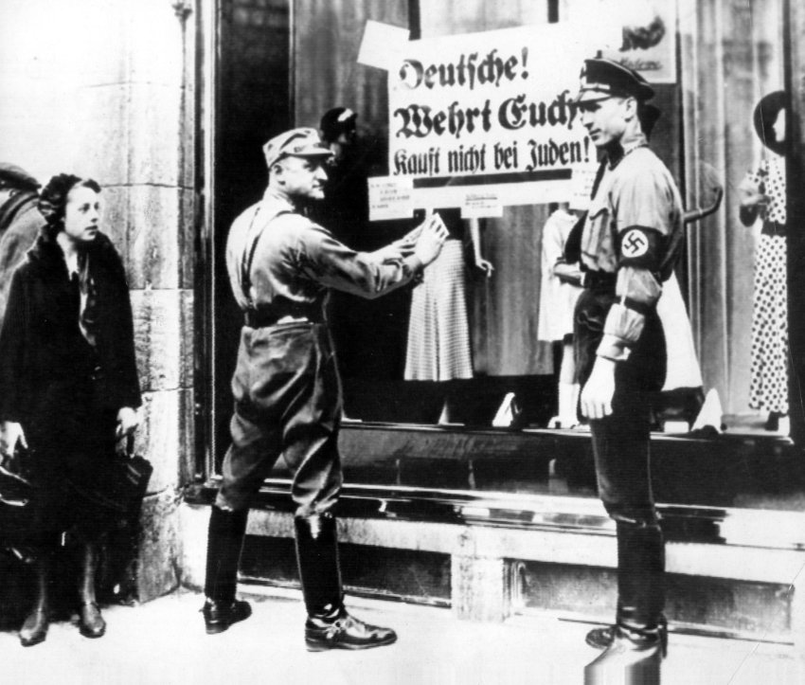
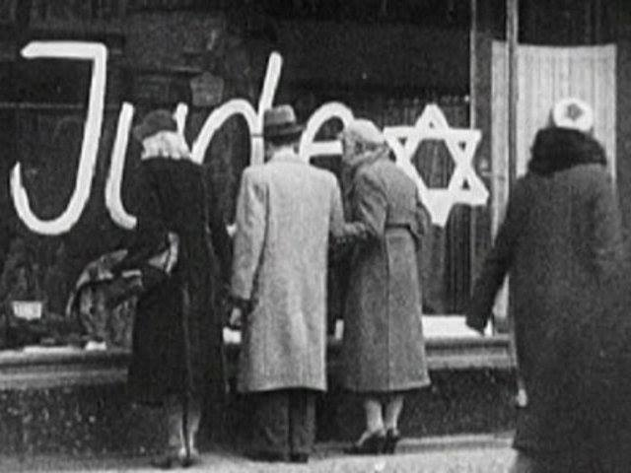
MODERN
ANTISEMITISM
FROM THE HOLOCAUST TO THE TODAY
• Boycott, Divestment and Sanctions Movement
Boycotting Jewish businesses isn’t a new thing.
Kristallnacht, November 9-10, 1938

Slide 49
MODERN
ANTI-SEMITISM
FROM THE HOLOCAUST TO THE TODAY
• Boycott, Divestment and Sanctions Movement
Boycott was reborn in 2005 as the modern BDS movement from the work of Mahmoud Abbas and Omar Barghouti.
• Lack of consistency in BDS is hypocritical at best.
• BDS exists beyond the University campuses.
• Boycott of Israel can be academic, cultural, political, economic and artistic.

Slide 50
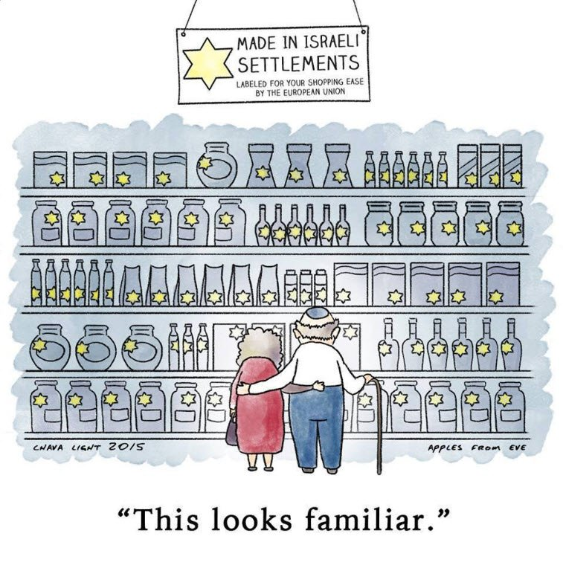
MODERN
ANTI-SEMITISM
FROM THE HOLOCAUST TO THE TODAY
“The real aim of BDS is to bring down the State of Israel.” As’ad AbuKalil, Professor of Political Science, University of California, Stanislaus.

Slide 51
MODERN
ANTI-SEMITISM
FROM THE HOLOCAUST TO THE TODAY
• Replacement Theology & Christian Palestinianism
• Replacement Theology continues it pervasive intrusion into biblical Christianity.
• Christian Palestinianism takes Replacement Theology to a new level.
• It is Replacement Theology on steroids.
1 Corinthians 10:32 Give no offense either to Jews or to Greeks or to the church of God.

Slide 52
MODERN
ANTI-SEMITISM
FROM THE HOLOCAUST TO THE TODAY
“Christian Palestinianism is an inverted mirror image of Christian Zionism. All the basic elements of a Christian Zionist eschatology are reversed, so that the Bible is seen to be Christian, not Jewish, the land of the Bible is Palestine not Israel, the son of God is a Palestinian not a Jew, the Holocaust is resented not remembered, 1948 is a catastrophe not a miracle, the Jewish people are illegal occupiers not rightful owners, and biblical prophecy is a moral manifesto and not a signpost to the Second Coming.”
Dr. Paul Wilkinson “For Zion Sake”
• Replacement Theology, Christian Palestinianism and Anti-Semitism are connected

Slide 53
MODERN
ANTI-SEMITISM
FROM THE HOLOCAUST TO THE TODAY
United Nations
• Keeps passing resolutions such as Resolution 2334 in Nov. 2016, making the building of settlements “illegal” and
punishable by international law.
UNESCO (United Nations Educational Scientific and
Cultural Organization)
• Recognized the State of Palestine (2011)
• Declared that the Temple Mount is a Muslim site (2016)
• Declared that Jerusalem has no right to be the Jewish Capital (2017)

Slide 54
MODERN
ANTI-SEMITISM
FROM THE HOLOCAUST TO THE TODAY
LIBERALS
HOLLYWOOD
CHRISTIAN PALESTINISTS
CAMPUS INTIFADA
ISRAEL AND THE
JEWISH PEOPLE
IRRATIONAL
RADICAL ISLAM
EVANGELICALS
BDS PROPONENTS
EUROPEAN UNION
UNITED NATIONS

Slide 55
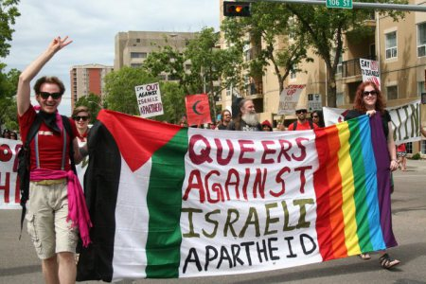
MODERN
ANTI-SEMITISM
FROM THE HOLOCAUST TO THE TODAY

Slide 56
END-TIMES
ANTI-SEMITISM
FROM 2012
TO THE TODAY
END-TIMES ANTISEMITISM
• Lliberal Christians, atheists and radical Muslims are groups that are often on the two extremes of the ideological spectrum, except when it comes to Israel and the Jews.
• End-times Anti-Semitism blends classic Anti-Semitism and the new Anti-Semitism.
• 2012 “L’affaire Merah” – 7 dead including a rabbi and 3 young students at a school in Toulouse, France.
• End-Times Anti-Semitism kills, but people today don’t always differentiate between verbal abuse, defacing of property or loss of life.
SATAN’S MACHINE OF HATRED AGAINST THE JEWS IS MOVING FULL STEAM FORWARD

Slide 57
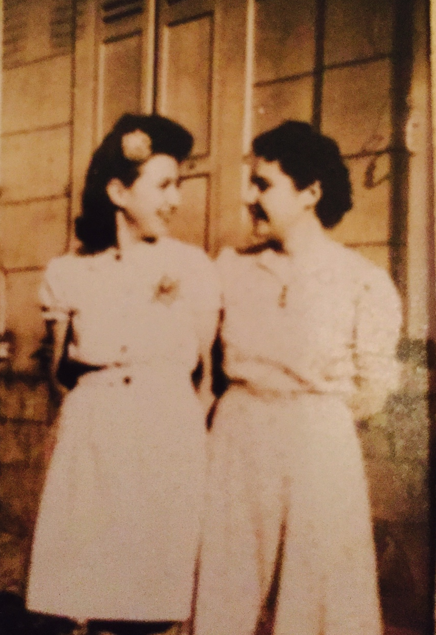
END-TIMES
ANTI-SEMITISM
FROM THE 2012
TO THE TODAY
Only 77 Years
have passed
between these
2 photos!

Slide 58
END-TIMES
ANTI-SEMITISM
FROM 2012
TO THE TODAY
Paris January 9, 2015
4 killed at the Hyper Cacher Supermarket

Slide 59
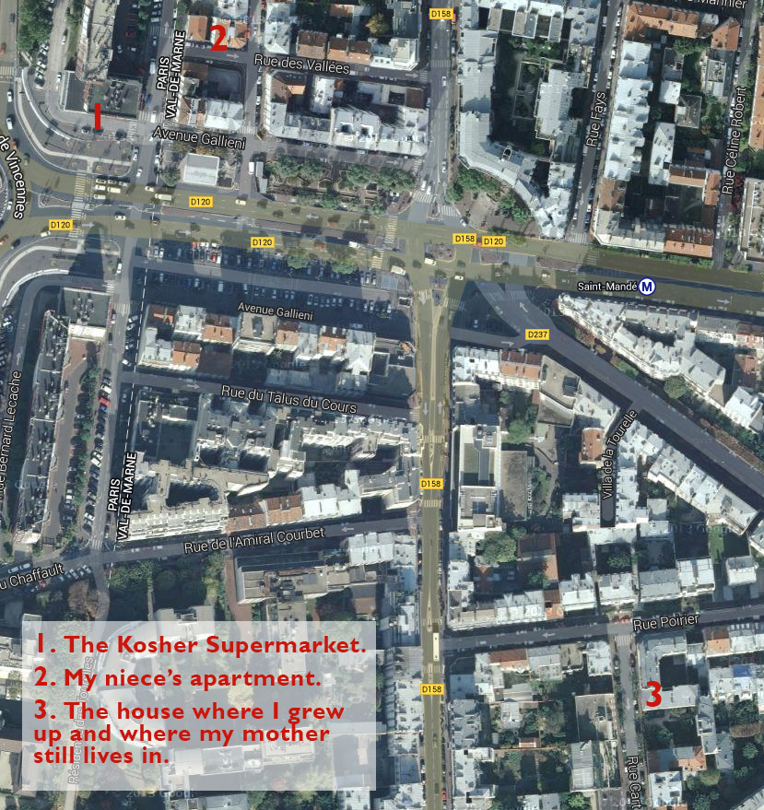
END-TIMES
ANTI-SEMITISM
FROM THE 2012
TO THE TODAY
2
1
“Olivier,
are they coming
back
for us?”
3

Slide 60
END-TIMES ANTI-SEMITISM:
A Believer’s Response
1. Education
Know the players
Know the agenda
Know the ultimate goal
2. Share your knowledge
With your children
With your students
With your congregations

Slide 61
END-TIMES ANTI-SEMITISM:
A Believer’s Response
3. Support Israel
Attend events in your area
Attend events on Campuses
Visit Israel
4. Speak up
Confront revisionism with facts and with the Bible whenever possible
Stay away from character assassination

Slide 62
END-TIMES ANTI-SEMITISM:
A Believer’s Response
5. Fight BDS
Buy Israeli products
Defend Israel with the truth
Sustain Israel in prayer

Slide 63
END-TIMES ANTI-SEMITISM:
A Believer’s Response
Remember who we fight
Ephesians 6:12 For our struggle is not against flesh and blood, but against the rulers, against the powers, against the world forces of this darkness, against the spiritual forces of wickedness in the heavenly places.

Slide 64
END-TIMES ANTI-SEMITISM:
A Believer’s Response
Remember who we also pray for
Matthew 5:44
“But I say to you, love your enemies and pray for those who persecute you.”

Slide 65
END-TIMES ANTI-SEMITISM:
A Believer’s Response
Remember who we serve
Jeremiah 31:35-37
Thus says the Lord, Who gives the sun for light by day And the fixed order of the moon and the stars for light by night, Who stirs up the sea so that its waves roar; The Lord of hosts is His name:“If this fixed order departs From before Me,” declares the Lord, “Then the offspring of Israel also will
cease From being a nation before Me forever.”

Slide 66
MODERN ANTI-SEMITISM
FROM “NEVER AGAIN”
TO “OVER AGAIN!”
Zechariah 8:23 Thus says the Lord of hosts, “In those days ten men from all the nations will grasp the garment of a Jew, saying, ‘Let us go with you, for we have heard that God is with you.’”

