Slide 1
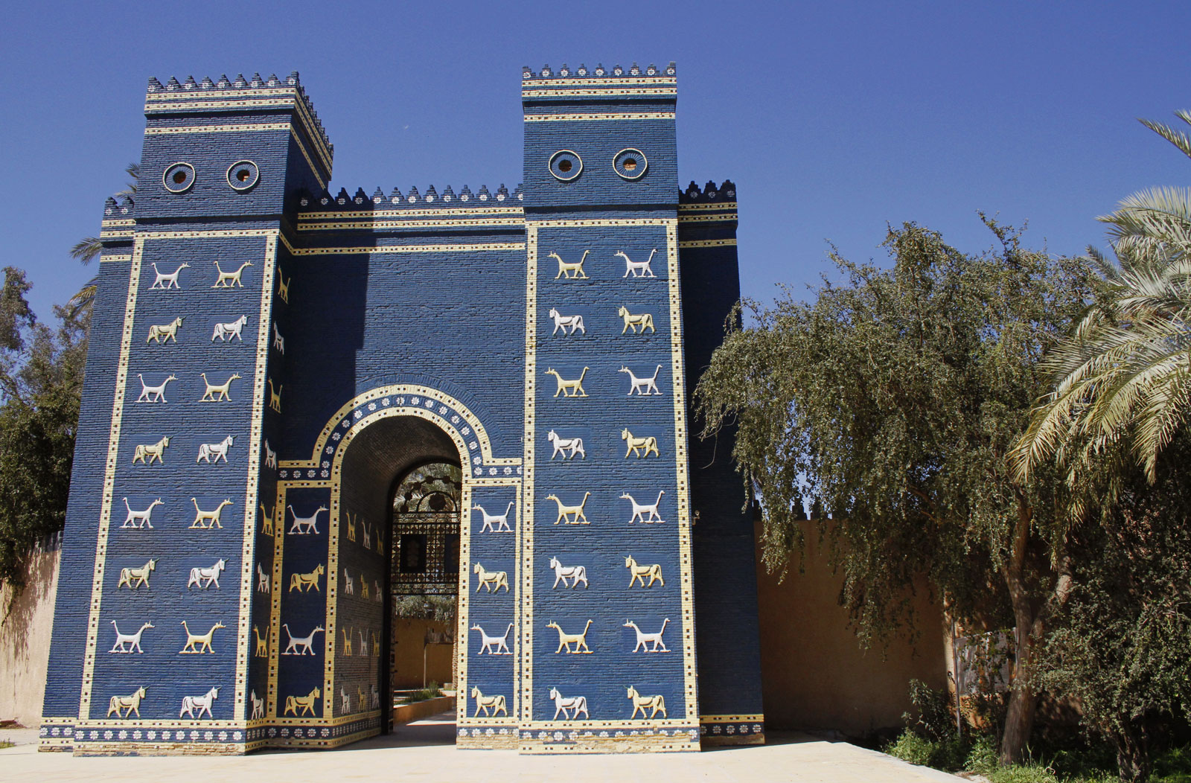
The Role of Babylon in Bible Prophecy Pre-Trib. Study Group December 2020, Prophecy Conference
Dr. Andy Woods
Senior Pastor – Sugar Land Bible Church
President – Chafer Theological Seminary

Slide 2
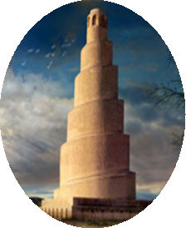
Seven Areas
Tower of Babel (Gen. 1–11)
Prophecies of Isaiah (13–14) & Jeremiah (50–51)
Prophecy of Zechariah (Zech. 5:5-11)
Kings of the East (Rev. 9:14; 16:12)
End-Time Harlot (Rev. 17–18)
Inadequate Theories
Current Events

Slide 3
Seven Areas
Tower of Babel (Gen. 1–11)
Prophecies of Isaiah (13–14) & Jeremiah (50–51)
Prophecy of Zechariah (Zech. 5:5-11)
Kings of the East (Rev. 9:14; 16:12)
End-Time Harlot (Rev. 17–18)
Inadequate Theories
Current Events

Slide 4
Genesis 11:1-4
¹ Now the whole earth used the same language and the same words. ² It came about as they journeyed east, that they found a plain in the land of Shinar and settled there. ³ They said to one another, “Come, let us make bricks and burn them thoroughly.” And they used brick for stone, and they used tar for mortar. ⁴ They said, “Come, let us build for ourselves a city, and a tower whose top will reach into heaven, and let us make for ourselves a name, otherwise we will be scattered abroad over the face of the whole earth.”

Slide 5
Genesis 11:1-4
¹ Now the whole earth used the same language and the same words. ² It came about as they journeyed east, that they found a plain in the land of Shinar and settled there. ³ They said to one another, “Come, let us make bricks and burn them thoroughly.” And they used brick for stone, and they used tar for mortar. ⁴ They said, “Come, let us build for ourselves a city, and a tower whose top will reach into heaven, and let us make for ourselves a name, otherwise we will be scattered abroad over the face of the whole earth.”

Slide 6
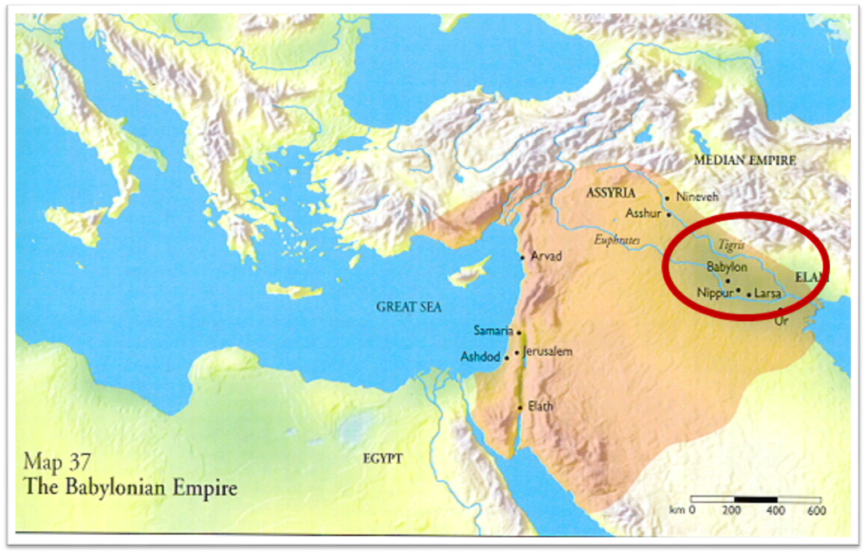

Slide 7
Daniel 1:1-2
“¹ In the third year of the reign of Jehoiakim king of Judah, Nebuchadnezzar king of Babylon came to Jerusalem and besieged it.² The Lord gave Jehoiakim king of Judah into his hand, along with some of the vessels of the house of God; and he brought them to the land of Shinar, to the house of his god, and he brought the vessels into the treasury of his god.”

Slide 8
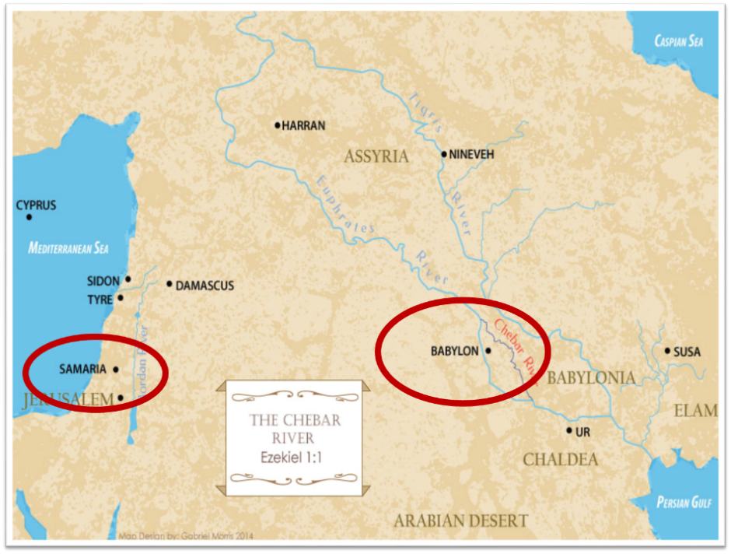

Slide 9
Genesis 11:1-4
¹ Now the whole earth used the same language and the same words. ² It came about as they journeyed east, that they found a plain in the land of Shinar and settled there. ³ They said to one another, “Come, let us make bricks and burn them thoroughly.” And they used brick for stone, and they used tar for mortar. ⁴ They said, “Come, let us build for ourselves a city, and a tower whose top will reach into heaven, and let us make for ourselves a name, otherwise we will be scattered abroad over the face of the whole earth.”

Slide 10
Spread of the Mother-Child Cult
 | Mother | Child
Assyria | Ishtar | Tammuz
Phoenicia | Astarte | Baal
Egypt | Isis | Osirus/Horus
Greece | Aphrodite | Eros
Rome | Venus | Cupid
Asia | Cybele | Desius
India | Isi | Aswara
Roman Catholicism | Mary | Jesus
Israel | Queen of Heaven (Jer. 7:18; 44:17) | Tammuz (Ezek. 8:14-15)
Alexander Hislop, Two Babylons

Slide 11
Larkin, The Book of Revelation, 151.
“The river Euphrates, on which the city of Babylon was built, was one of the four branches into which the river that flowed through the Garden of Eden was divided, and Satan doubtless chose the site of Babylon as his headquarters from which to sally forth to tempt Adam and Eve. It was doubtless here that the Antediluvian apostasy had its source that ended in the flood. To this centre the ‘forces of Evil’ gravitated after the Flood, and ‘Babel’ was the result. This was the origin of the nations, but the nations were not scattered abroad over the earth until Satan had implanted in them the ‘Virus’ of a doctrine that has been the source of every false religion the world has ever known.”

Slide 12
Seven Areas
Tower of Babel (Gen. 1–11)
Prophecies of Isaiah (13–14) & Jeremiah (50–51)
Prophecy of Zechariah (Zech. 5:5-11)
Kings of the East (Rev. 9:14; 16:12)
End-Time Harlot (Rev. 17–18)
Inadequate Theories
Current Events

Slide 13
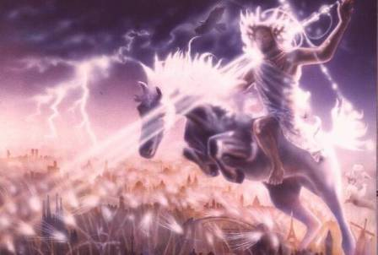
Isaiah 13-14
Day of the Lord (13:6-9)
Cosmic disturbances (13:10-13)
Global judgment (13:11-12)
Sodom and Gomorrah (13:19)
Complete and final desolation (13:20-22)
Universal peace and rest (14:5-8)
Israel’s regeneration (14:1-4)
Henry Morris, Revelation Record, 348.

Slide 14
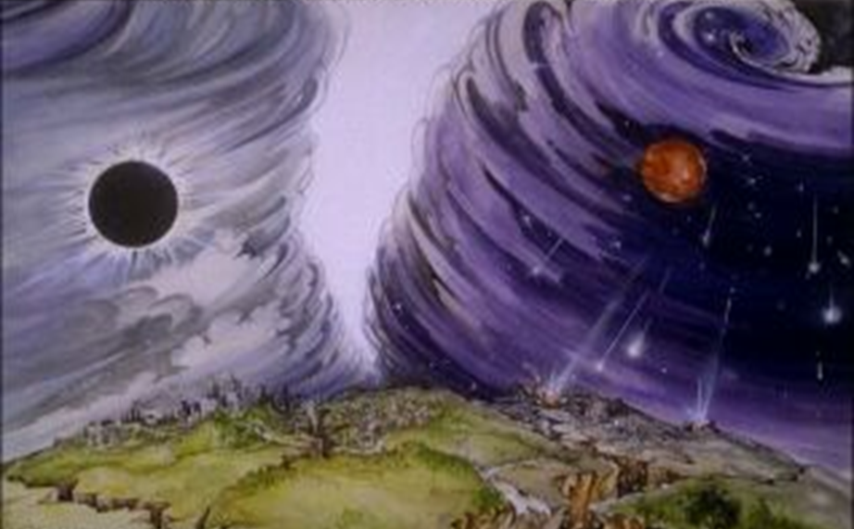
Isaiah 13/Matthew 24 Connection
Isaiah 13:10; Matthew 24:29
Isaiah 13:12; Matthew 24:21-22

Slide 15
Isaiah 13:12
“I will make mortal man scarcer than pure gold and mankind than the gold of Ophir.”

Slide 16
Matthew 24:21-22
“²¹ For then there will be a great tribulation, such as has not occurred since the beginning of the world until now, nor ever will. ²² Unless those days had been cut short, no life would have been saved; but for the sake of the elect those days will be cut short.”

Slide 17
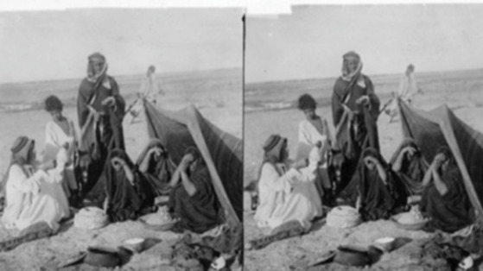
ARAB TENT HOME at Babylon 1899-1908 “It will never be inhabited or lived in from generation to generation; Nor will the Arab pitch his tent there” (Isaiah 13:20)
https://www.bibleprophecyaswritten.com/2-arabs/

Slide 18
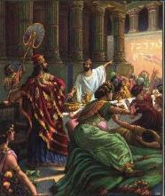
Isaiah’s Oracles Against the Nations (Isa 13–23)
Babylon (13:1-14:23) Assyria (14:24-27) Philistia (14:28-32) Moab (15-16) Damascus and Samaria (17) Ethiopia (18) | Egypt (19-20) Babylon (21:1-10) Edom (21:11-12) Arabia (21:13-17) Jerusalem (22) Tyre (23)

Slide 19
Isaiah’s Oracles Against the Nations (Isa 13–23)
Babylon (13:1-14:23) Assyria (14:24-27) Philistia (14:28-32) Moab (15-16) Damascus and Samaria (17) Ethiopia (18) | Egypt (19-20) Babylon (21:1-10) Edom (21:11-12) Arabia (21:13-17) Jerusalem (22) Tyre (23)

Slide 20
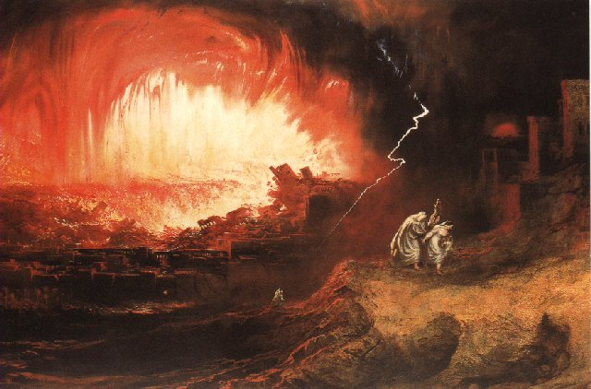
Jeremiah 50-51
Sudden destruction (51:8)
Complete destruction (50:3, 13, 26, 39-40; 51:29, 43, 62)
No reuse of building materials (51:26)
Believers flee (50:8; 51:6, 45)
Israel’s regeneration (50:2, 4-5, 20; 51:50)
Dyer, "The Identity of Babylon in Revelation 17–18 (Part 2)," 443-49.

Slide 21
Herodotus, Histories, 1:191 (450 B.C.)
“…he (Cyrus) conducted the river by a channel into the lake…and so he made the former course of the river passable by the sinking of the stream. When this had been done, the Persians who had been posted for this very purpose entered by the bed of the river Euphrates into Babylon, the stream having sunk so far that it reached about to the middle of a man’s thigh…those Babylonians who dwelt in the middle did not know that they had been captured…”

Slide 23
James Pritchard
The Ancient Near East Texts Relating to the Old Testament, 315-16.
Without any battle... sparing Babylon... any calamity....I am Cyrus...king of Babylon....When I entered Babylon...under jubilation and rejoicing...troops walked around Babylon...in peace, I did not allow anybody to terrorize (any place) of the [country of Sumer] and Akkad. I strove for peace in Babylon...and in all his (other) sacred cities....I returned to (these) sacred cities on the other side of the Tigris, the sanctuaries of which have been in ruins for a long time, the images which (used) to live therein and established for them permanent sanctuaries.

Slide 24
James Pritchard
The Ancient Near East Texts Relating to the Old Testament, 315-16.
I (also) gathered all their (former) inhabitants and returned (to them) their habitations. Furthermore, I resettled... unharmed, in their (former) chapels, the places which make them happy. May all the gods whom I have resettled in their sacred cities ask daily Bel and Nebo for a long life for me...all of them I resettled in a peaceful place... ducks and doves,...I endeavoured to fortify/repair their dwelling places . . .

Slide 25
Babylon’s History After 539 B.C.
Herodotus gives Babylon’s measurements (450 B.C.)
Alexander the Great visits and dies in Babylon (323 B.C.)
Seleucus seizes Babylon (312 B.C.)
Strabo pronounces Babylon’s hanging gardens as one of “seven wonders of the world” (25 B.C)
Babylonians present on Pentecost (Acts 2:9)
Talmud promulgated from Babylon (A.D. 500)
Haukal mentions Babylonian village (A.D. 917)
Babylon known as “Two Mosques” and “Hilah” (A.D. 1100)
Hitchcock and Ice, The Truth Behind Left Behind, 109

Slide 26
Dr. John Walvoord
The Nations in Prophecy, 63-64
“As far as the historic fulfillment is concerned, it is obvious from both Scripture and history that these verses have not been literally fulfilled. The city of Babylon continued to flourish after the Medes conquered it, and though its glory dwindled, especially after the control of the Medes and the Persians ended in 323 B.C., the city continued in some form or substance until A.D. 1000 and did not experience a sudden termination such as anticipated in this prophecy.”

Slide 27
Parallels Between Jeremiah 50-51 & Revelation 17-18
 | Jeremiah | Revelation
Associated with a Golden cup | 51:7a | 17:3-4; 18:6
Dwelling on many waters | 51:13 | 17:1
Intoxicating the nations | 51:7b | 17:2
Same name | 50:1 | 17:5
Persecuting the saints | 51:48 | 17:6; 18:24
Stone sinking into Euphrates | 51:63-64 | 18:21
Sudden destruction | 51:8 | 18:8
Destroyed by fire | 51:30 | 17:16
Final, uninhabitable | 50:39 | 18:21
Deserved | 50:29 | 18:6
God’s people flee | 51:6, 45 | 18:4
Heaven rejoices | 51:48 | 18:20
Dyer, "The Identity of Babylon in Revelation 17–18 (Part 2)," 441-43.

Slide 28
Larkin, The Book of Revelation, 158.
“…and this is in exact harmony with the words of Isa. 13:19. ‘And Babylon, the glory of kingdoms, the beauty of the Chaldees’ excellency, shall be as when God overthrew Sodom and Gomorrah;’ and the Prophet Jeremiah makes the same statement. Jer. 50:40. The destruction of Sodom and Gomorrah was not protracted through many centuries, their glory disappeared in a few hours (Gen. 19:24–28), and as ancient Babylon was not thus destroyed, the prophecies of Isaiah and Jeremiah cannot be fulfilled unless there is to be a future Babylon that shall be thus destroyed. In Rev. 16:17–19, we are told that Babylon shall be destroyed by an Earthquake, attended with most vivid and incessant lightning and awful thunder.”

Slide 29
Seven Areas
Tower of Babel (Gen. 1–11)
Prophecies of Isaiah (13–14) & Jeremiah (50–51)
Prophecy of Zechariah (Zech. 5:5-11)
Kings of the East (Rev. 9:14; 16:12)
End-Time Harlot (Rev. 17–18)
Inadequate Theories
Current Events

Slide 30
Zechariah 5:5-11
⁵ Then the angel who was speaking with me went out and said to me, “Lift up now your eyes and see what this is going forth.” ⁶ I said, “What is it?” And he said, “This is the ephah going forth.” Again he said, “This is their appearance in all the land ⁷ (and behold, a lead cover was lifted up); and this is a woman sitting inside the ephah.” ⁸ Then he said, “This is Wickedness!” And he threw her down into the middle of the ephah and cast the lead weight on its opening.

Slide 31
Zechariah 5:5-11
⁹ Then I lifted up my eyes and looked, and there two women were coming out with the wind in their wings; and they had wings like the wings of a stork, and they lifted up the ephah between the earth and the heavens. ¹⁰ I said to the angel who was speaking with me, “Where are they taking the ephah?” ¹¹ Then he said to me, “To build a temple for her in the land of Shinar; and when it is prepared, she will be set there on her own pedestal.”

Slide 32
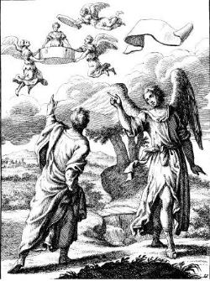
Zechariah 5:5-11
Woman (wickedness)
Ephah (commerce)
House (Temple-2 Sam 7; religion)
Shinar (Gen 10:10; 11:2; Dan 1:2)

Slide 33
Zechariah 5:5-11
Woman (wickedness)
Ephah (commerce)
House (Temple-2 Sam 7; religion)
Shinar (Gen 10:10; 11:2; Dan 1:2)

Slide 35
Genesis 11:1-4
¹ Now the whole earth used the same language and the same words. ² It came about as they journeyed east, that they found a plain in the land of Shinar and settled there. ³ They said to one another, “Come, let us make bricks and burn them thoroughly.” And they used brick for stone, and they used tar for mortar. ⁴ They said, “Come, let us build for ourselves a city, and a tower whose top will reach into heaven, and let us make for ourselves a name, otherwise we will be scattered abroad over the face of the whole earth.”

Slide 36
Daniel 1:1-2
“¹ In the third year of the reign of Jehoiakim king of Judah, Nebuchadnezzar king of Babylon came to Jerusalem and besieged it.² The Lord gave Jehoiakim king of Judah into his hand, along with some of the vessels of the house of God; and he brought them to the land of Shinar, to the house of his god, and he brought the vessels into the treasury of his god.”

Slide 37
Hitchcock The Second Coming of Babylon, 109.
ZECHARIAH 5:5-11 | REVELATION 17–18
Woman sitting in a basket | Woman sitting on beast, seven mountains, many waters (17: 3, 9, 15)
Emphasis on commerce (basket for measuring grain) | Emphasis on commerce (merchant of grain, 18:13)
Woman’s name is wickedness | Woman’s name is Babylon the Great, Mother of Harlots and Abominations of the Earth
Focus on False worship (temple is built for the woman) | Focus on False worship (17:5)
Woman taken to Babylon | Woman called Babylon

Slide 38
“The vision or prophecy (Zec. 5) contains the germ which is afterward expanded and developed in such detail in Rev. 17 and 18.” Pink, The Antichrist, 281.

Slide 39
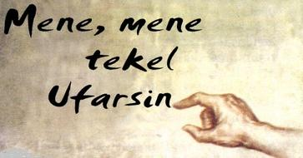
Daniel Interprets the Writing (5:24-28)

Slide 40
Zechariah 1:7
On the twenty-fourth day of the eleventh month, which is the month Shebat, in the second year of Darius (519 b.c.*), the word of the Lord came to Zechariah the prophet, the son of Berechiah, the son of Iddo, as follows:
*Babylon fell in 539 b.c!

Slide 41
Newton Babylon: Its Future, History, and Doom, 1890, p. 64.
“That this event predicted in this remarkable passage remains still unaccomplished, is sufficiently evident from the fact of Zechariah’s having prophesied after Babylon had received that blow under which it has gradually waned. Zechariah lived after Babylon had passed into the hands of the Persians . . .”

Slide 42
Seven Areas
Tower of Babel (Gen. 1–11)
Prophecies of Isaiah (13–14) & Jeremiah (50–51)
Prophecy of Zechariah (Zech. 5:5-11)
Kings of the East (Rev. 9:14; 16:12)
End-Time Harlot (Rev. 17–18)
Inadequate Theories
Current Events

Slide 43
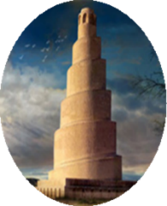
Revelation 9:14
“one saying to the sixth angel who had the trumpet, ‘Release the four angels who are bound at the great river Euphrates.’”

Slide 44
Revelation 16:12
“The sixth angel poured out his bowl on the great river, the Euphrates; and its water was dried up, so that the way would be prepared for the kings from the east.”

Slide 46
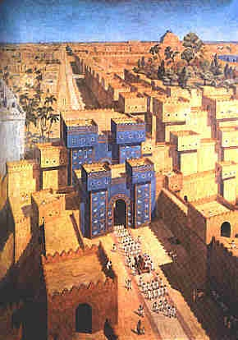
East = Babylon
Genesis 2:8
Genesis 11:2
Matthew 2:2

Slide 47
Genesis 11:1-4
¹ Now the whole earth used the same language and the same words. ² It came about as they journeyed east, that they found a plain in the land of Shinar and settled there. ³ They said to one another, “Come, let us make bricks and burn them thoroughly.” And they used brick for stone, and they used tar for mortar. ⁴ They said, “Come, let us build for ourselves a city, and a tower whose top will reach into heaven, and let us make for ourselves a name, otherwise we will be scattered abroad over the face of the whole earth.”

Slide 49
Seven Areas
Tower of Babel (Gen. 1–11)
Prophecies of Isaiah (13–14) & Jeremiah (50–51)
Prophecy of Zechariah (Zech. 5:5-11)
Kings of the East (Rev. 9:14; 16:12)
End-Time Harlot (Rev. 17–18)
Inadequate Theories
Current Events

Slide 52
5 Non-Chronological Parenthetical Insertions
Rev 7 – 144,000 Jews
Rev 10:1-11:13 – Announcement of no more delay and the two witnesses
Rev 12-14 – Israel’s flight, two beasts, six scenes of hope
Rev 16:13-16 – Gathering of the nations to Armageddon
Rev 17:1-19:6 – Babylon’s fall

Slide 53
5 Non-Chronological Parenthetical Insertions
Rev 7 – 144,000 Jews
Rev 10:1-11:13 – Announcement of no more delay and the two witnesses
Rev 12-14 – Israel’s flight, two beasts, six scenes of hope
Rev 16:13-16 – Gathering of the nations to Armageddon
Rev 17:1-19:6 – Babylon’s fall

Slide 54
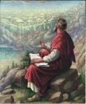
Revelation 17:1
“Then one of the seven angels who had the seven bowls came and spoke with me, saying, “Come here, I will show you the judgment of the great harlot who sits on many waters.”

Slide 55
Revelation 17:18
“The woman whom you saw is the great city, which reigns over the kings of the earth.”

Slide 56
Revelation 18:10
“standing at a distance because of the fear of her torment, saying, ‘Woe, woe, the great city, Babylon, the strong city! For in one hour your judgment has come.’”

Slide 57
Literal Geography in Revelation
Asia | 1:4 | Philadelphia | 3:7
Patmos | 1:9 | Laodicea | 3:14
Ephesus | 2:1 | Euphrates | 9:14;16:12
Smyrna | 2:8 | Jerusalem | 11:8
Pergamum | 2:12 | Armageddon | 16:16
Thyatira | 2:18 | Jerusalem | 20:9
Sardis | 3:1 | New Jerusalem | 21:2

Slide 58
OT Descriptions of Babylon in Rev 17–18
 | Revelation 17–18 | Old Testament
Waters | 17:1 | Psalm 137:1
Babylon the Great | 17:5 | Daniel 4:30
Mother harlots | 17:5 | Genesis 11:1-9
Fallen, fallen is Babylon | 18:2 | Isaiah 21:9
Will not see widowhood | 18:7 | Isaiah 47:7-9
Colorful attire | 17:4; 18:16 | Daniel 5:7, 16, 29
Sorcery | 18:23 | 1saiah 47:9-13
Destroyed in a day | 18:8, 10 | Daniel 5:30
Occupation of Birds | 18:2 | Daniel 4:12

Slide 59
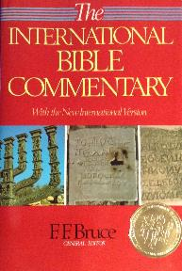
F. F. Bruce
“Revelation,” in International Bible Commentary, 1986, p. 1621.
“This title was written on her forehead: Mystery: ‘mystery’ indicates that the name she bears...is not to be understood literally, but allegorically: Babylon the Great is read, but ‘Rome’ is meant (cf. verses 9, 19).”

Slide 60
“MYSTERY” IN HARLOT’S TITLE? REV. 17:5
And on her forehead a name was written: MYSTERY, BABYLON THE GREAT, THE MOTHER OF HARLOTS AND OF THE ABOMINATIONS OF THE EARTH. (KJV, NIV)
… and upon her forehead a name was written, a mystery, “BABYLON THE GREAT, THE MOTHER OF HARLOTS AND OF THE ABOMINATIONS OF THE EARTH.” (NASB)

Slide 61
“Mystery” Defined
“In the N.T, it [mystērion] denotes, not the mysterious (as with the Eng. word), but that which, being outside the range of unassisted natural apprehension, can be made known only by Divine revelation, and is made known in a manner and at a time appointed by God, and to those who are illumined by His Spirit.”
W. E. Vine, Merrill F. Unger, and William White, Vine's Complete Expository Dictionary of the Old and New Testament Words (Nashville: Nelson, 1996), 424.

Slide 62
Colossians 1:26
“that is, the mystery which has been hidden from the past ages and generations, but has now been manifested to His.”

Slide 63
“We believe that the English translators have misled many by printing (on their own authority) the word ‘mystery’ in large capital letters, thus making it appear that this was a part of ‘the woman’s name. This we are assured is a mistake. That ‘mystery’ is connected with the ‘Woman’ herself and not with her ‘name’ is clear from v. 7, where the angel says unto John, ‘I will tell thee the mystery of the Woman, and of the beast which carrieth her.’”
Pink, The Antichrist, 262.

Slide 64
Revelation 17:3
“And he carried me away in the Spirit into a wilderness; and I saw a woman sitting on a scarlet beast, full of blasphemous names, having seven heads and ten horns.”

Slide 65
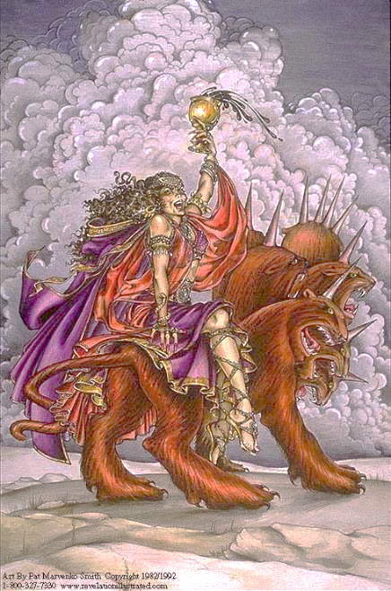

Slide 66
Seven Areas
Tower of Babel (Gen. 1–11)
Prophecies of Isaiah (13–14) & Jeremiah (50–51)
Prophecy of Zechariah (Zech. 5:5-11)
Kings of the East (Rev. 9:14; 16:12)
End-Time Harlot (Rev. 17–18)
Inadequate Theories
Current Events

Slide 67
Revelation 17:5
“and on her forehead a name was written, a mystery, “BABYLON THE GREAT, THE MOTHER OF HARLOTS AND OF THE ABOMINATIONS OF THE EARTH.”

Slide 68
Other Alternatives?
Religious system?
Jerusalem?
Rome?
Revived Rome?
Two Babylons?
Trans-temporal
Eclecticism

Slide 69
Other Alternatives?
Religious system?
Jerusalem?
Rome?
Revived Rome?
Two Babylons?
Trans-temporal
Eclecticism

Slide 70
Revelation 17:18
“The woman whom you saw is the great city, which reigns over the kings of the earth.

Slide 71
Revelation 18:10
“standing at a distance because of the fear of her torment, saying, ‘Woe, woe, the great city, Babylon, the strong city! For in one hour your judgment has come.’”

Slide 72
Bullinger The Apocalypse or “The Day of the Lord”, 509
“It is indeed surprising how any mistake could have been made in the identification of this woman. For the Holy Spirit first shows us her very name upon her forehead. Then, in verse 18, He tells us as plainly as words can tell anything, that ‘the woman which thou sawest is that great city, which reignest over the kings of the earth’, and chap. xvi. 19, as well as xvii. 5, identifies this city with Babylon. God says it is a ‘city.’ He does not say a system or a religion, but a ‘CITY.’”

Slide 73
Other Alternatives?
Religious system?
Jerusalem?
Rome?
Revived Rome?
Two Babylons?
Trans-temporal
Eclecticism

Slide 74
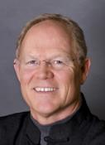
Hank Hanegraaff
The Apocalypse Code: Find out What the Bible Really Says About the End Times and Why It Matters (Nashville, TN: Nelson, 2007), 118, 19-20.
“What has puzzled me over the years is not the identity of “the great prostitute,” but how so many could mistake her historical identity...In biblical history only one nation is inextricably linked to the moniker “harlot.” And that nation is Israel! Anyone who has read the Bible even once has flashbacks to the graphic images of apostate Israel when they first encounter the great prostitute of Revelation. From the Pentateuch to the Prophets, the image is repeated endlessly. Perhaps the most gut-wrenching portrayal of Israel as prostitute is found in Hosea.”

Slide 75
Nahum 3:4
“All because of the many harlotries of the harlot, The charming one, the mistress of sorceries, Who sells nations by her harlotries And families by her sorceries.”

Slide 76
Isaiah 23:17
“It will come about at the end of seventy years that the Lord will visit Tyre. Then she will go back to her harlot’s wages and will play the harlot with all the kingdoms on the face of the earth.”

Slide 78
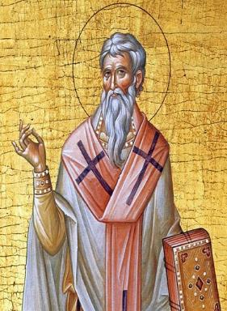
Late Date (A.D. 95) Irenaeus Against Heresies 5.30.3
“But if it had been necessary to announce his name plainly at the present time, it would have been spoken by him who saw the apocalypse. For it was not seen long ago, but almost in our own time, at the end of the reign of Domitian.”

Slide 79
Other Alternatives?
Religious system?
Jerusalem?
Rome?
Revived Rome?
Two Babylons?
Trans-temporal
Eclecticism

Slide 81
Revelation 17:9-10
“Here is the mind which has wisdom. The seven heads are seven mountains [oros] on which the woman sits, ¹⁰ and they are seven kings; five have fallen, one is, the other has not yet come; and when he comes, he must remain a little while.”

Slide 82
Daniel 2:37-38
You, O king, are the king of kings, to whom the God of heaven has given the kingdom, the power, the strength and the glory; ³⁸ and wherever the sons of men dwell, or the beasts of the field, or the birds of the sky, He has given them into your hand and has caused you to rule over them all. You are the head of gold.

Slide 83
Revelation 17:3
“And he carried me away in the Spirit into a wilderness; and I saw a woman sitting on a scarlet beast, full of blasphemous names, having seven heads and ten horns.”

Slide 85
1 Peter 5:13
“She who is in Babylon, chosen together with you, sends you greetings, and so does my son, Mark.”

Slide 86
1 Peter 1:1
“To those who reside as aliens, scattered throughout Pontus, Galatia, Cappadocia, Asia, and Bithynia, who are chosen.”

Slide 87
Galatians 2:7-8
“⁷ But on the contrary, seeing that I had been entrusted with the gospel to the uncircumcised, just as Peter had been to the circumcised ⁸ (for He who effectually worked for Peter in his apostleship to the circumcised effectually worked for me also to the Gentiles).”

Slide 89
Josephus Antiquities, 15.2.2
“But when Hyrcanus was brought into Parthia the king Phraates treated him after a very gentle manner, as having already learned of what an illustrious family he was; on which account he set him free from his bonds, and gave him a habitation at Babylon, where there were Jews in great numbers. These Jews honored Hyrcanus as their high priest and king, as did all the Jewish nation that dwelt as far as Euphrates; which respect was very much to his satisfaction...”

Slide 90
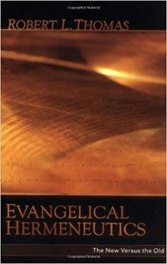
Robert Thomas
“Evangelical Hermeneutics,” .336.
“Another clear distinctive of literal interpretation is its avoidance of assumptions not justified in the text. Theories that 'Babylon' in Revelation chapters 14 and 16-18 is a code for Rome have been widespread.”

Slide 91
Martin Luther
"Against the Roman Papacy, an Institution of the Devil," in Luther's Works, ed. Eric. W. Gritsch (Philadelphia, PA: Fortress Press, 1966), 273-74.
“No man can believe what an abomination the papacy is. A Christian does not have to be of low intelligence, either, to recognize it. God himself must deride him in the hellish fire, and our Lord Jesus Christ, St. Paul says in II Thessalonians 2 [:8] will slay him with the breath of his mouth and destroy him by his glorious coming." I only deride, with my own weak derision, so that those who now live and those who will come after us should know what I have thought of the pope, the damned antichrist, and so that whoever wishes to be a Christian may be warned against such an abomination.”

Slide 92
John Calvin
Calvin, Institutes, IV, ii, 12.
…therefore is evident that we by no means deny that the churches under his tyranny remain churches. But these he has profaned by his sacrilegious impiety, afflicted by his inhuman domination, corrupted and well-nigh killed by his evil and deadly doctrines, which are like poisoned drinks. In them Christ lies hidden, half buried, the gospel overthrown, piety scattered, the worship of God nearly wiped out. In them, briefly, everything is so confused that there we see the face of Babylon rather than that of the Holy City of God.”

Slide 93
Other Alternatives?
Religious system?
Jerusalem?
Rome?
Revived Rome?
Two Babylons?
Trans-temporal
Eclecticism

Slide 94
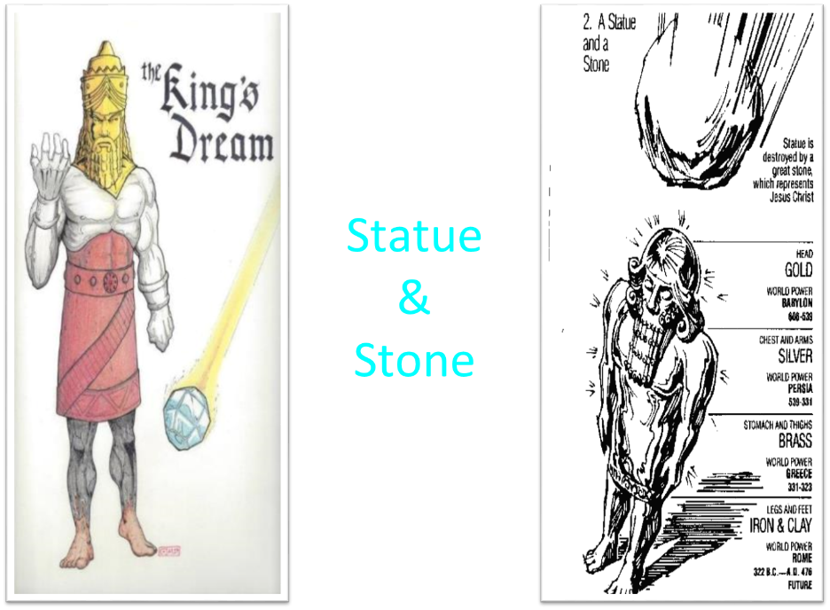

Slide 95
Revelation 17:3
“And he carried me away in the Spirit into a wilderness; and I saw a woman sitting on a scarlet beast, full of blasphemous names, having seven heads and ten horns.”

Slide 97
Other Alternatives?
Religious system?
Jerusalem?
Rome?
Revived Rome?
Two Babylons?
Trans-temporal
Eclecticism

Slide 98
John F. Walvoord The Revelation of Jesus Christ: A Commentary (Chicago: Moody, 1966), 267.
“Babylon, ecclesiastically symbolized by the woman in Revelation 17, proposes a common worship and a common religion through uniting in a world church. This is destroyed by the beast in Revelation 17:16 who thus fulfills the will of God (Rev. 17:17). Babylon, politically symbolized by the great city of Revelation 18, attempts to achieve its domination of the world by a world common market and a world government. These are destroyed by Christ at His second coming (Rev. 19:11–21).”

Slide 99
John F. Walvoord The Revelation of Jesus Christ: A Commentary (Chicago: Moody, 1966), 257, 263.
“The city here according to verse 5 is a mystery, not a literal city...The ultimate decision depends upon the judgment of the expositor, but in many respects it is simpler to postulate a rebuilt Babylon as fulfilling literally the Old Testament prophecies as well as that embodied in this chapter.”

Slide 100
Revelation 17:18
“The woman whom you saw is the great city, which reigns over the kings of the earth.

Slide 101
Revelation 18:10
“standing at a distance because of the fear of her torment, saying, ‘Woe, woe, the great city, Babylon, the strong city! For in one hour your judgment has come.’”

Slide 102
Bullinger The Apocalypse or “The Day of the Lord”, 509
“It is indeed surprising how any mistake could have been made in the identification of this woman. For the Holy Spirit first shows us her very name upon her forehead. Then, in verse 18, He tells us as plainly as words can tell anything, that ‘the woman which thou sawest is that great city, which reignest over the kings of the earth’, and chap. xvi. 19, as well as xvii. 5, identifies this city with Babylon. God says it is a ‘city.’ He does not say a system or a religion, but a ‘CITY.’”

Slide 103
Revelation 17:1
“Then one of the seven angels who had the seven bowls came and spoke with me, saying, “Come here, I will show you the judgment of the great harlot who sits on many waters.”

Slide 104
ONE BABYLON
 | Rev. 17 | Rev. 18
Same name | 17:5 | 18:2
City | 17:18 | 18:10
Same clothing | 17:4 | 18:16
Holding a cup | 17:4 | 18:6
Fornicating with Kings | 17:2 | 18:3
Drunk with wine of immorality | 17:2 | 18:3
Persecuting believers | 17:6 | 18:20, 24
Destroyed by fire | 17:16 | 18:8, 18
Destroyed by God | 17:17 | 18:5, 8
Dyer, "The Identity of Babylon in Revelation 17–18 (Part 1)," 311-13.

Slide 105
Two Babylons View
 | Ecclesiastical Babylon | Commercial Babylon
Chapter | Revelation 17 | Revelation 18
Literalness | Not literal | Literal
Time of Destruction | 1st half of Tribulation | Second Advent
Emphasis | Religion | Commercial & Political

Slide 106
Other Alternatives?
Religious system?
Jerusalem?
Rome?
Revived Rome?
Two Babylons?
Trans-temporal
Eclecticism

Slide 107
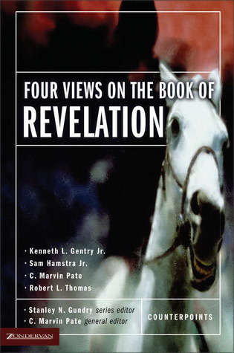
Sam Hamstra
Sam Hamstra, "An Idealist View of Revelation," in Four Views on the Book of Revelation, ed. C. Marvin Pate (Grand Rapids: Zondervan, 1998), 117.
“In the first century, Babylon was Rome. Two generations ago it was Berlin. Today, perhaps, it is Las Vegas or even a university campus. Babylon can be found everywhere throughout the history of the world. It is the center of anti-Christian seduction any time in history.”

Slide 108
Other Alternatives?
Religious system?
Jerusalem?
Rome?
Revived Rome?
Two Babylons?
Trans-temporal
Eclecticism

Slide 109
Robert Thomas
“Evangelical Hermeneutics,” .362.
“Blaising and Bock…interpret Babylon n Revelation 17‒18 as representing Rome and Rebuilt Babylon on the Euphrates, and in addition, in ‘the sweep of history’ it could represent any city since the world empire’s center is always shifting.”

Slide 110
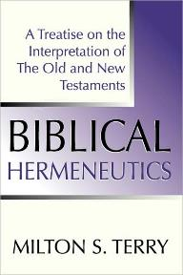
Milton Terry
Biblical Hermeneutics: A Treatise on the Interpretation of the Old and New Testaments (1885; reprint, Grand Rapids: Zondervan, 1947), 205.
Milton Terry explains: “A fundamental principle in grammatico-historical exposition is that the words and sentences can have but one significance in one and the same connection. The moment we neglect this principle we drift upon a sea of uncertainty and conjecture.”

Slide 111
Seven Areas
Tower of Babel (Gen. 1–11)
Prophecies of Isaiah (13–14) & Jeremiah (50–51)
Prophecy of Zechariah (Zech. 5:5-11)
Kings of the East (Rev. 9:14; 16:12)
End-Time Harlot (Rev. 17–18)
Inadequate Theories
Current Events

Slide 112
Early Babylon Interpreters
Govett (1813–1901) | Pink (1923)
Newton (1853) | Jennings (1937)
Newell (1935) | Pember (1941)
Bullinger (1909) | Cooper (1942)
Seiss (1909) | Lang (1948)
Larkin (1919) | Dyer (1979)
Ice, “Babylon in Bible Prophecy,” 5 . www.pre-trib.org.

Slide 113
Morris
The Revelation Record, 349
“Computer studies of the Institute for Creation Research have shown, for example, that Babylon is very near the geographical center of all the earth’s land masses. It is within navigable distances of the Persian Gulf and is at the crossroads of the three great continents of Europe, Asia and Africa. Thus there is no more ideal location anywhere for a world trade center, a world communication center, a world banking center, a world educational center, or especially, a world capital! The greatest historian of modern times, Arnold Toynbee, used to stress to all his readers and hearers that Babylon would be the best place in the world to build a future world cultural metropolis.”

Slide 114
June 2007 Conventional Oil Reserves
Rank | Country | Percentage of oil reserves
1 | Saudia Arabia | 21.9 %
2 | Iran | 11.4 %
3 | Iraq | 9.5 %
4 | Kuwait | 8.4 %
5 | United Arab Emirates | 8.1 %
6 | Venezuela | 6.6 %
7 | Russia | 6.6 %
8 | Libya | 3.4 %
David Jeremiah, What in the World is Going On, 207

Slide 115
Iraq Celebrates Naming Babylon a UNESCO World Heritage Site
QASSIM ABDUL-ZAHRA of Times of Israel - July 6, 2019
“BAGHDAD (AP) — Iraq on Friday celebrated the UNESCO World Heritage Committee’s decision to name the historic city of Babylon a World Heritage Site in a vote held in Azerbaijan’s capital, years after Baghdad began campaigning for the site to be added to the list…The 4,300-year-old Babylon — now mainly an archaeological ruin and two important museums — is where dynasties have risen and fallen since the earliest days of settled human civilization. King Hammurabi wrote his famous code of laws in Babylon, while Nebuchadnezzar sent his vast army from the city to Jerusalem to put down an uprising and bring the Jews back as slaves.”

Slide 116
“Want Middle East Stability? Move UN to Iraq”
“The idea of moving U.N. headquarters seems to resonate with many....Where should it go? Try Iraq…In order to maintain its fledgling democracy, Iraq needs international commitment, an inducement to stop factional violence, and a stable form of income not subject to the terrorists’ reprisals…New York is an expensive city, and representation at the U.N. is currently a costly endeavor…The remaining big spenders should have a positive effect on the Iraqi job market and improve the overall economy of the entire region, which might in turn reduce the tendency …”
Cynthia E. Ayers and David W. Cammons, “Want Middle East Stability? Move UN to Iraq,” Newsweek, April 9, 2007, posted at: Http://newsweek.washingtonpost.com/postglobal/needtoknow/2007/04/want_middle_east_stability_mov.html

Slide 117
How Could Babylon Be Built So Quickly?
Too literal & too small
Imminency?
Gap
Speed?
Chicago fire
Dubai
Neom, Saudi Arabia
Harbor?

Slide 118
How Could Babylon Be Built So Quickly?
Too literal & too small
Imminency?
Gap
Speed?
Chicago fire
Dubai
Neom, Saudi Arabia
Harbor?

Slide 119
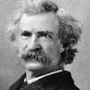
Mark Twain
The Innocents Abroad, Complete, 1st ed. (A Public Domain Book, 1869), 267, 285, 302. These quotes can be found in chapters 47, 49, 52.
“... A desolate country whose soil is rich enough, but is given over wholly to weeds… a silent mournful expanse…. a desolation is here that not even imagination can grace with the pomp of life and action…. we never saw a human being on the whole route…. there was hardly a tree or shrub anywhere. Even the olive tree and the cactus, those fast friends of a worthless soil, had almost deserted the country.”

Slide 120
Why?
COUNTRY | GROSS DOMESTIC PRODUCT
ISRAEL | $123 BILLION
Egypt | $81 billion
Syria | $26 billion
Lebanon | $21 billion
Jordan | $12 billion
Source: CIA World Fact Book, 2005

Slide 121
How Could Babylon Be Built So Quickly?
Too literal & too small
Imminency?
Gap
Speed?
Chicago fire
Dubai
Neom, Saudi Arabia
Harbor?

Slide 122
How Could Babylon Be Built So Quickly?
Too literal & too small
Imminency?
Gap
Speed?
Chicago fire
Dubai
Neom, Saudi Arabia
Harbor?

Slide 123
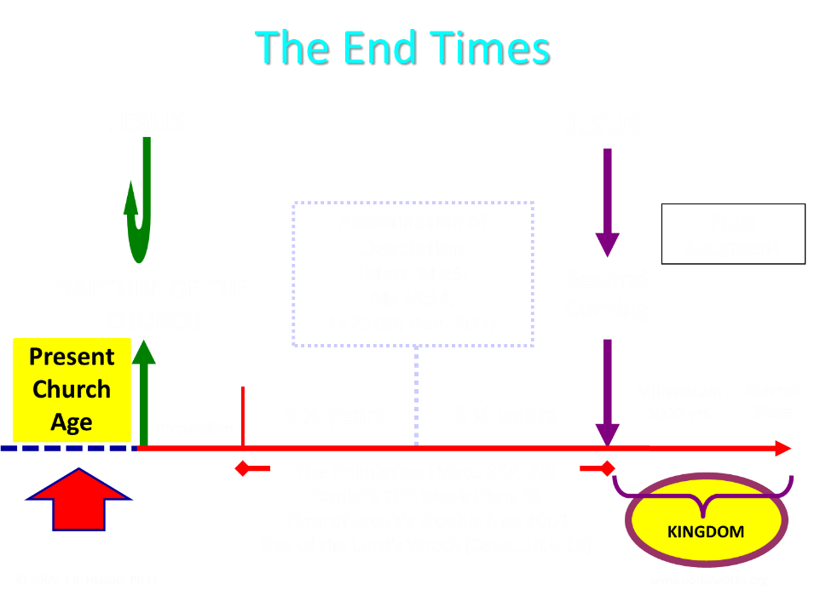

Slide 124
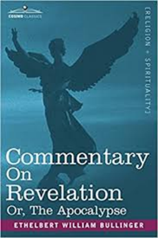
Bullinger (1909)
Commentary on Revelation, 577
“And Babylon, though fallen gradually, and very low, has never suffered such a destruction. There is only one conclusion, that in the interval of, say some 30 or more years between the removal of the church and the last "week "of Daniel's prophecy, it will be revived and exceed all its former magnificence.”

Slide 125
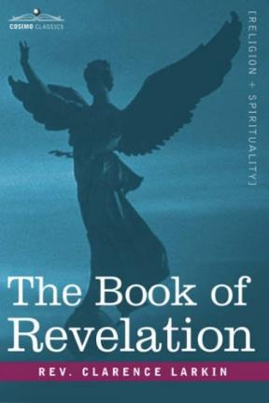
Larkin (1919)
The Book of Revelation, 162
“But I hear the protest, how can you say we be expecting Jesus to come at "any moment," if the city of Babylon must be rebuilt before He can come? There is not a word in Scripture that says that Jesus cannot come and take away His Church until Babylon is rebuilt. The Church may be taken out of the world 25 or even 50 years before that.”

Slide 126
How Could Babylon Be Built So Quickly?
Too literal & too small
Imminency?
Gap
Speed?
Chicago fire
Dubai
Neom, Saudi Arabia
Harbor?

Slide 127
How Could Babylon Be Built So Quickly?
Too literal & too small
Imminency?
Gap
Speed?
Chicago fire
Dubai
Neom, Saudi Arabia
Harbor?

Slide 128
Larkin (1919)
The Book of Revelation, 162
“The rapid growth of modern cities is one of the remarkable phenomena of the times. Since 1880 more than 500 cities have been built in America. Less than 100 years ago the site of the City of Chicago was but a swampy expanse at the mouth of the Chicago river. Now it has been transformed into a beautiful Metropolis, stretching 25 miles along the shore of Lake Michigan, with 5000 miles of streets, many of them beautiful boulevards 120 feet wide. In 1840 Chicago had only 4470 inhabitants, today the population is over 3,000,000. Once the Capitalists of the world are ready the revived City of Babylon will spring up in a few years.”

Slide 129
How Could Babylon Be Built So Quickly?
Too literal & too small
Imminency?
Gap
Speed?
Chicago fire
Dubai
Neom, Saudi Arabia
Harbor?

Slide 130
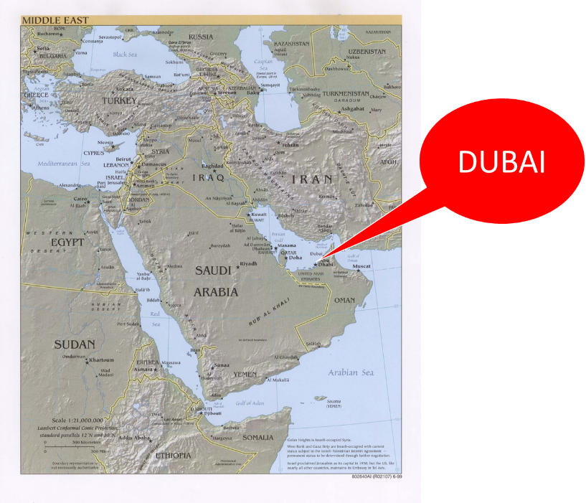

Slide 131
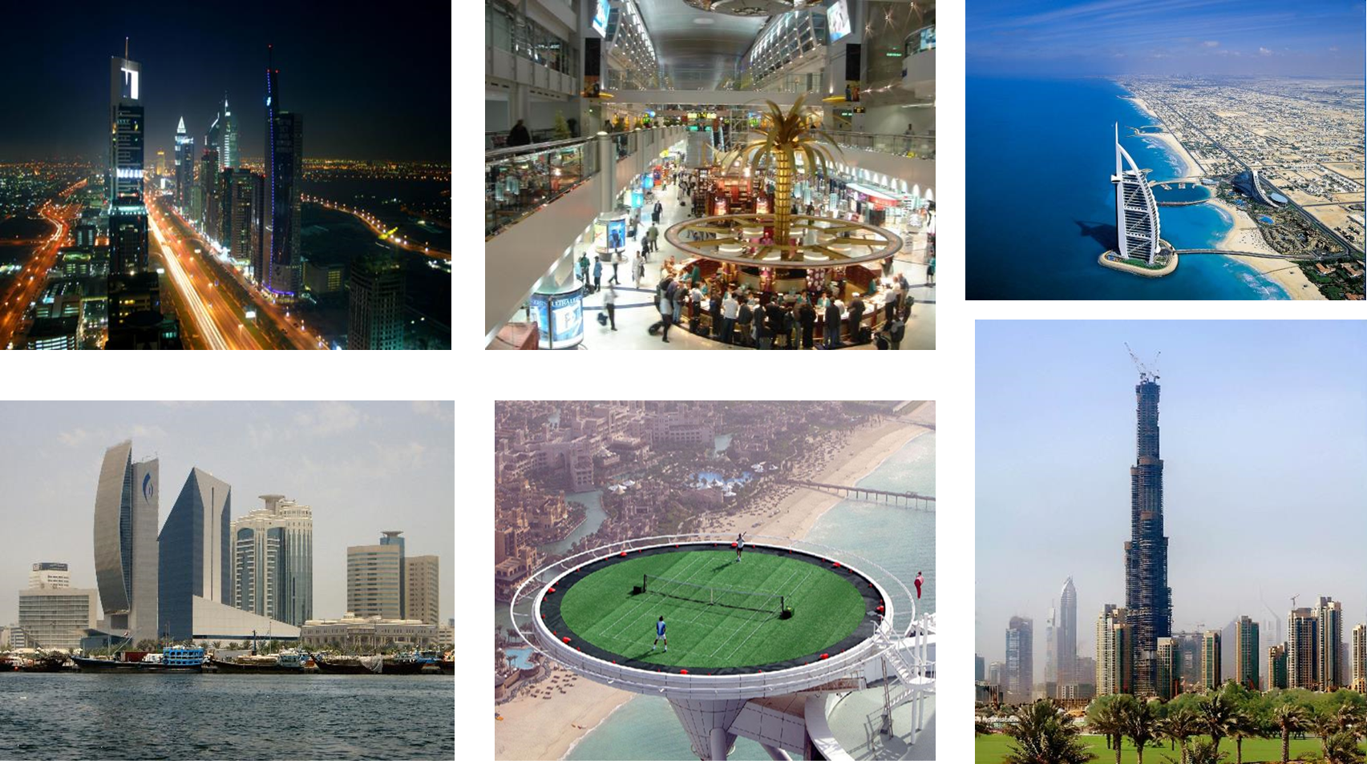

Slide 132
How Could Babylon Be Built So Quickly?
Too literal & too small
Imminency?
Gap
Speed?
Chicago fire
Dubai
Neom, Saudi Arabia
Harbor?

Slide 133
A Prince’s $500 Billion Desert Dream: Flying Cars, Robot Dinosaurs and a Giant Artificial Moon
“Saudi Arabia’s crown prince turned to U.S. consultants for help imagining a massive new city-state in a barren section of his kingdom. What emerged was a Jetsons-style world of automation. SHARMA, Saudi Arabia—This seaside corner of northwest Saudi Arabia is so barren that the only abundant resources a group of consultants could identify were sunlight and ‘unlimited access to salt water.’ But Saudi crown prince Mohammed bin Salman didn’t see a wasteland when he landed in his helicopter here a few years ago. He saw the future — and hatched a plan for a $500 billion city-state to cover 10,000 square miles of rocky desert and empty coastline to attract the ‘world’s greatest minds and best talents’ to the world’s best paying jobs in the world’s most livable city.”
Justin Scheck, Rory Jones, and Summer Sawww.wsj.comid, “A Prince’s $500 Billion Dollar Desert Dream,” online:, 25 July 2019.

Slide 134
How Could Babylon Be Built So Quickly?
Too literal & too small
Imminency?
Gap
Speed?
Chicago fire
Dubai
Neom, Saudi Arabia
Harbor?

Slide 135
Babylon Needs a Harbor?
“It was unacceptable to Saddam [Hussein] that a country as great as Iraq did not have a long coastline. Over and over he talked about the necessity of building a Navy and becoming a seafaring power. Iraq’s isolation from the sea was a cruel accident of history, he believed, and one that had to be rectified—a theme he continued to dwell on after his invasion of Kuwait.”
Elaine Sciolino, The Outlaw State: Saddam Hussein’s Quest for Power and the Gulf Crisis (New York: John Wiley & Sons, Inc., 1991), 191-192.

Slide 136
Babylon Needs a Harbor?
“Actually, the Tigris and Euphrates Rivers converge in southern Iraq and enter the Persian Gulf in Iraqi territory. The problem has been that Iran and Kuwait squeeze Iraq into a bottleneck at the mouth of the rivers and Iraq’s attempts to forge a harbor there have been thwarted by the hostile refusals of those two countries. But suppose international pressures were brought to bear upon Iran to allow Iraq access to the Shatt al-Arab waterway all the way to Basra and cooperation could be coerced from Kuwait to open up the area around its little island of Bubiyan and Warba.”
Dan Hayden, Iraq: In the Crosshairs of Destiny: What the Bible Says About the Future of Iraq (Altamonte Springs, FL: Advantage Books, 2008), 115.

Slide 137
Babylon Needs a Harbor?
“A commercial port and harbor for ships could become a reality for Babylon in a relatively short period of time. With modern dredging equipment, a deep channel waterway could be opened from the Persian Gulf all the way to Babylon. With its location on the Euphrates River, ships and sailors could indeed have access to this future queen of modern cities. The Antichrist ruler, with his political and economic power and global influence, could easily make that happen. So, as you can see, a harbor in Babylon is not at all out of the question.”
Dan Hayden, Iraq: In the Crosshairs of Destiny: What the Bible Says About the Future of Iraq (Altamonte Springs, FL: Advantage Books, 2008), 115.

Slide 138
Conclusion

Slide 139
Seven Areas
Tower of Babel (Gen. 1–11)
Prophecies of Isaiah (13–14) & Jeremiah (50–51)
Prophecy of Zechariah (Zech. 5:5-11)
Kings of the East (Rev. 9:14; 16:12)
End-Time Harlot (Rev. 17–18)
Inadequate Theories
Current Events

Slide 140
Ecclesiastes 1:9
“That which has been is that which will be, And that which has been done is that which will be done. So there is nothing new under the sun.”

