Slide 1
Notes:
2020 Word of the Year “PANDEMIC”
Many views of the pandemic.
Story about our time in Israel and getting back
“Armageddon was closed” Lockdown
Things are pretty bad when Armageddon is closed.

Slide 2
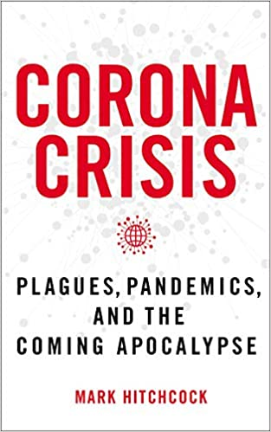
Poll of likely voters in the U.S.
44.3% believe the coronavirus and resulting economic meltdown is a “wake-up call for us to turn back to faith in God,” signs of “coming judgment,” or both.
29% believe the corona crisis suggests that “we are living in what the Bible calls the “last days.””

Slide 3
New York Times (4/2/20)
“For people of many faiths, and even none at all, it can feel lately like the end of the world is near. Not only is there a plague, but hundreds of billions of locusts are swarming East Africa. Wildfires have ravaged Australia, killing an untold number of animals. A recent earthquake in Utah even shook the Salt Lake Temple to the top of its iconic spire, causing the golden trumpet to fall from the angel Moroni’s right hand.”

Slide 4
Pale Rider
Birth Pains
Prophetic Significance

Slide 5
THE PALE RIDER
Notes:
“pestilence” thanato “Death” (often assoc with famine and the sword in Scripture)
1 Chron. 21:12)
“wild beasts of the earth” theerion 38x in Rev.
Wild animals will become ferocious, unrestrained
Plagues from animals
Military and political rulers (All other references are to the coming Antichrist or his henchman the false prophet)

Slide 6
Leviticus 26:22 “I will send wild animals against you, and they will rob you of your children, destroy your cattle and make you so few in number that your roads will be deserted.”
Deuteronomy 32:24 “I will send wasting famine against them, consuming pestilence and deadly plague; I will send against them the fangs of wild beasts, the venom of vipers that glide in the dust.”
Jeremiah 15:3 “I will send four kinds of destroyers against them," declares the LORD, “the sword to kill and the dogs to drag away and the birds and the wild animals to devour and destroy.”
Notes:
Seems implausible to me that wild animals will kill 25% of the earth
along with these other judgments.

Slide 7
Famine, pestilence, sword, and wild beasts are frequently linked together the OT.
“I will send famine and wild beasts against you, and they will leave you childless. Plague and bloodshed will sweep through you, and I will bring the sword against you. I the Lord have spoken (Ezek 5:17).”
Notes:
30 new infectious diseases in the last 30 years.
75% are zoonotic diseases (spillovers)

Slide 8
COVID-19 is not a fulfillment of Rev 6
The rapture has not occurred
The tribulation has not commenced (the rider on the white horse [Antichrist] has not emerged.

Slide 9
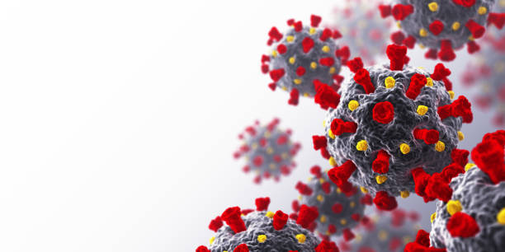
Plagues, Pestilence and Birth Pains
Matt 24:4-8
Luke 21:11
3 Main Signposts
- Heresy
- Rivalry
- Calamity
Notes:
Jesus’ blueprint of the end.
“pestilence” in Matt 24:7 in KJV, but not most
modern translations.

Slide 10
Al Mohler
“But Christians looking to this news and of course looking with concern also have to look, recognizing that we are hearing echoes of what we find in Scripture. For example, in the Gospel of Luke 21:11 where Jesus says, “There will be earthquakes and in various places, plagues and famines and there will be terrors and great signs from heaven.”

Slide 11
Todd Hampson
“I believe what we are witnessing with COVID-19 is part of the birth pains Jesus talked about in the Olivet Discourse. In fact, I think it is a major birth pain, as is the locust plague that is ravaging Africa and the Mideast; as is the large number of social uprisings in countries around the world; as is the increase in earthquake activity; as were the record-breaking Australian wild fires; as is . . . you get the picture. Birth pains increase in frequency and intensity and continue to do so until the moment of delivery.”
Notes:
Many view vv. 4-14 as unfolding during the current church age.
Same with EBOLA.

Slide 12
3 Reasons to Put the Birth Pains in the Tribulation
The Nature of Birth Pains [increase in frequency and
intensity].
2. Birth pains are associated with the tribulation or Day of
the Lord in Scripture (Jer 30:5-7; 1 Thess 5:1-3).
3. The correlation / parallels between Matt 24 and Rev 6.

Slide 14
Warren Wiersbe
“Matthew 24:1-44 indicates that our Lord was discussing events that will take place on earth during the time of Tribulation. . . . After the church has been suddenly taken out of the world, there will be a period of “peace and safety” (1Thes. 5:1-4) followed by a time of terrible suffering. Many Bible scholars believe this period will last seven years (Dan. 9:24-27). It is this period of “Tribulation” that Jesus described in the Olivet Discourse. At the end of that period, Jesus will return to the earth, defeat His foes, and establish the promised kingdom.”

Slide 15
John MacArthur
“It seems more sensible and more consistent, therefore, to take a futurist approach with respect to the Olivet Discourse . . . These are events that will immediately precede Christ’s coming to establish His kingdom, and therefore they are events that are yet future even today. That seems to be the sense conveyed in the passage itself (e.g., vv. 29-31), and it is the interpretation I believe the text demands.”

Slide 16
“That doesn’t mean the era we are living in is the one Christ describes. But it does underscore the imminency of Christ’s return for the church. The world in which we live is already ripe for the Tribulation. Elements like the birth-pang signs are already being seen and felt. The present afflictions may merely be like Braxton-Hicks contractions—premature labor pains—but they nonetheless signify that time for hard labor, and then delivery, is inevitable and swiftly drawing near.”

Slide 17
Prophetic Implications
of COVID
Notes:
Whatever the genesis of the virus, it has been seized upon
by the global elites and politicians to gain power.
Leveraged to re-shape society. Serving all kinds of agendas.

Slide 18
Notes:
Corona Virus points toward increased globalism.

Slide 19
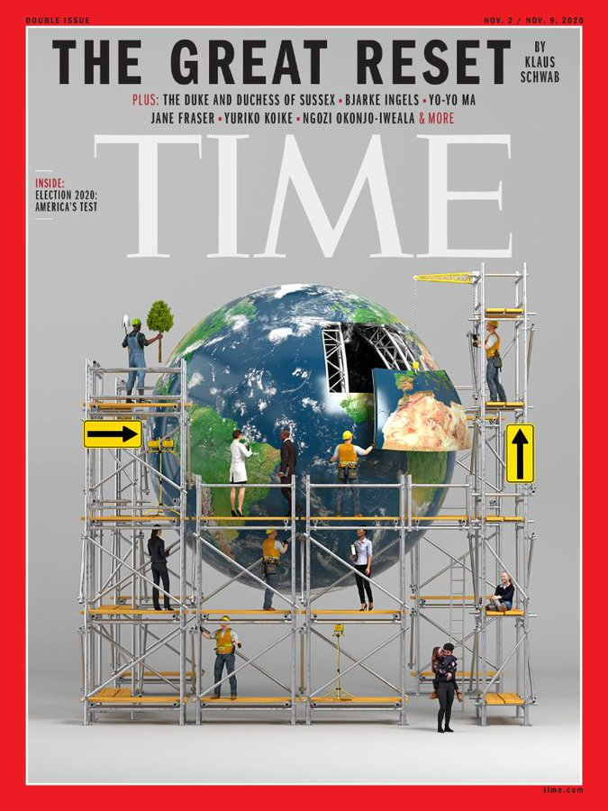

Slide 20
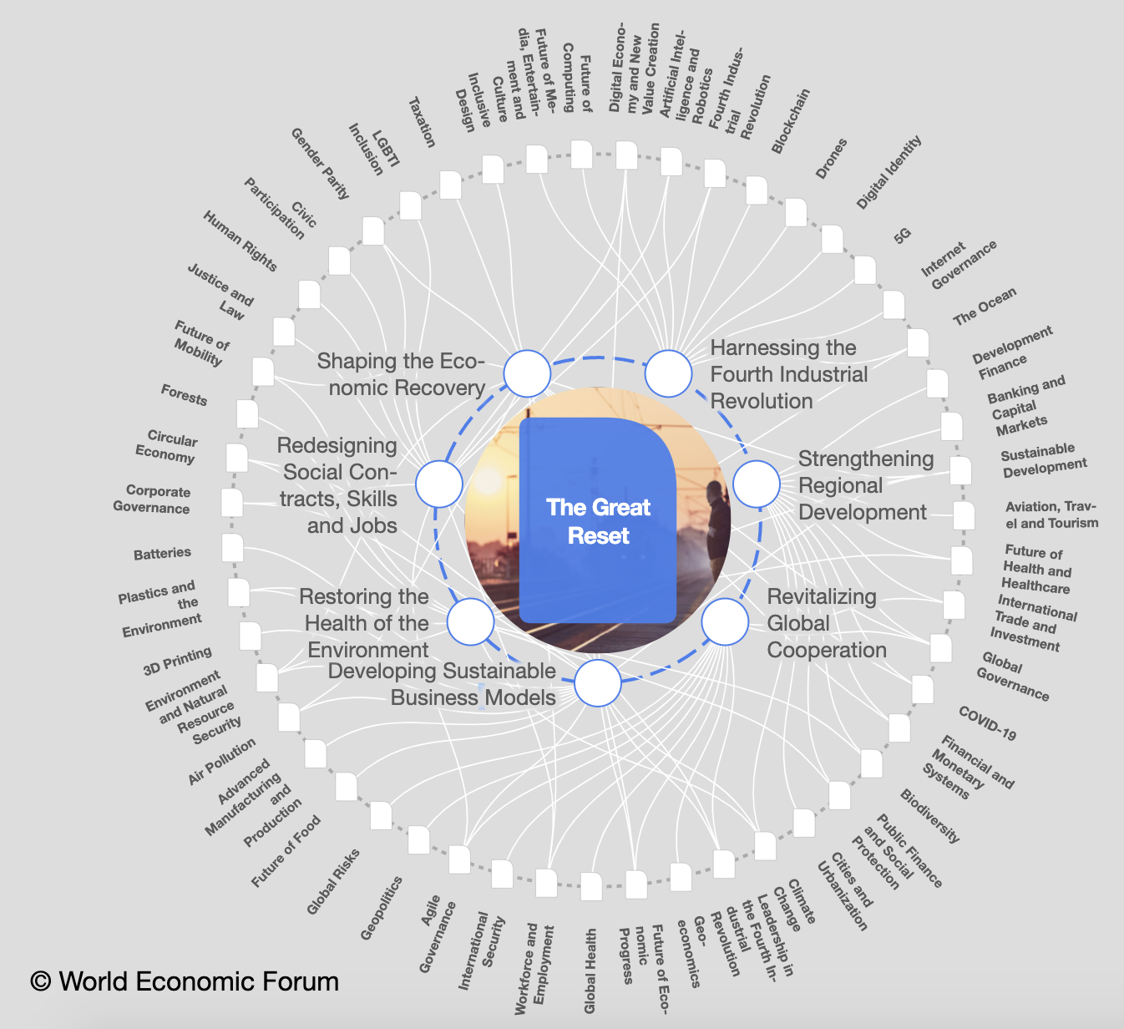

Slide 21
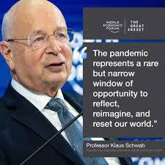

Slide 22
“To achieve a better outcome, the world must act jointly and swiftly to revamp all aspects of our societies and economies, from education to social contracts and working conditions.”

Slide 24
Dr. Anthony Fauci
Wants UN to ‘Rebuild the Infrastructures of Human Existence’

Slide 25
“What changes after covid-19? I’m betting on everything”
The Washington Post (Megan McArdie, 11/29/20)
“ The only thing I’m quite sure of is that 2022 won’t look quite like 2019 — or anything else that any one person can now imagine. . . . On closer inspection, the more I realize I don’t really know what “there” will look like. For all the talk of a “return to normal,” large chunks of the old normal are due for a post-covid-19 rethink.”

Slide 26
“The more I think about it, the more I think I’m talking about practically everything. . . . And how about the nonmedical things we could be doing to control infectious disease? Are we going to bring handshaking back, and if so, why? Should we accelerate the arrival of a cashless, touchless payment economy, despite the loss of privacy? . . . The only thing I’m quite sure of is that 2022 won’t look quite like 2019 — or anything else that any one person can now imagine.”

Slide 27
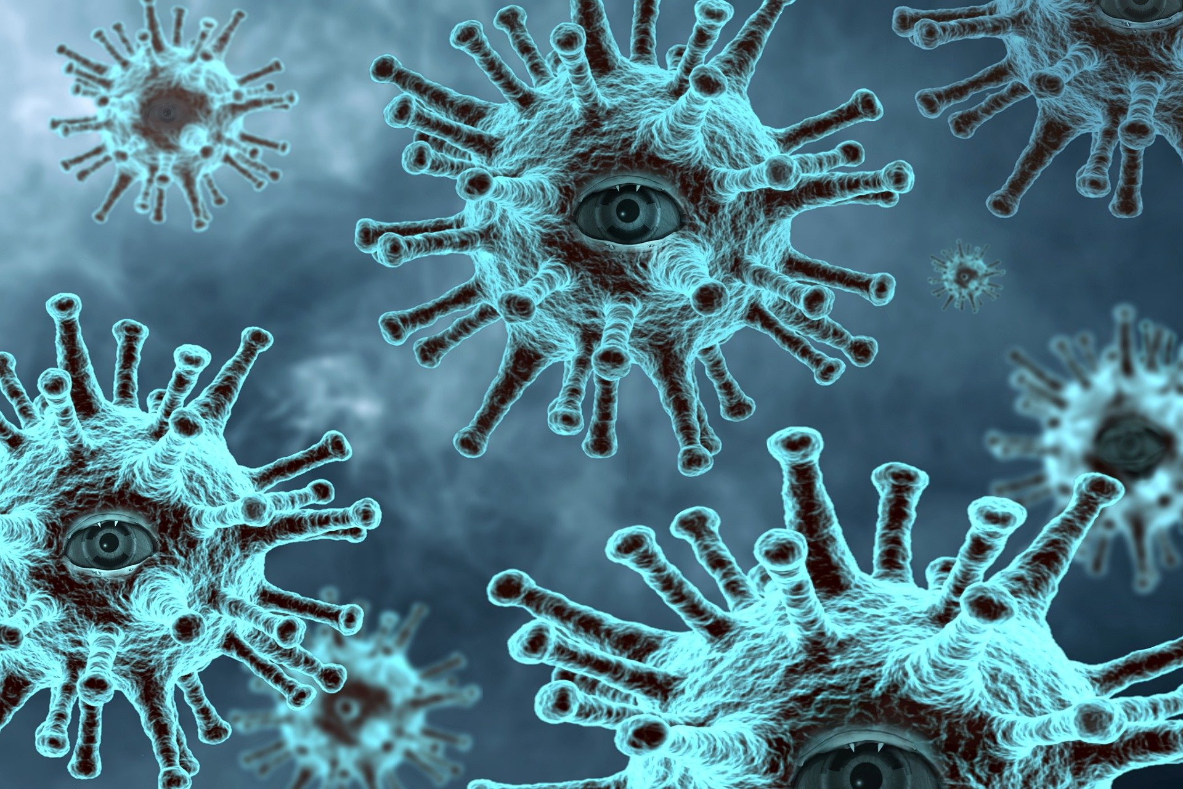

Slide 28
U.S. Supreme Court Justice Samuel Alito
"We have never before seen restrictions as severe, extensive and prolonged. [The pandemic] has resulted in "previously unimaginable restrictions on individual liberty.”
“[It’s an] “indisputable statement of fact that we have never before seen restrictions as severe, extensive and prolonged as those experienced for most of 2020.”
Notes:
Sounding the alarm.

Slide 29
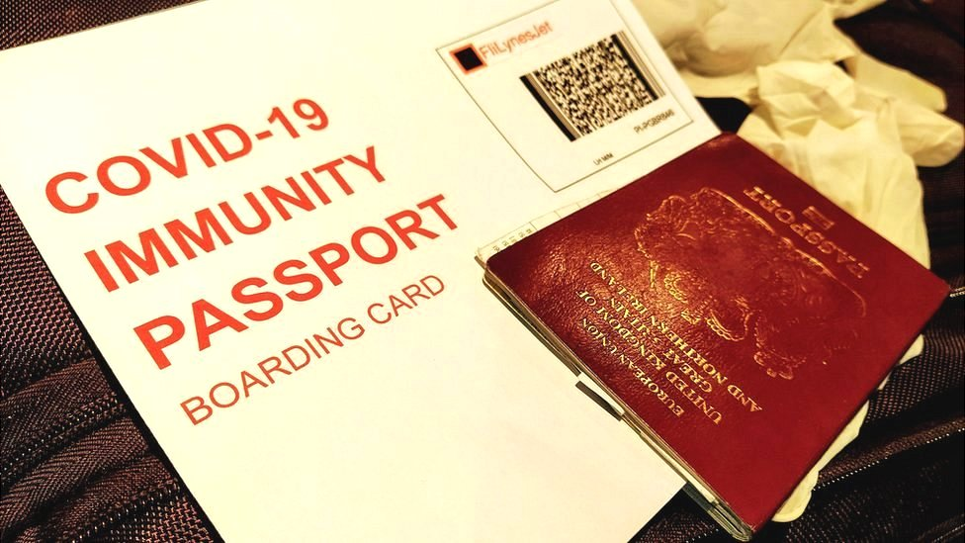

Slide 30
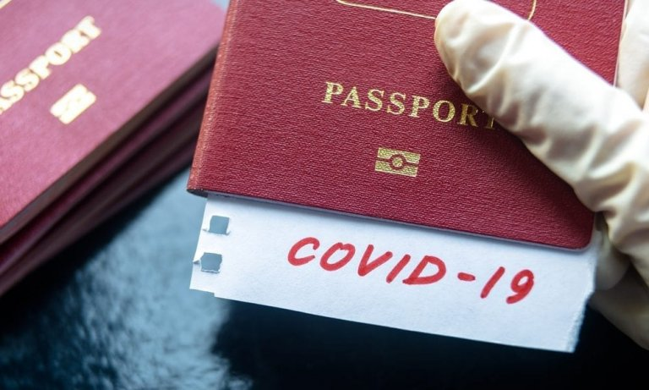

Slide 31
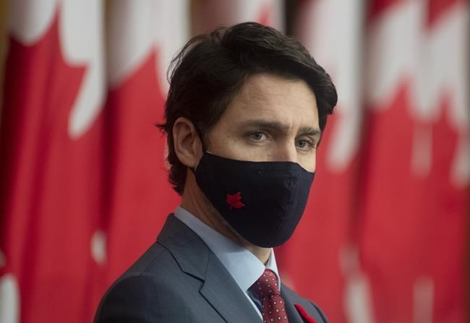
Canadian Prime Minister
Justin Trudeau
“This pandemic has provided an opportunity for a reset. This is our chance to accelerate our pre-pandemic efforts to reimagine economic systems that actually address global challenges like extreme poverty, inequality and climate change.”.”
Notes:
Pretext for more power
Increasing social controls
In keeping with the movement toward global govt., more govt. power, etc.

Slide 32
Conclusions
COVID-19 is a faint foreshadow of Rev 6 and the Pale Rider.
COVID-19 is not one of the birth pains Jesus predicted, but could be premature contractions.
COVID-19 is part of the stage-setting preparing the world for the rise of Antichrist and global government.
Notes:
Theme of our conference this year: “With our eye on the sky”
Elon Musk tweeted on May 22 SpaceX launched
a Falcon 9 rocket carrying the first US astronauts into space in 9 yrs.
Queen “Bohemian Rhapsody” “Open your eyes, look up to the skies.”
Let’s keep our eye on the sky—not as a form of escapism, but in expectation.
In hope, that the best is yet to come.
“Open your eyes look up to the sky”

