Slide 1
FALLEN
The Sons of God and the Nephilim Tim Chaffey, M.Div., Th.M.

Slide 3
And it came about, when mankind began to multiply on the face of the earth, and daughters were born to them, that the sons of God saw the daughters of men, that they were beautiful. And they took for themselves wives from any they chose.
Genesis 6:1–2

Slide 4
And Yahweh said, “My spirit will not remain with man indefinitely, in that he is flesh; his days will be one hundred twenty years.” The Nephilim were on the earth in those days—and also afterward—whenever the sons of God went in to the daughters of men, who bore to them children. They were the mighty men of antiquity, men of renown.
Genesis 6:3–4

Slide 5
Key Terms
Key terms and concepts
daughters of men
sons of God
took wives
Yahweh (YHWH)
120 years
Nephilim
mighty men
when or whenever

Slide 6
How do people usually interpret this passage?

Slide 7
The Sons of God: Three Major Views
Sethite
Descendants of Seth (sons of God) married female descendants of Cain (daughters of men)
Royalty
Wicked kings, tyrants, or judges who viewed themselves as divine (sons of God) took common women (daughters of men) as wives
Fallen Angel
Heavenly beings (sons of God) married women (daughters of men)
Some think these fallen angels possessed men who married women

Slide 8
The Sons of God: Three Minor Views
Cainite
Descendants of Cain (sons of God) married female descendants of Seth (daughters of men)
Liberal
The passage is borrowed from pagan mythology, likely a polemic with no historical reality
Demon-possessed men
The sons of God were fallen angels who possessed the men who married the daughters of men

Slide 9
Examining the Sethite View

Slide 10
Sethite View: Positive Arguments
Genesis 4 and 5 discuss the descendants of Cain and Seth.

Slide 11
Sethite View: Positive Arguments
We know some Sethites (Enoch and Noah) were godly and that some Cainites were ungodly (Cain and Lamech).

Slide 12
Sethite View: Positive Arguments
The dominant view in church history from 4th century until early 20th century.

Slide 13
Sethite View: Weaknesses
Inadequate explanations for other biblical passages
Numbers 13:33
1 Peter 3:18–20
2 Peter 2:4
Jude 6

Slide 14
Sethite View: Weaknesses
Why would the offspring be unique?

Slide 15
Sethite View: Weaknesses
Why would a common sin bring about such harsh judgment?

Slide 16
Sethite View: Weaknesses
Why would godly men continually marry ungodly women?

Slide 17
Sethite View: Weaknesses
Where does the Bible ever tell us that Cain’s line was ungodly and that Noah’s line were godly?

Slide 18
Sethite View: Weaknesses
Ungodly Cainites?
Cain
Enoch
Irad
Mehujael – “smitten by God”?
Methushael – “man of God”?
Lamech

Slide 19
And as for Seth, to him also a son was born; and he named him Enosh. Then men began to call on the name of Yahweh.
Genesis 4:26, NKJV

Slide 20
Sethite View: Weaknesses
Does “sons” of God imply godliness?

Slide 21
Now the sons of the prophets who were at Bethel came out to Elisha, and said to him, “Do you know that the Lord will take away your master from over you today?”
2 Kings 2:3, NKJV
Notes:
bene ha neviim

Slide 22
Sethite View: Weaknesses
Not found in the text

Slide 23
And it came about, when mankind began to multiply on the face of the earth, and daughters were born to them,
Genesis 6:1

Slide 24
that the sons of God saw the daughters of men, that they were beautiful. And they took for themselves wives from any they chose.
Genesis 6:2

Slide 25
And Yahweh said, “My spirit will not remain with man indefinitely, in that he is flesh; his days will be one hundred twenty years.”
Genesis 6:3

Slide 26
The Nephilim were on the earth in those days—and also afterward—whenever the sons of God went in to the daughters of men, who bore to them children. They were the mighty men of antiquity, men of renown.
Genesis 6:4

Slide 27
Then Yahweh saw that the wickedness of man was great in the earth, and that every intent of the thoughts of his heart was only evil continually.
Genesis 6:5, NKJV

Slide 28
Sethite View: Weaknesses
No explanation for post-Flood Nephilim

Slide 29
Examining the Royalty View

Slide 30
Royalty View: Positive Arguments
Some kings in ANE thought of themselves as divine
Pharaoh considered a god

Slide 31
Royalty View: Positive Arguments
Offspring could be known as “men of renown”

Slide 32
Royalty View: Positive Arguments
Nimrod was a king and was called a gibbor (Genesis 10:8–10)

Slide 33
Royalty View: Positive Arguments
’elohim is translated as “judges” in Exodus a handful of verses

Slide 34
Royalty View: Weaknesses
Overestimating the “divine” view of kings in the Ancient Near East

Slide 35
Royalty View: Weaknesses
No specific mention of kings, judges, etc., in Gen. 1–6

Slide 36
Royalty View: Weaknesses
“Took wives” is an idiom for marriage—not force
Abram & Sarai
Abraham & Keturah
Isaac & Rebekah

Slide 37
Royalty View: Weaknesses
Not developed until allegorical hermeneutic became popular among Jewish interpreters

Slide 38
Royalty View: Weaknesses
’elohim is better understood as a term for an inhabitant of the spiritual realm
God
Members of the divine council
Angels
False gods / demons
Departed spirit of Samuel with Saul and medium (1 Sam. 28)

Slide 39
’elohim in the Bible
God – over 90% of the time

Slide 40
“In the beginning God [’elohim] created the heavens and the earth.”
Genesis 1:1

Slide 41
’elohim in the Bible
Members of the divine council
Angelic beings
Sons of the Most High

Slide 42
God [’elohim] has taken his place in the divine council [‘adat ’el]; in the midst of the gods [’elohim] he holds judgment:
Psalm 82:1, ESV

Slide 43
’elohim in the Bible
It can refer to angels

Slide 44
“For You have made him a little lower than the angels [’elohim], and You have crowned him with glory and honor.”
Psalm 8:5, NKJV

Slide 45
’elohim in the Bible
It can refer to demons

Slide 46
“They sacrificed to demons, not to God, to gods [’elohim] they did not know, to new gods, new arrivals that your fathers did not fear.”
Deuteronomy 32:17, NJKV

Slide 47
“They sacrificed to demons that were no gods, to gods [’elohim] they had never known, to new that had come recently, whom your fathers had never feared.”
Deuteronomy 32:17, ESV

Slide 48
’elohim in the Bible
It can refer to the departed spirit of a person

Slide 49
“And the king said to her, ‘Do not be afraid. What did you see?’ And the woman said to Saul, ‘I saw a spirit [’elohim] ascending out of the earth.’”
1 Samuel 28:13

Slide 50
Royalty View: Weaknesses
’elohim is better understood as a term for an inhabitant of the spiritual realm
God
Members of the divine council
Angels
False gods / demons
Departed spirit of Samuel with Saul and medium (1 Sam. 28)

Slide 51
Are There Other Gods Besides Yahweh?

Slide 52
“You shall have no other gods [’elohim] before Me.”
Exodus 20:3, NKJV
Notes:
He isn’t saying, “Don’t have any imaginary things before Me.”

Slide 53
What am I saying then? That an idol is anything, or what is offered to idols is anything? Rather, that the things which the Gentiles sacrifice they sacrifice to demons and not to God, and I do not want you to have fellowship with demons.
1 Corinthians 10:19–20, NJKV

Slide 54
And God spoke to Moses and said to him: “I am Yahweh. I appeared to Abraham, to Isaac, and to Jacob, as God Almighty, but by My name Yahweh I was not known to them.
Exodus 6:2–3, NJKV

Slide 55
“For Yahweh is a great God, a great King above all gods [’elohim].”
Psalm 95:3, NJKV

Slide 56
Yahweh, who is like You among the gods [’elohim]? Who is like You, majestic in holiness, revered with praises, performing wonders?
2 Chronicles 2:5, NJKV

Slide 57
For we do not wrestle against flesh and blood, but against principalities, against powers, against the rulers of the darkness of this age, against spiritual hosts of wickedness in the heavenly places.
Ephesians 6:12, NJKV

Slide 58
The Divine Council

Slide 59
God [’elohim] has taken his place in the divine council [‘adat ’el]; in the midst of the gods [’elohim] he holds judgment:
Psalm 82:1, ESV

Slide 60
“How long will you judge unjustly and show partiality to the wicked?”
Psalm 82:2, ESV

Slide 61
“Give justice to the weak and the fatherless; maintain the right of the afflicted and the destitute.
Rescue the weak and the needy; deliver them from the hand of the wicked.”
Psalm 82:3–4, ESV

Slide 62
“They have neither knowledge nor understanding, they walk about in darkness; all the foundations of the earth are shaken.”
Psalm 82:5, ESV

Slide 63
“I said, ‘You are gods [’elohim], sons of the Most High, all of you;
nevertheless, like men you shall die, and fall like any prince.’”
Psalm 82:6–7, ESV

Slide 64
“I and My Father are one.” Then the Jews took up stones again to stone Him.
John 10:30–31, NKJV

Slide 65
Jesus answered them, “Is it not written in your Law, ‘I said, you are gods’?
John 10:34, ESV

Slide 66
If he called them gods to whom the word of God came—and Scripture cannot be broken— do you say of him whom the Father consecrated and sent into the world, ‘You are blaspheming,’ because I said, ‘I am the Son of God’?”
John 10:35, ESV

Slide 67
“Arise, O God [’elohim], judge the earth;
for you shall inherit all the nations!”
Psalm 82:8, ESV

Slide 68
God Will Inherit All Nations

Slide 69
“Remember the days of old, consider the years of many generations; ask your father, and he will show you, your elders, and they will tell you.
Deuteronomy 32:7

Slide 70
When the Most High gave the nations their inheritance, when he divided mankind, he fixed the borders of the peoples according to the number of the sons of God [bene ’elohim].* *Masoretic Text has “sons of Israel [bene yisrael].
Deuteronomy 32:8, ESV

Slide 71
But Yahweh’s portion is his people, Jacob his allotted heritage.
Deuteronomy 32:9, ESV

Slide 72
bene ’elohim or bene yisrael?
Masoretic (Leningrad Codex)
“sons of Israel” (bene yisrael)
Dead Sea Scrolls
4QDeut^{j} has bene ’elohim
4QDeut^{q} has bene ’el___
Septuagint (c. 3rd cent. BC)
“angels of God” (aggelōn theou)

Slide 73
Rebellion at Babel
“Let us go down there and confuse their language.” (Gen. 11:7)

Slide 74
Rebellion at Babel
God disinherits the nations
The pagan gods are allotted to the nations. (Deut. 32:8, cf. 4:19; 29:26)

Slide 75
Rebellion at Babel
Yahweh gets Israel, the nation He will found with one man beginning in the Bible’s next chapter.

Slide 76
Not Polytheism
Polytheism generally places all the gods at roughly the same class
Henotheism is like polytheism, but only one of the gods is worshiped

Slide 77
Not Polytheism
The Bible teaches:
Many ’elohim (gods), but there is only one Yahweh
Yahweh is an ’elohim but no other ’elohim is Yahweh.
Only Yahweh is eternal, omniscient, omnipotent, etc.

Slide 78
Examples of the Divine Council in the Bible

Slide 79
Micaiah and the Divine Council

Slide 80
Then Micaiah said, “Therefore hear the word of Yahweh: I saw Yahweh sitting on His throne, and all the host of heaven standing by, on His right hand and on His left. And Yahweh said, ‘Who will persuade Ahab to go up, that he may fall at Ramoth Gilead?’ So one spoke in this manner, and another spoke in that manner.
1 Kings 22:19–20, NKJV

Slide 81
Then a spirit came forward and stood before the Lord and said, ‘I will persuade him.’ Yahweh said to him, ‘In what way?’ So he said, ‘I will go out and be a lying spirit in the mouth of all his prophets.’ And Yahweh said, ‘You shall persuade him, and also prevail. Go out and do so.’”
1 Kings 22:21–22, NKJV

Slide 82
The Divine Council in Isaiah

Slide 83
In the year that King Uzziah died I saw the Lord sitting upon a throne, high and lifted up; and the train of his robe filled the temple...And I heard the voice of the Lord saying, “Whom shall I send, and who will go for us?” Then I said, “Here I am! Send me.”
Isaiah 6:1, 8, ESV

Slide 84
“The sentence is by the decree of the watchers, the decision by the word of the holy ones, to the end that the living may know that the Most High rules the kingdom of men and gives it to whom he will and sets over it the lowliest of men.” “It is a decree of the Most High, which has come upon my lord the king…”
Daniel 4:17, 24, ESV

Slide 85
The Divine Council in Psalms

Slide 86
Let the heavens praise your wonders, O Yahweh, your faithfulness in the assembly of the holy ones! For who in the skies can be compared to Yahweh? Who among the heavenly beings [bene ’elim] is like Yahweh,
Psalm 89:5–6, ESV

Slide 87
a God greatly to be feared in the council of the holy ones, and awesome above all who are around him? O Yahweh God of hosts, who is mighty as you are, O Yahweh, with your faithfulness all around you?
Psalm 89:7–8, ESV

Slide 88
No other ’elohim besides God?

Slide 89
Thus says Yahweh, the King of Israel and his Redeemer, Yahweh of hosts: “I am the first and I am the last; besides me there is no god [’elohim].”
Isaiah 44:6, ESV

Slide 90
Declare and present your case; let them take counsel together! Who told this long ago? Who declared it of old? Was it not I, Yahweh? And there is no other god [’elohim] besides me,
Isaiah 45:21, ESV

Slide 91
“See now the I, even I, am he, and there is no god [’elohim] beside me; I kill and I make alive; I wound and I heal; and there is none that can deliver out of my hand.”
Deuteronomy 32:39, ESV

Slide 92
Incomparability not Contradiction
The Bible uses the language of incomparability
Compared to Yahweh, these other ’elohim are nothing.
Same type of language used about people and nations

Slide 93
. . . for his dominion is an everlasting dominion, and his kingdom endures from generation to generation; all the inhabitants of the earth are accounted as nothing, and he does according to his will among the host of heaven and among the inhabitants of the earth;
Daniel 4:34–35, ESV

Slide 94
All the nations are as nothing before him, they are accounted by him as less than nothing and emptiness.
Isaiah 40:17, ESV

Slide 95
“Hear, O Israel: Yahweh our God, Yahweh is one. You shall love Yahweh your God with all your heart, with all your soul, and with all your strength.”
Deuteronomy 6:4

Slide 96
Babel and the Table of Nations
Japheth 14
Ham 30
Shem 26
Total = 70 people groups depart from Babel

Slide 97
Ugarit and Canaan
Ugarit
Language very similar to Hebrew
El had 70 sons (bn ’il) or gods
Congregation of the stars
Canaan
Baal held council over the gods
El was his son and equal

Slide 98
“How you are fallen from heaven, O Day Star, son of Dawn! How you are cut down to the ground, you who laid the nations low! You said in your heart, ‘I will ascend to heaven; above the stars of God I will set my throne on high; I will sit on the mount of assembly in the far reaches of the north (tzaphon);”
Isaiah 14:12–13

Slide 99
Mountains of the Gods
Olympus
Zeus—Greeks
Hermon (Sirion, Senir)
Deuteronomy 3:9
El of the Ugaritic people
Tzaphon (Zaphon)
Baal of the Canaanites
See Isaiah 14:12–13

Slide 100
Examining the Fallen Angel View

Slide 101
Fallen Angel View: Positive Arguments
Genesis 4 and 5 discuss the descendants of Cain and Seth.

Slide 102
Fallen Angel View: Positive Arguments
Bene ’elohim (“sons of God”) refers to angelic beings

Slide 103
“When the morning stars sang together,
and all the sons of God [bene ’elohim] shouted for joy.”
Job 38:7

Slide 104
Now there was a day when the sons of God [bene ha’elohim] came to present themselves before the Lord, and Satan also came among them.
Job 1:6

Slide 105
Again there was a day when the sons of God [bene ha’elohim] came to present themselves before the Lord, and Satan also came among them to present himself before the Lord.
Job 2:1

Slide 106
“When the Most High gave the nations their inheritance, when he divided mankind, he fixed the borders of the peoples according to the number of the sons of God [bene ’elohim].”
Deuteronomy 32:8, ESV

Slide 107
Fallen Angel View: Positive Arguments
Bene ’elohim (“sons of God”) refers to angelic beings
Aramaic equivalent does too

Slide 108
“But I see four men unbound, walking in the midst of the fire, and they are not hurt; and the appearance of the fourth is like a son of the gods [bar elahin]…Blessed be the God of Shadrach, Meshach, and Abednego, who has sent his angel and delivered his servants…’”
Daniel 3:25,28, ESV

Slide 109
Fallen Angel View: Positive Arguments
Bene ’elohim (“sons of God”) refers to angelic beings
Aramaic equivalent does too
Similar terms also refer to angels

Slide 110
Let the heavens praise your wonders, O Lord, your faithfulness in the assembly of the holy ones! For who in the skies can be compared to the Lord? Who among the heavenly beings [bene elim] is like the Lord, a God greatly feared in the council of the holy ones, and awesome above all those who are around Him?
Psalm 89:5–7

Slide 111
Ascribe to Lord, O heavenly beings [bene elim] ,
ascribe to the Lord glory and strength.
Ascribe to the Lord the glory due his name;
worship the Lord in the splendor of holiness.
Psalm 29:1–2

Slide 112
Fallen Angel View: Positive Arguments
New Testament passages seem to confirm this view

Slide 113
“For Christ died also for sins once for all, the just for the unjust, so that He might bring us to God, having been put to death in the flesh, but made alive in the spirit; in which also He went and made proclamation to the spirits now in prison, who once were disobedient, when the patience of God kept waiting in the days of Noah…”
1 Peter 3:18–20

Slide 114
For if God did not spare angels when they sinned, but cast them to hell (tartarosas) and committed them to pits of darkness, reserved for judgment; and did not spare the ancient world, but preserved Noah, a preacher of righteousness, with seven others, when He brought a flood upon the world of the ungodly.
2 Peter 2:4–5

Slide 115
“Now I desire to remind you…that the Lord, after saving a people out of the land of Egypt, subsequently destroyed those who did not believe. And the angels who did not keep their own domain, but abandoned their proper abode, He has kept in eternal bonds under darkness for the judgment of the great day.”
Jude 5–6

Slide 116
“Now Enoch, the seventh from Adam, prophesied about these men also, saying, “Behold the Lord comes with ten thousands of His saints, to execute judgment on all...”
Jude 14–15

Slide 117
Fallen Angel View: Positive Arguments
Earliest Jewish view
Septuagint (c. 3rd cent. BC)
1 Enoch
Book of Jubilees
Genesis Apocryphon
Damascus Document
2 Baruch
Judith
Testament of Reuben
Testament of Naphtali

Slide 118
Fallen Angel View: Positive Arguments
Earliest Christian view
(c. 150) Justin Martyr 1 Apology 5
(c. 200) Irenaeus of Lyons Heresies 16.2
(2nd cent) Athenagoras A Plea for the Christians, 24

Slide 119
Fallen Angel View: Positive Arguments
Earliest Christian view
(c. 200) Clement of Alexandria Miscellanies 5.1.10
(c. 200) Tertullian Idolatry 9; Veiling 7
(c. 220) Pseudo-Clementine Recognitions, I.29

Slide 120
Fallen Angel View: Positive Arguments
Earliest Christian view
(c. 250) Commodianus Instructions, #3
(c. 300) Lactantius Divine Institutes, 2.15
(c. 325) Eusebius of Caesarea Preparation, 5.5

Slide 121
Fallen Angel View: Positive Arguments
Consistent hermeneutic
Explains severe judgements
Flood
Reduced Lifespan
Explains origin of Nephilim

Slide 122
Addressing Objections to the Fallen Angel View

Slide 123
Can Angels Take Human Form?
Old Testament examples
Gabriel to Daniel (Daniel 9)
Two angels to Abraham and Lot (Genesis 18)
New Testament examples
Angels at the tomb (Matthew 28)
Entertaining angels unaware (Hebrews 13:2)

Slide 124
Angels Are Not Formless
Angels are localized
Not omnipresent
A spiritual body
They are frequently described in Scripture
Not invisible, bodiless beings

Slide 125
Are Angels Capable of Procreating with Humans?

Slide 126
Can Angels Procreate?
Angels perform human acts
Ate and drank with Abram
Grabbed Lot by the hand
What about fallen angels?
Did Satan manifest during temptations of Jesus?
Are demonic “plagues” of Revelation 9 physical?
They might even create…
Notes:
The fifth trumpet - 7 The shape of the locusts was like horses prepared for battle. On their heads were crowns of something like gold, and their faces were like the faces of men. 8 They had hair like women’s hair, and their teeth were like lions’ teeth. 9 And they had breastplates like breastplates of iron, and the sound of their wings was like the sound of chariots with many horses running into battle. 10 They had tails like scorpions, and there were stings in their tails. Their power was to hurt men five months.

Slide 127
“Aaron cast down his staff before Pharaoh and his servants, and it became a serpent. Then Pharaoh summoned the wise men and the sorcerers, and they, the magicians of Egypt, also did the same by their secret arts. For each man cast down his staff, and they became serpents.”
Exodus 7:10–12

Slide 128
Does this Violate the Principle that Kind Brings Forth After its Kind?

Slide 129
Violation of Kinds?
Genesis doesn’t say this about humans
The issue is whether angels took on human form
The offspring were men
Are angels made in the image of God?

Slide 130
Would God really allow such evil and disgusting actions?

Slide 131
God Would Never Allow It?
The Yuck Factor
False idea of what it was like
Hypocritical for those who aren’t disgusted by Thor and Jane, etc.
God allows all sorts of evil
Rape, murder, incest, etc.

Slide 132
Would the Bible Really Call this Marriage?

Slide 133
Marriage?
Not Ideal
Polygamy is called “marriage”
Non-ideal can still be marriage
True worship and false worship
It is still called worship

Slide 134
Why Would the Bible Call Ungodly Beings Sons of God?

Slide 135
Ungodly Sons of God?
Christians are sons of God
Yet we still sin
“Sons of” refers to a class
Sons of God may not refer to all angelic beings but just a special class of them

Slide 136
Did Jesus Say that Angels Cannot Marry?

Slide 137
“For in the resurrection they neither marry nor are given in marriage, but are like the angels of God in heaven.”
Matthew 22:30

Slide 138
Can Angels Marry?
Jesus spoke about the angels in heaven
He did not address those that left heaven
He said godly angels “do not” marry
He did not say whether they were capable

Slide 139
“For when they rise from the dead, they neither marry nor are given in marriage, but are like angels in heaven.”
Mark 12:25

Slide 140
Can Angels Marry?
In Luke’s version Jesus may have endorsed the Fallen Angel view
He connected angels with sons of God

Slide 141
Jesus answered and said to them, “The sons of this age marry and are given in marriage. But those who are counted worthy to attain that age, and the resurrection from the dead, neither marry nor are given in marriage; nor can they die anymore, for they are equal to the angels and are sons of God, being sons of the resurrection.”
Luke 20:34–36

Slide 142
Was Fallen Angel View Borrowed from Pagan Mythology?

Slide 143
Genesis 1–11 in Pagan Cultures?
Creation accounts
Fall accounts
Flood accounts
Babel accounts
Gods and demigods

Slide 144
Borrowing from Pagans?
Allegorical hermeneutic arose among Greek philosophers to “save” the stories of their gods
The gods and their actions were reinterpreted to stand for something else
Notes:
Greeks were embarrassed by the stories of their gods, but they still revered Homer’s tales. So they reinterpreted it. The church did the same thing with Israel beginning in the middle of the second century, and many believers do it today with the creation account.

Slide 145
Borrowing from Pagans?
The Sethite and Royalty views were developed after the rise of the allegorical hermeneutic

Slide 146
Why Would the Fallen Angels Do This?

Slide 147
Why Would Angels Do This?
They saw women were beautiful and longed for them
Perhaps an attempt to taint the Messianic bloodline
Perhaps an attempt to attain immortality

Slide 148
120 Years: Three Views
Countdown
A popular idea that God gave man a 120-year period to repent before He sent the Flood.
Jubilees
A Jubilee is a 50-year period. This view states that man will be on earth for 120 Jubilees (6,000 years).
Lifespan
God pronounced that man’s lifespan would be reduced from 900+ years to a maximum of 120 years.

Slide 149
Lifespan View
Curbing man’s potential for wickedness
Only one person (Jehoiada) lives past 120 after Moses

Slide 150
Lifespan View
The Bible stops recording age at death shortly after Moses
Answers why we don’t live 900+ years and why we don’t surpass 120 today.

Slide 151
The Nephilim were on the earth in those days—and also afterward—whenever the sons of God went in to the daughters of men, who bore to them children. They were the mighty men of antiquity, men of renown.
Genesis 6:4

Slide 152
The Nephilim were on the earth in those days—and also afterward—whenever the sons of God went in to the daughters of men, who bore to them children. They were the mighty men of antiquity, men of renown.
Genesis 6:4
Notes:
Gesenius’ Hebrew Grammar (2nd ed.) – as it appears here in association with an imperfect verb, is used “to express actions, etc., which were repeated in the past, either at fixed intervals or occasionally (the modus rei repetitae).” Davidson’s Introductory Hebrew Grammar Hebrew Syntax – the Hebrew wording “is very common in graphic descriptions of past events that were customary or habitual, and in giving the details of a scene.” Waltke & O’Connor – Introductory Hebrew Syntax – this should be understood as “after this, then, afterward.”

Slide 153
Who Were the Nephilim?
The offspring of the sons of God and the daughters of men
They were gibborim (mighty ones), but not all gibborim were Nephilim.

Slide 154
What Does Nephilim Mean?
Does not mean “fallen ones”
Hebrew verb naphal would become nophelim or nephulim if used as a noun (participle)
Aramaic noun naphila becomes nephilin
Hebrew form would be nephilim
Plural noun means giants

Slide 155
“There also we saw the Nephilim (the sons of Anak are part of the Nephilim); and we became like grasshoppers in our own sight, and so we were in their sight.”
Numbers 13:33

Slide 156
Did the Spies Lie about Giants?
Nephilim described as giants in Numbers 13:33
Anakim are of the Nephilim
Spies compared themselves to grasshoppers

Slide 157
Did the Spies Lie about Giants?
Cowards but they didn’t lie about the giants
“True report” of bad tidings; compare with Joseph’s report in Genesis 37:2
The spies did not lie about giants in the land; the narrator, Moses, tells us that the sons of Anak were in Hebron

Slide 158
“So they went up and spied out the land from the Wilderness of Zin as far as Rehob, near the entrance of Hamath. And they went up through the South and came to Hebron; Ahiman, Sheshai, and Talmai, the descendants of Anak, were there.”
Numbers 13:21–22

Slide 159
Why Were the Israelites Afraid?

Slide 160
Then they told him, and said: “We went to the land where you sent us. It truly flows with milk and honey, and this is its fruit. Nevertheless the people who dwell in the land are strong; the cities are fortified and very large; moreover we saw the descendants of Anak there.”
Numbers 13:27–28

Slide 161
“We are not able to go up against the people for they are stronger than we.”
Numbers 13:31

Slide 162
And they gave the children of Israel a bad report of the land which they had spied out saying, “The land through which we have gone as spies is a land that devours its inhabitants, and all the people whom we saw in it are men of great stature.”
Numbers 13:32
Notes:
Land consumed by war – this would make it ripe for attack

Slide 163
Man-eating Giants?
“Devours its inhabitants…”
Common idea in literature
Jack and the Beanstalk (giants live between heaven and earth)
Common in ancient Jewish literature
Book of Enoch, Jubilees, etc.

Slide 164
Mythological Connection?
Joshua drove them toward the Mediterranean
Roughly 200 years later, the battle of Troy took place
Odysseus’ first stop was the island of the Laestrygonians
Second stop was the island of the Cyclops
Both featured man-eating giants

Slide 165
What Happened to the Nephilim?

Slide 166
And at that time Joshua came and cut off the Anakim from the mountains: from Hebron, from Debir, from Anab, from all the mountains of Judah, and from all the mountains of Israel; Joshua utterly destroyed them with their cities. None of the Anakim were left in the land of the children of Israel; they remained only in Gaza, in Gath, and in Ashdod.
Joshua 11:21–22, NKJV

Slide 167
What Happened to Them?
Joshua eliminated them from the Promised Land except in Gaza, Gath, and Ashdod

Slide 168
What Happened to Them?
David and his mighty men apparently finished them off
The giants were under the kherem (devoted to destruction)

Slide 169
Got Questions?
Notes:
Probably end here and take questions. If I still have time, continue on below.

Slide 170
Where Were the Nephilim Based?
And they went up through the South and came to Hebron; Ahiman, Sheshai, and Talmai, the descendants of Anak were there. (Numbers 13:22)
What else was Hebron called?
Kirjath (Kiriath) Arba – “city of Arba”
Mamre

Slide 171
Hebron – Village of the Patriarchs
“Then Abram moved his tent, and went and dwelt by the terebinth trees of Mamre, which are in Hebron…” (Genesis 13:18)

Slide 172
Hebron – Village of the Patriarchs
So Sarah died in Kirjath Arba (that is, Hebron)…Abraham buried Sarah his wife in the cave of the field of Machpelah, before Mamre (that is, Hebron) in the land of Canaan. (Genesis 23:2, 19)

Slide 173
Hebron – Village of the Patriarchs
Then Jacob came to his father Isaac at Mamre, or Kirjath Arba (that is, Hebron), where Abraham and Isaac had dwelt. (Genesis 35:27)

Slide 174
Hebron – Village of the Patriarchs
Then he said to him, “Please go and see if it is well with your brothers and well with the flocks, and bring back word to me.” So he sent him out of the Valley of Hebron, and he went to Shechem. (Genesis 37:14)

Slide 175
Hebron – Village of the Patriarchs
So his sons did for him just as he had commanded them. For his sons carried him to the land of Canaan, and buried him in the cave of the field of Machpelah, before Mamre… (Genesis 50:13)

Slide 176
In the fourteenth year Chedorlaomer and the kings that were with him came and attacked the Rephaim in Ashteroth Karnaim, the Zuzim in Ham, the Emim in Shaveh Kiriathaim, and the Horites in their mountain of Seir, as far as El Paran, which is by the wilderness.
Genesis 14:5–6, NKJV

Slide 177
Then Yahweh said to me, “Do not harass Moab, nor contend with them in battle, for I will not give you any of their land as a possession, because I have given Ar to the descendants of Lot as a possession.”
Deuteronomy 2:9–11, NKJV

Slide 178
(The Emim had dwelt there in times past, a people as great and numerous and tall as the Anakim. They were also regarded as giants, like the Anakim, but the Moabites call them Emim…)
Deuteronomy 2:9–11, NKJV

Slide 179
And when you come near the people of Ammon, do not harass them or meddle with them, for I will not give you any of the land of the people of Ammon as a possession, because I have given it to the descendants of Lot as a possession.
Deuteronomy 2:19–21, NKJV

Slide 180
(That was also regarded as a land of giants; giants formerly dwelt there. But the Ammonites call them Zamzummim, a people as great and numerous and tall as the Anakim. But the Lord destroyed them before them, and they dispossessed them and dwelt in their place…)
Deuteronomy 2:19–21, NKJV

Slide 181
Giant Clans
Anakim
Nephilim
Rephaim
Emim
Zuzim (Zamzummim)
Amorites

Slide 182
Yet I destroyed the Amorite as Israel advanced; his height was like the cedars, and he was as sturdy as the oaks; I destroyed his fruit above and his roots beneath.
Amos 2:9, NKJV

Slide 183
Did They Suffer from Gigantism?

Slide 184
Gigantism?
Entire clans of giants in Scripture
Modern “giants” are usually the result of a tumor on the pituitary gland
Do not have “giant” children
Suffer from numerous health problems and are not like warriors

Slide 185
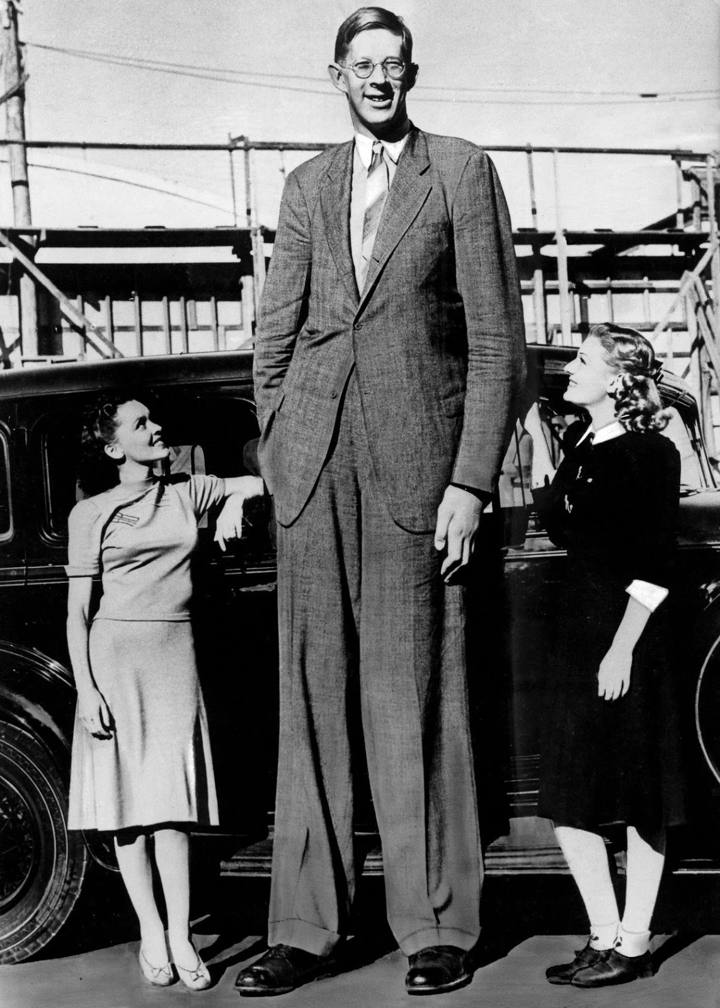
Robert Wadlow - 8’11”

Slide 186
How Tall Was Goliath?
Goliath
6’9” or 9’9”?
Ancient textual evidence slightly favors shorter Goliath
Internal evidence seems to suggest the larger Goliath
Coat of mail – 125 pounds
Spearhead – 15 pounds

Slide 187
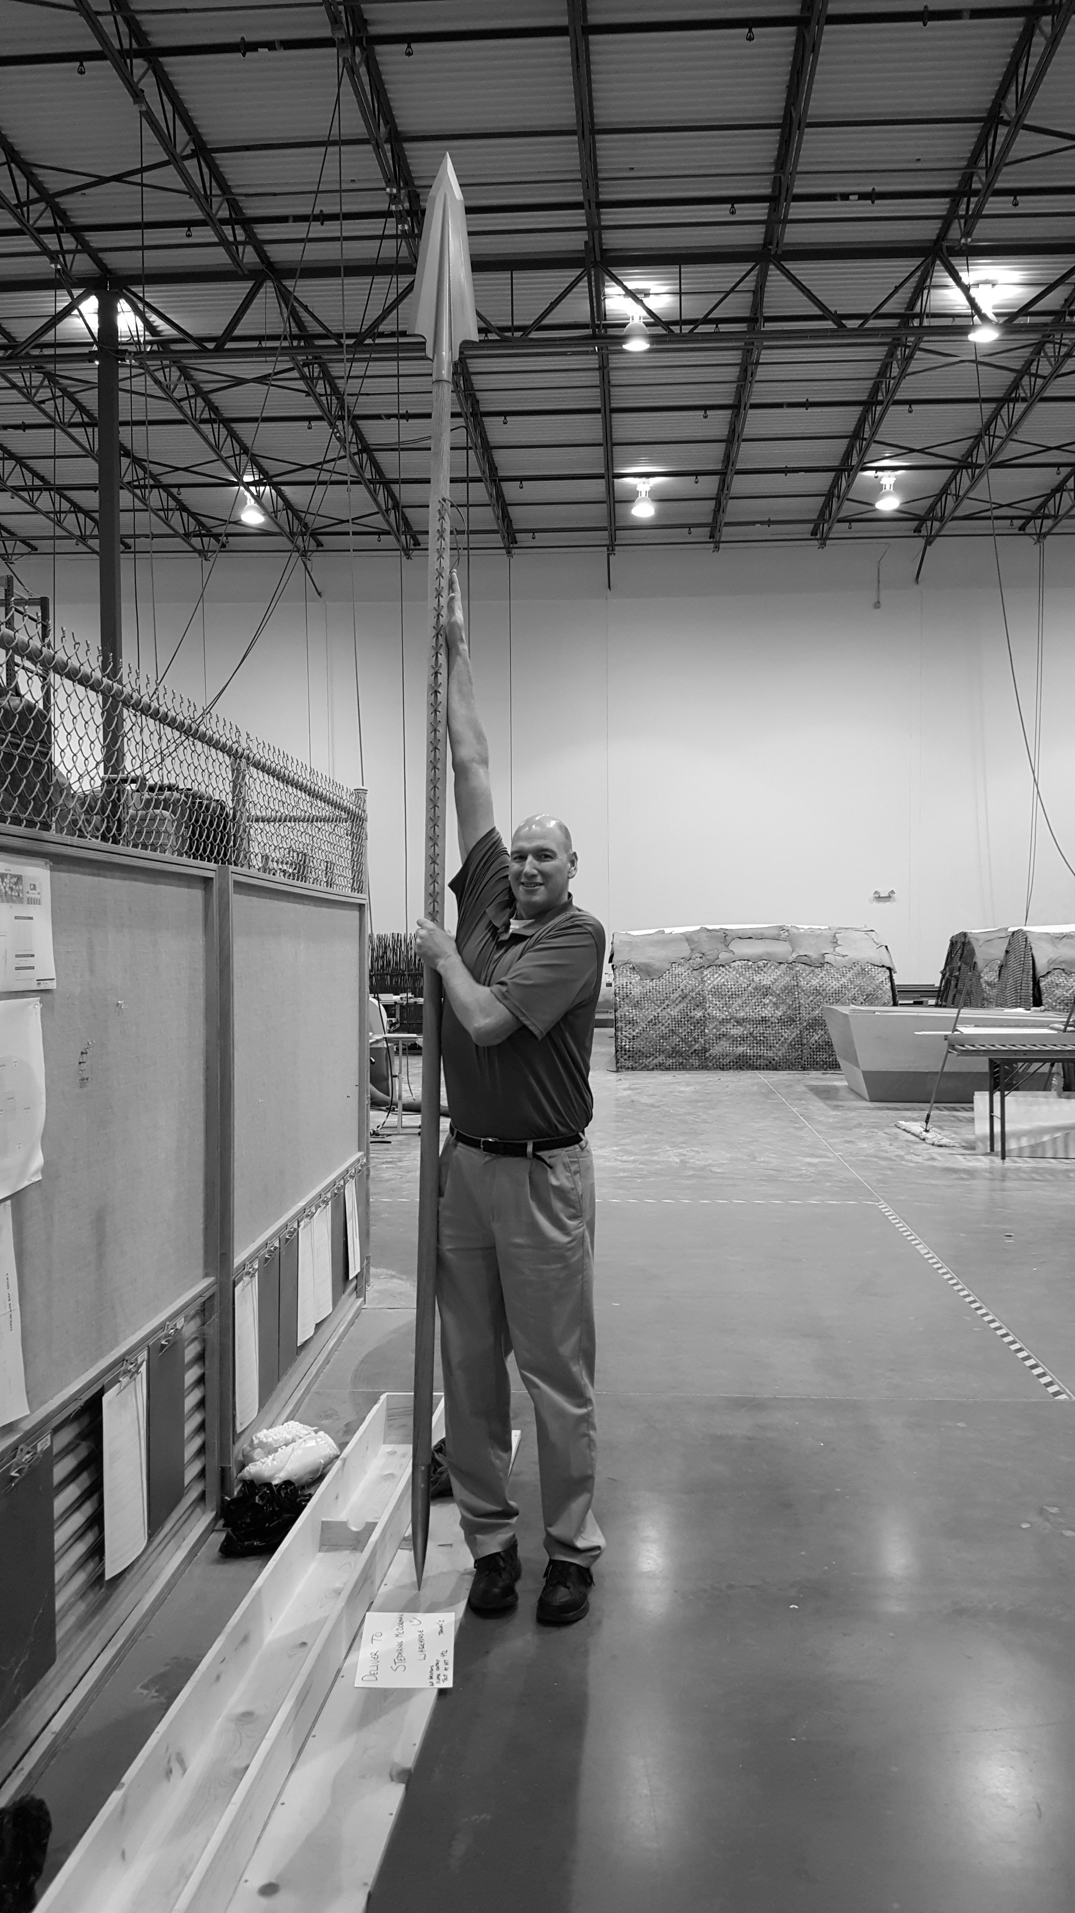
Tim with Goliath Spear

Slide 188
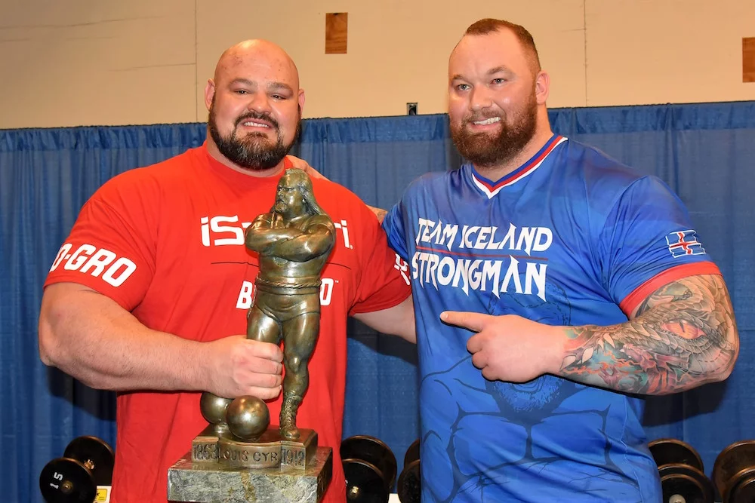
Brian Shaw (left)
Hafthor Bjornsson
(right)

Slide 189
Hafthor Bjornsson
with wife Kelsey
6’9” and 5’2”

Slide 190
How Tall Was Goliath?
Goliath
Was he measured by David’s cubit? Was David short?

Slide 191
How Tall Were the Israelites?
Numerous scholars cite Victor Matthews, Manners and Customs in the Bible, rev. ed.,
Page 3, “…short in stature (averaging about 5 feet tall for males)”
No documentation other than generic reference to burials
Describing people in Patriarchal period—not David’s time

Slide 192
How Tall Were the Israelites?
Bible and Spade (1995), “Tomb And Teeth: A Dentist’s View Of Ancient Israelites”
Khirbet Nisya cave (period of Judges)
792 teeth plus jaw fragments
Average height about 5’6”
“Estimates from other sites (including nearby Jerusalem 400 years later) suggest males ranged from 5’4” to 5’8” in height.”

Slide 193
How Big Was David?
He wielded Goliath’s sword
Older brother was big
Saul offered his armor to David
Called a mighty man of war before Goliath
Had already killed a bear and lion barehanded

Slide 194
How Tall Was Goliath?
Goliath
Egyptian records speak of the Anakim and describe them as being up to 8’7”
Shasu spies are depicted as being very tall

Slide 195
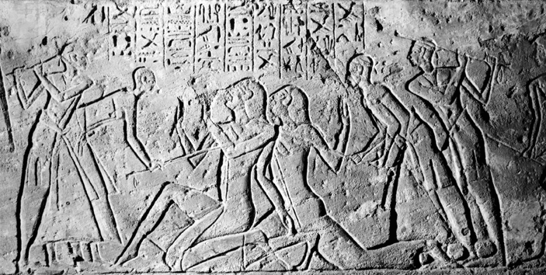
Shasu spies
(kneeling in center)

Slide 196
For only Og king of Bashan remained of the remnant of the giants. Indeed his bedstead was an iron bedstead. (Is it not in Rabbah of the people of Ammon?) Nine cubits is its length and four cubits its width, according to the standard cubit [i.e. “by the cubit of a man”].
Deuteronomy 3:11, NKJV

Slide 197
How Big Was Og?
Og
Bed – 6’ x 13’6”
If Og were as tall as his bed is long, and built to my proportions (6’9” and 250 pounds), then he would have weighed 2000 pounds

Slide 198
Got Questions?

