Slide 1


Slide 2

“We’ve seen an explosion of prophetic signs that shout, ‘The hour is late!’”
~Dr. Bradford Reaves

Slide 3

SIGNS OF THE TIMES
Record-breaking storms
Volcanoes and earthquakes
Israel attacked by enemies
Antisemitism on the rise like never before
Digital currencies, global IDs, surveillance
AI claiming sentience
Christian persecution

Slide 4


Slide 5

The closer we get to the Lord’s return the further the church is falling away from Him!

Slide 6

PRE-ORDER NOW!

Slide 7

APOSTASY:
FALLING AWAY

Slide 8

But know this, that in the last days perilous times will come:
(2 Timothy 3:1)

Slide 9
For men will be lovers of themselves, lovers of money, boasters, proud, blasphemers, disobedient to parents, unthankful, unholy, unloving, unforgiving, slanderers, without self-control, brutal, despisers of good, traitors, headstrong, haughty, lovers of pleasure rather than lovers of God, having a form of godliness but denying its power. And from such people turn away!
(2 Timothy 3:2–5)

Slide 10
But evil men and impostors will grow worse and worse, deceiving and being deceived. But you must continue in the things which you have learned and been assured of, knowing from whom you have learned them, and that from childhood you have known the Holy Scriptures, which are able to make you wise for salvation through faith which is in Christ Jesus.
(2 Timothy 3:13–15)

Slide 11
For the time will come when they will not endure sound doctrine, but according to their own desires, because they have itching ears, they will heap up for themselves teachers; and they will turn their ears away from the truth, and be turned aside to fables.
(2 Timothy 4:3–4)

Slide 12
Now the Spirit expressly says that in latter times some will depart from the faith, giving heed to deceiving spirits and doctrines of demons,
(1 Timothy 4:1)

Slide 13


THE END TIMES
RAPTURE
ABOMINATION OF DESOLATION
1 Thess. 4:13-18
Dan. 9:27
Matt. 24:15
ANTICHRIST UNVEILED
ARMAGEDDON AND
THE SECOND COMING
GREAT WHITE THRONE
Dan. 9:27
Rev. 19:11-16
Rev. 20:11-15
ETERNAL
STATE
(New Heaven
& New Earth)
CHURCH
Israel Protected for 3 ½ years
Israel Persecuted for 3 ½ years
PREPARATION
(75 Days)
PREPARATION (Unknown Length)
MILLENIUM
(1000 Years)
Eph. 3
Dan. 12:11-12
7-Year Tribulation (Matt. 24:4-28)
Daniel’s 70th Week (Dan. 9:24-27)
Time of Jacob‘s Trouble (Jer. 30:7)
Day of the Lord’s Wrath (Zeph. 1:14-18)
MESSIANIC KINGDOM
Last Days
Rev. 20-21; Isa. 65:17-25

Slide 14

God’s Plan of the Ages
Last Days
Tribulation/Wrath of God (Antichrist)
Revelation 6-18
1
2
3
4
5
6
7
Garden
of Eden
Innocence
(Adam & Eve)
Conscience
(Adam &
Eve’s
Family)
Human Gov’t
(Noah)
Promise
(Abraham)
Law
(Moses)
Church
(Christians)
Kingdom
(Christ)
Genesis
1:28-3:6
Genesis
3:7-6:7
Genesis
9-11
Genesis 12- Exodus 19
Exodus 20- Acts 2
Acts 2-Rev. 3
Revelation
19-22
c. 4004 BC
2348 BC
2091 BC
1446 BC
AD 33
FUTURE

Slide 15
APOSTASY:
SPIRITUAL FALLING AWAY

Slide 16

FAKE CHRISTIANS
“wells without water… for whom is reserved the blackness of darkness forever”
(2 Peter 2:17)

Slide 17
FALLEN CHRISTIANS
“shipwrecked in the faith”
(1 Timothy 1:19)

Slide 18
having faith and a good conscience, which some having rejected, concerning the faith have suffered shipwreck, of whom are Hymenaeus and Alexander, whom I delivered to Satan that they may learn not to blaspheme.
(1 Timothy 1:19–20)

Slide 19
deliver such a one to Satan for the destruction of the flesh, that his spirit may be saved in the day of the Lord Jesus.
(1 Corinthians 5:5)

Slide 20
And their message will spread like cancer. Hymenaeus and Philetus are of this sort, who have strayed concerning the truth, saying that the resurrection is already past; and they overthrow the faith of some.
(2 Timothy 2:17–18)

Slide 21
FALLEN CHRISTIANS
“forsaking the assembly together”

Slide 22
not forsaking the assembling of ourselves together, as is the manner of some, but exhorting one another, and so much the more as you see the Day approaching.
(Hebrews 10:25)

Slide 23
Let us hold fast the confession of our hope without wavering, for He who promised is faithful.
(Hebrews 10:23)

Slide 24
Therefore do not cast away your confidence, which has great reward.
(Hebrews 10:35)

Slide 25

Apostasy and Eternal Salvation

Slide 26
But where sin abounded,
grace abounded much more…
(Romans 5:20).

Slide 27
If we are faithless, He remains faithful; He cannot deny Himself.
(2 Timothy 2:13).

Slide 28
Nevertheless the solid foundation of God stands, having this seal: ‘The Lord knows those who are His,’ and, ‘Let everyone who names the name of Christ depart from iniquity’
(2 Timothy 2:19).

Slide 29
In Him you also trusted, after you heard the word of truth, the gospel of your salvation; in whom also, having believed, you were sealed with the Holy Spirit of promise, who is the guarantee of our inheritance until the redemption of the purchased possession, to the praise of His glory.
(Ephesians 1:13–14).

Slide 30
Does apostasy mean you were never really saved to begin with?

Slide 31
For this reason I also suffer these things; nevertheless I am not ashamed, for I know whom I have believed and am persuaded that He is able to keep what I have committed to Him until that Day.
(2 Timothy 1:12).

Slide 32
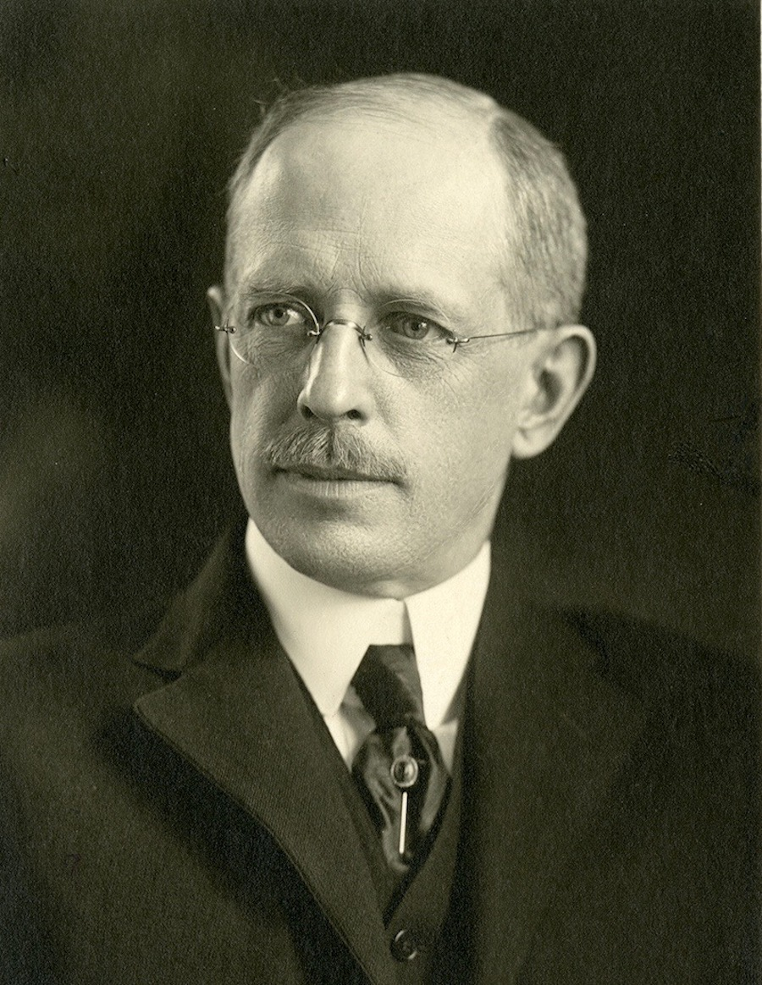
“It is quite possible for any intelligent person to know whether he has placed such confidence in the Savior. Saving faith is a matter of personal consciousness. ‘I know whom I have believed.’ To have deposited one’s eternal welfare in the hands of another is a decision of the mind so definite that it can hardly be confused with anything else. On this deposit of oneself into His saving grace depends one’s eternal destiny.”
~Lewis Sperry Chafer

Slide 33
7 MANIFESTATIONS
OF APOSTASY

Slide 34

Falling Away Biblically
Falling Away Eschatologically
Falling Away Morally
Falling Away Socially
Falling Away Evangelistically
Falling Away Academically
Falling Away Politically

Slide 35
3 MANIFESTATIONS
OF APOSTASY

Slide 36

FALLING AWAY BIBLICALLY
#1

Slide 37
Where has the Bible gone?

Slide 38
BIBLE CONTENT TEST
Who wrote the first four books of the New Testament?
Who delivered the Sermon on the Mount?
Who spent three days in the belly of a great fish?
Who was thrown into the lion’s den?
Who built the ark?

Slide 39
A Straw in the Wind

Slide 40
Biblical Apostasy
Postmodernism in Historical Perspective
Why Do You Believe What You Believe?
The Secularization of the Christian Worldview
Hell? Yes!

Slide 41
FALLING AWAY
MORALLY
#2

Slide 42
Embracing the LGBTQ+ Agenda

Slide 43
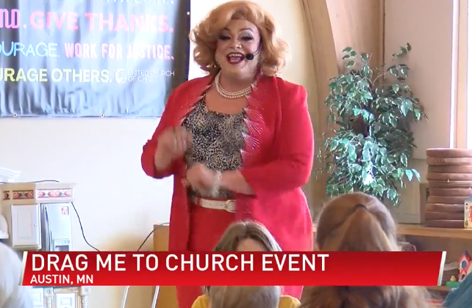

Slide 44
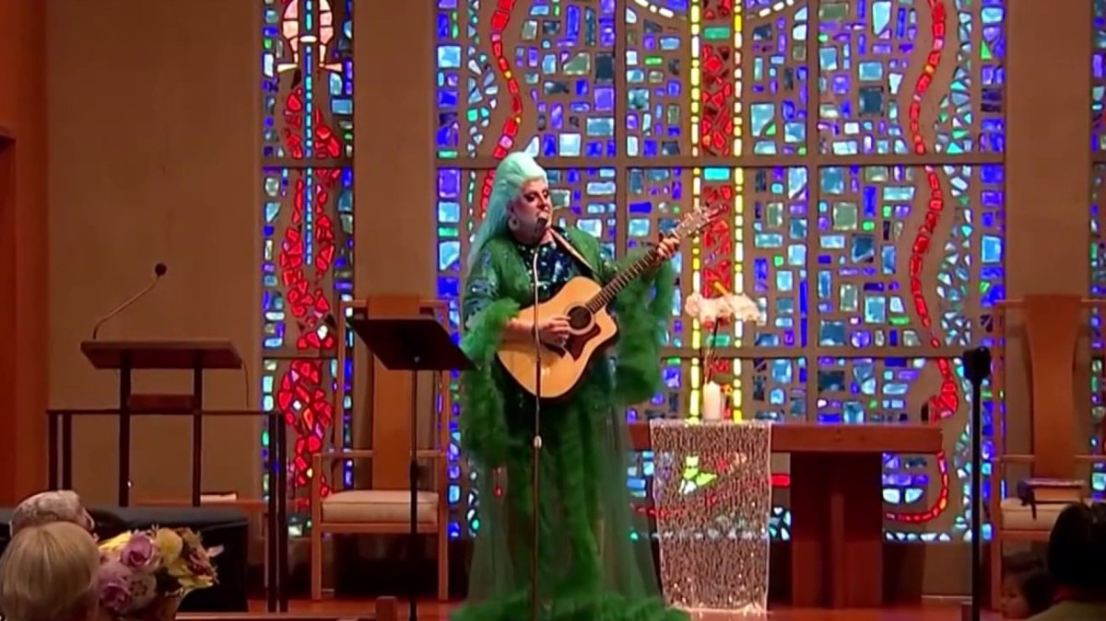

Slide 45


Slide 46


Slide 47

The Republican Party:
Proud to Support the
Sanctity of Life Sometimes

Slide 48

Any law that ends with the phrase,
“…and then it’s okay to kill the baby,”
is morally wrong.

Slide 49


Slide 50
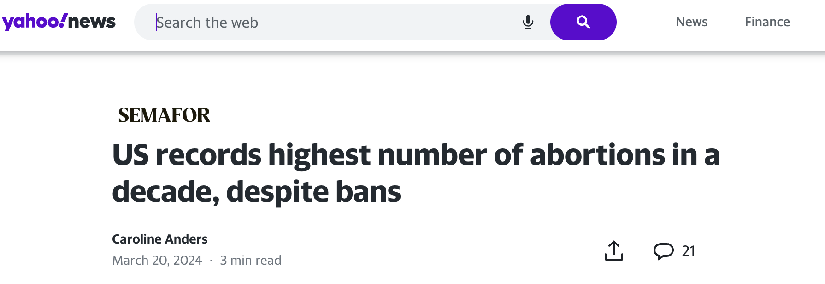

Slide 51
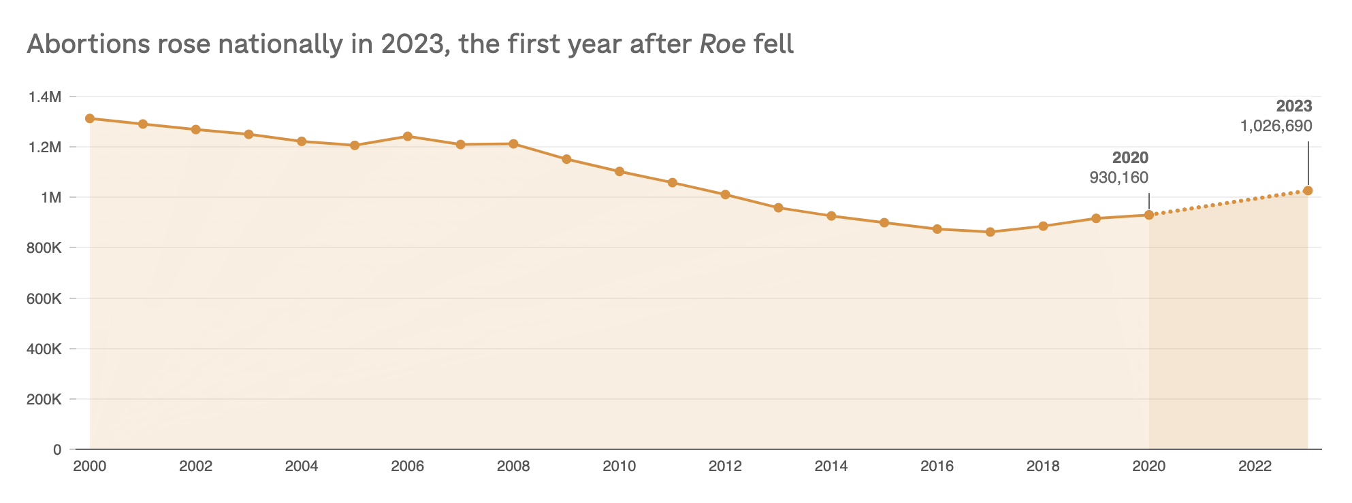

Slide 52
Moral Apostasy
Moral Failures in the Pulpit
Homosexuality and Gay Marriage
The Transgender Movement
The Sanctity of Life
Nibbling Leads to Swallowing

Slide 53
FALLING AWAY
POLITICALLY
#3

Slide 54


“Politics:
Poly = many
Ticks = blood-sucking
creatures!
~Robin Williams

Slide 55



Slide 56
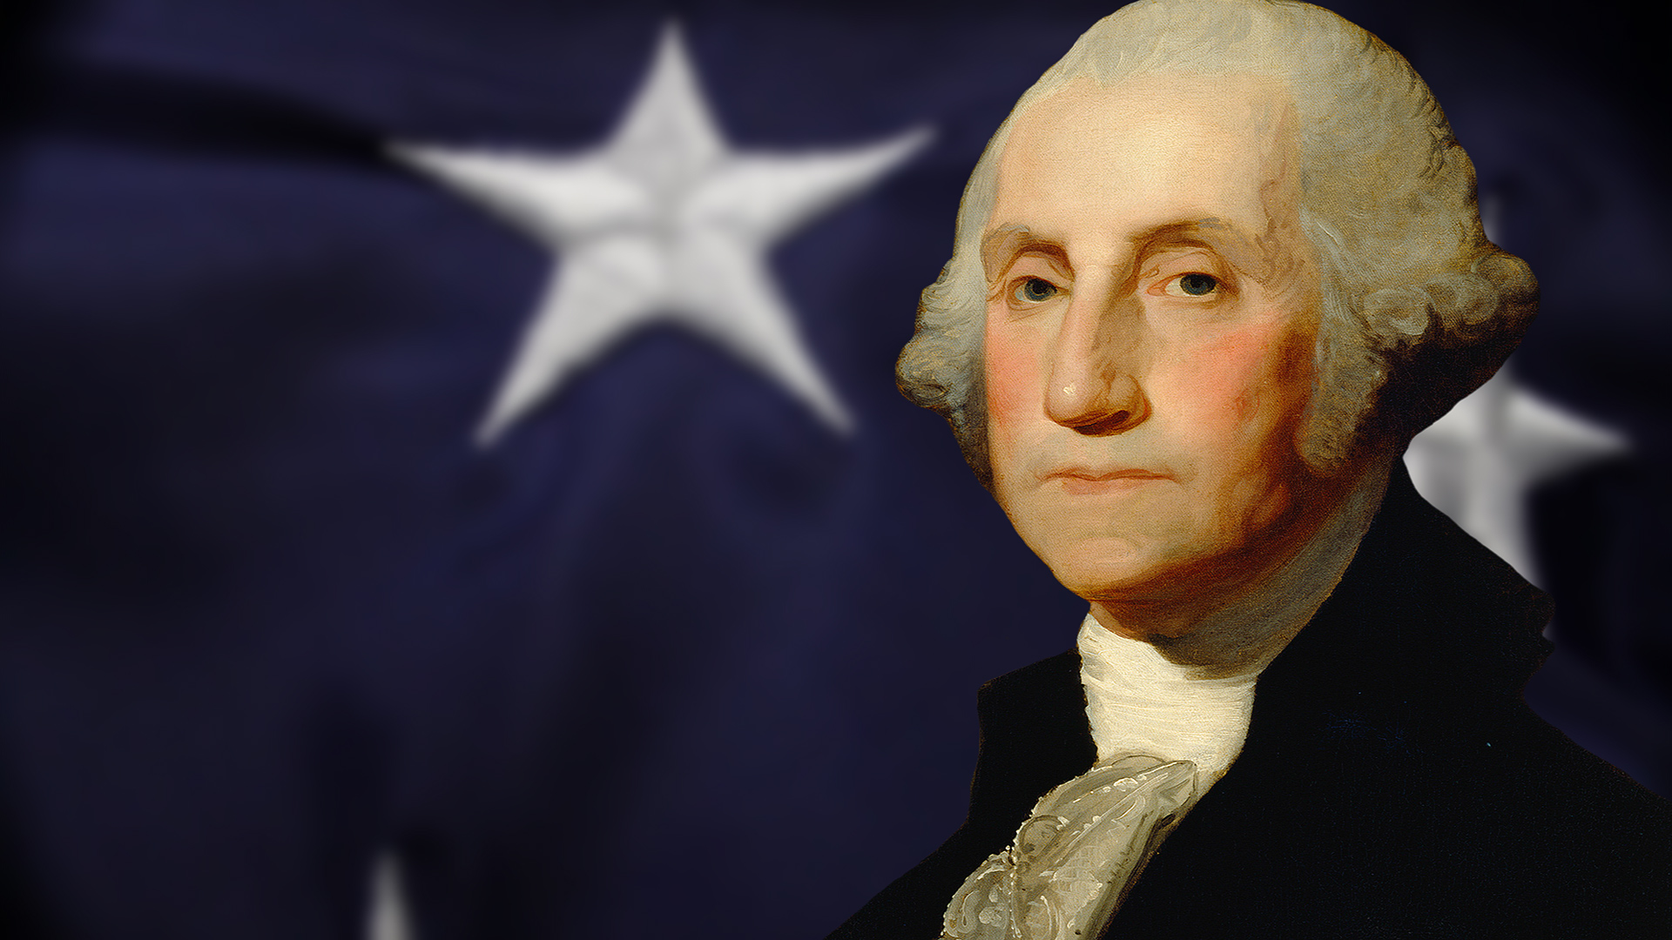
“Few men have the virtue to withstand the highest bidder.”
~George Washington

Slide 57
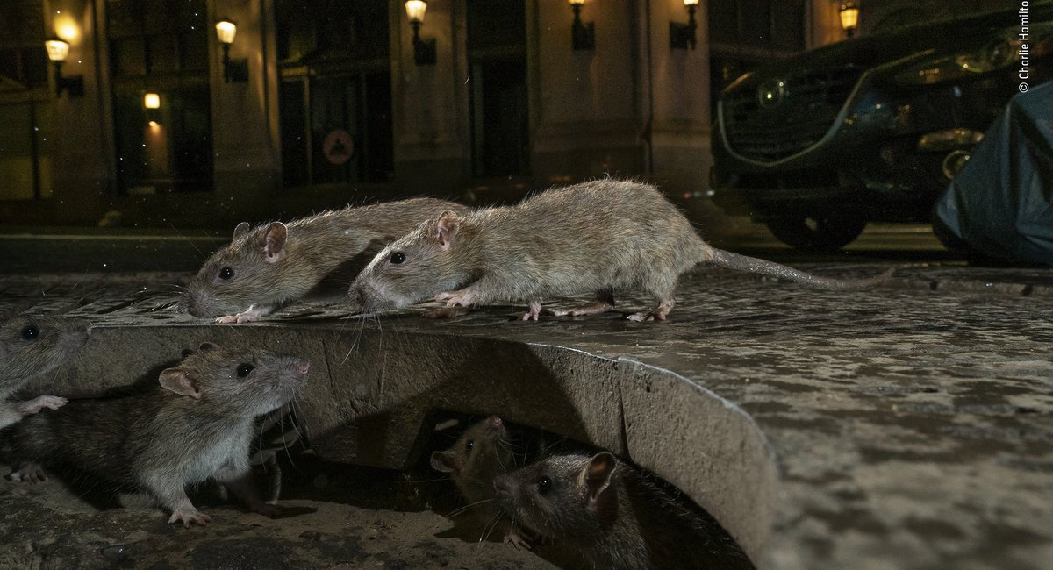

Slide 58
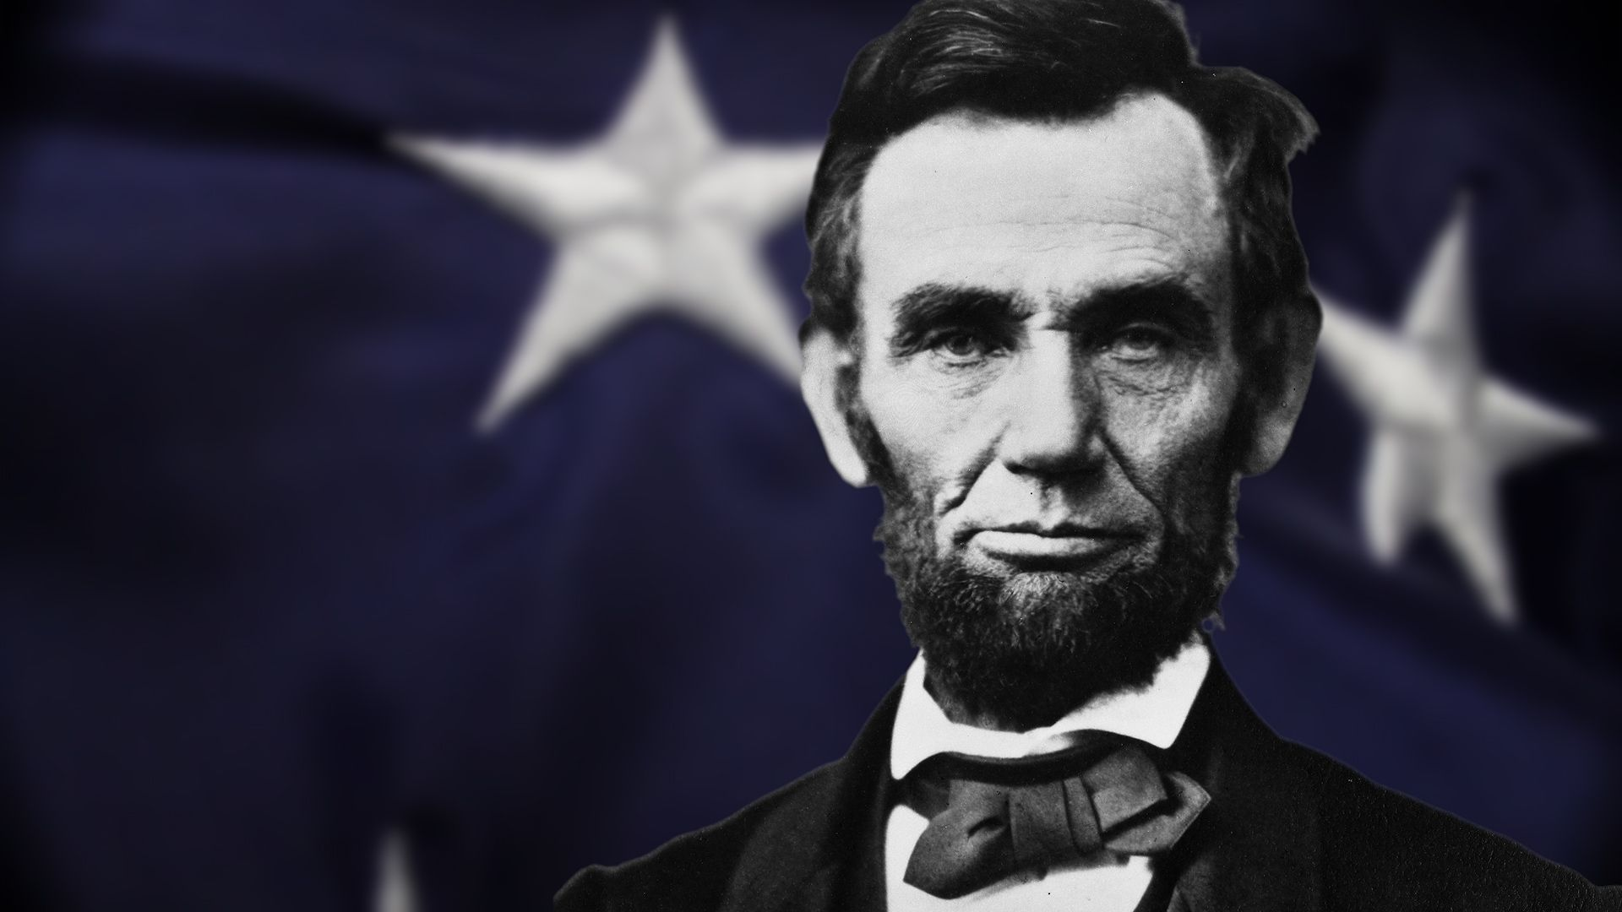
“America will never be destroyed from the outside. If we falter and lose our freedoms, it will be because we destroyed ourselves.”
~Abraham Lincoln

Slide 59
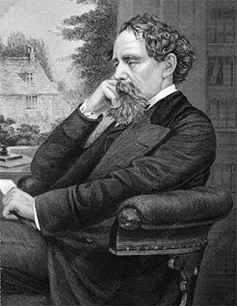
Washington, D.C. is a place with “spacious avenues that begin in nothing and lead nowhere.”
~Charles Dickens, 1842

Slide 60

“Mixing good in with evil is a clever tactic to woo the masses and pacify [the conservative] base. Many will be deceived by the bait and switch.”
~Leo Hohmann

Slide 61
You are all sons of light and sons of the day. We are not of the night nor of darkness. Therefore let us not sleep, as others do, but let us watch and be sober.
(1 Thessalonians 5:5–6)

Slide 62
Beloved, do not believe every spirit, but test the spirits, whether they are of God; because many false prophets have gone out into the world.
(1 John 4:1)

Slide 63
Christians are an easy mark.

Slide 64
Evil is the new good.

Slide 65
“I, wisdom, dwell with prudence, and find out knowledge and discretion. ...By me kings reign, and rulers decree justice. By me princes rule, and nobles, all the judges of the earth. I love those who love me, and those who seek me diligently will find me.”
(Proverbs 8:12–17)

Slide 66


Slide 67

The Luciferian Conspiracy Exposed!
SpiritoftheAntichrist.org

Slide 68


Slide 69


Slide 70
Chapter 9 and
Pages 177-180
PRE-ORDER NOW!

Slide 71


Slide 72


Slide 73
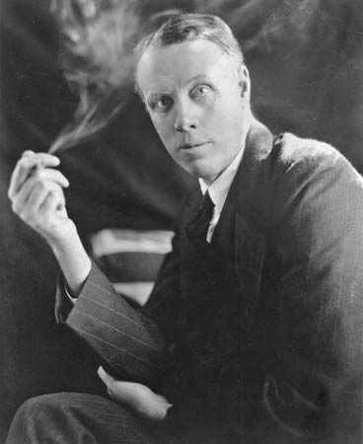
“When fascism comes to America, it will be wrapped in the flag and carrying the cross.”
~Sinclair Lewis

Slide 74
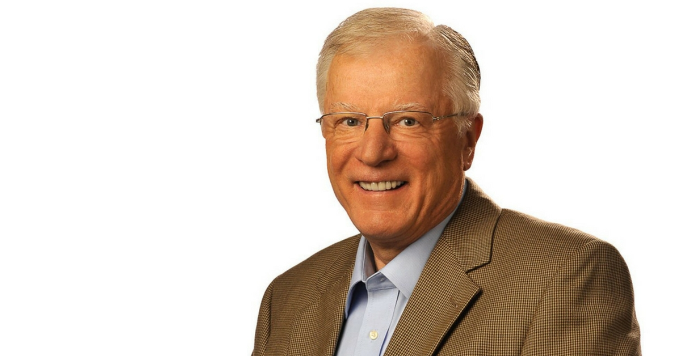
“Perhaps the most enduring lesson of that period of history is that through the power of compelling propaganda and intimidation, ordinary people can become a part of an evil movement and be willingly caught up with the euphoria that surrounds a mesmerizing leader.”
~Erwin Lutzer

Slide 75
Political Apostasy
The Overton Window Needs Cleaning
Why NAR is DOA
Christian Nationalism
The Seven Mountain Mandate

Slide 76
Falling Away Biblically
Falling Away Morally
Falling Away Politically
(Plus 4 more in the book!)

Slide 77
WHERE DOES THE CHURCH GO FROM HERE?

Slide 78
Watch, stand fast in the faith, be brave, be strong.
(1 Corinthians 16:13)

Slide 79
Therefore, brethren, stand fast and hold the traditions which you were taught, whether by word or our epistle.
(2 Thessalonians 2:15)

Slide 80
that you keep this commandment without spot, blameless until our Lord Jesus Christ’s appearing,
(1 Timothy 6:14)

Slide 81


Slide 82
PRE-ORDER NOW!

Slide 83
Falling Away Biblically
Falling Away Eschatologically
Falling Away Morally
Falling Away Socially
Falling Away Evangelistically
Falling Away Academically
Falling Away Politically

Slide 84


Slide 85


Slide 86


Slide 87
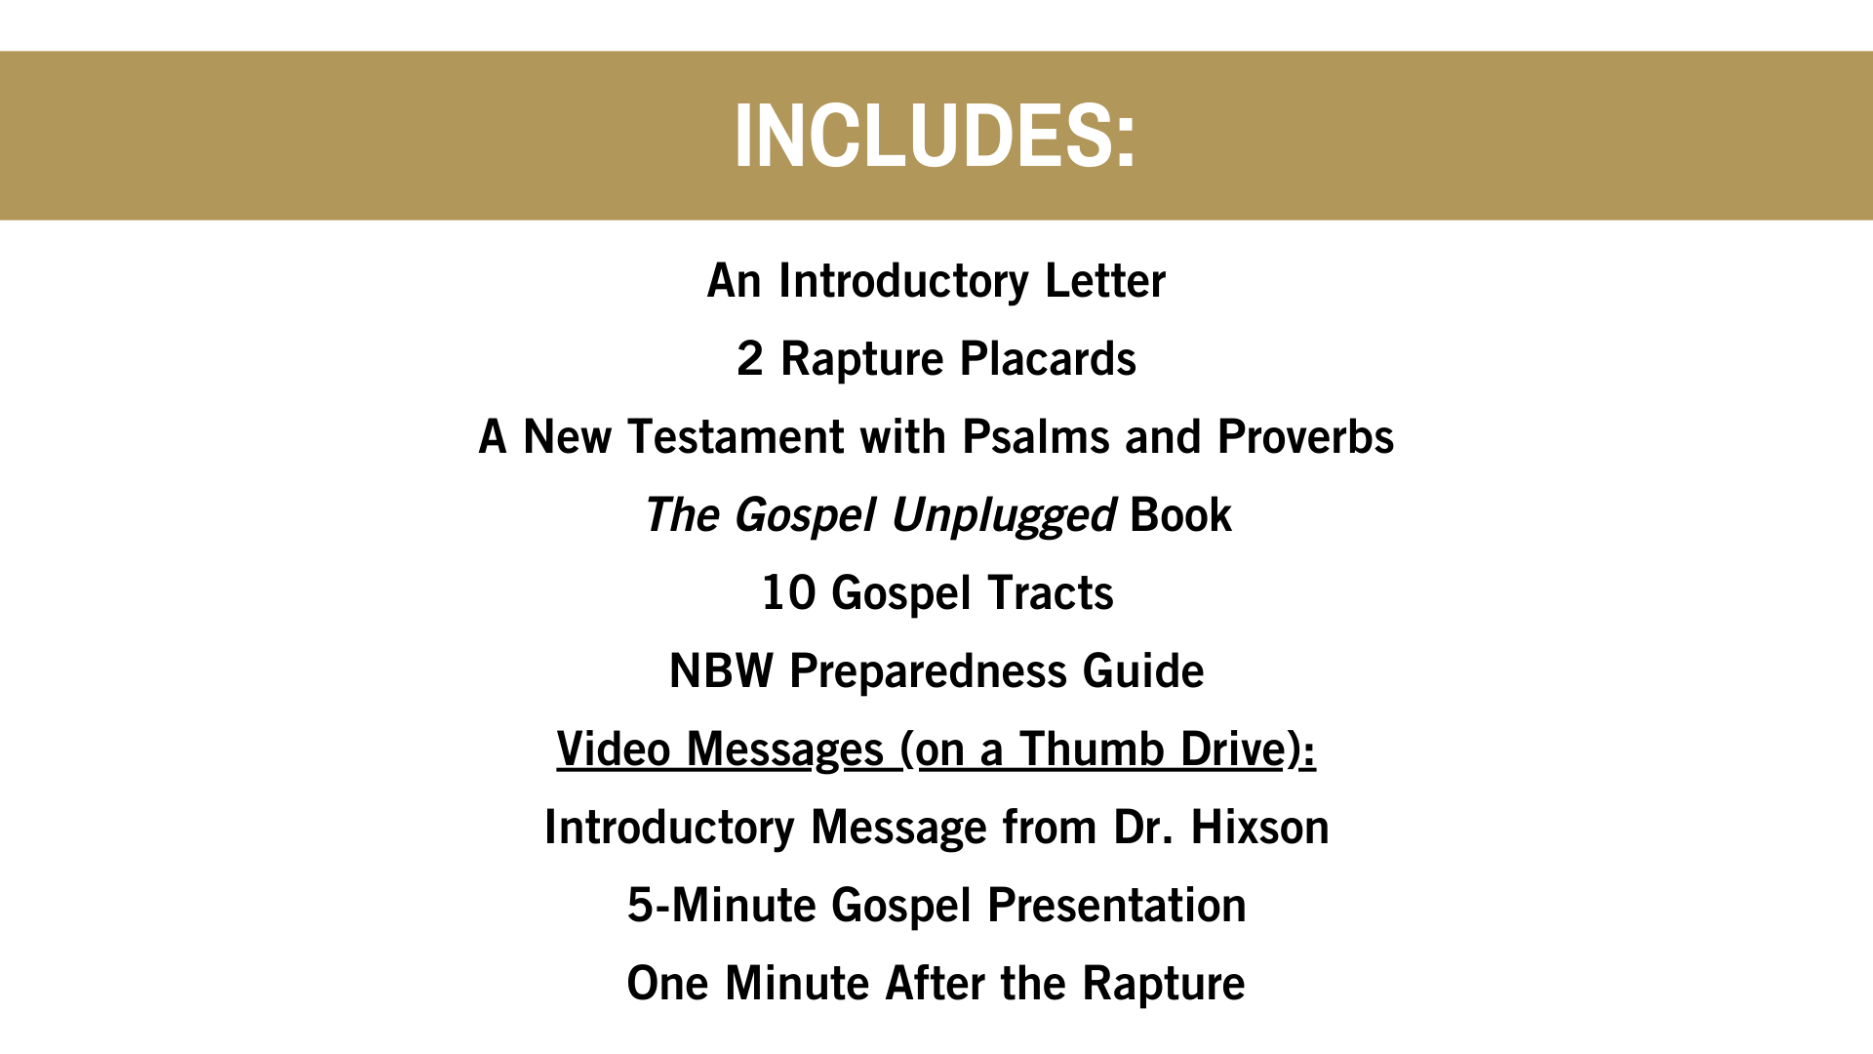

Slide 88


Slide 89


Slide 90


Slide 91


Slide 92
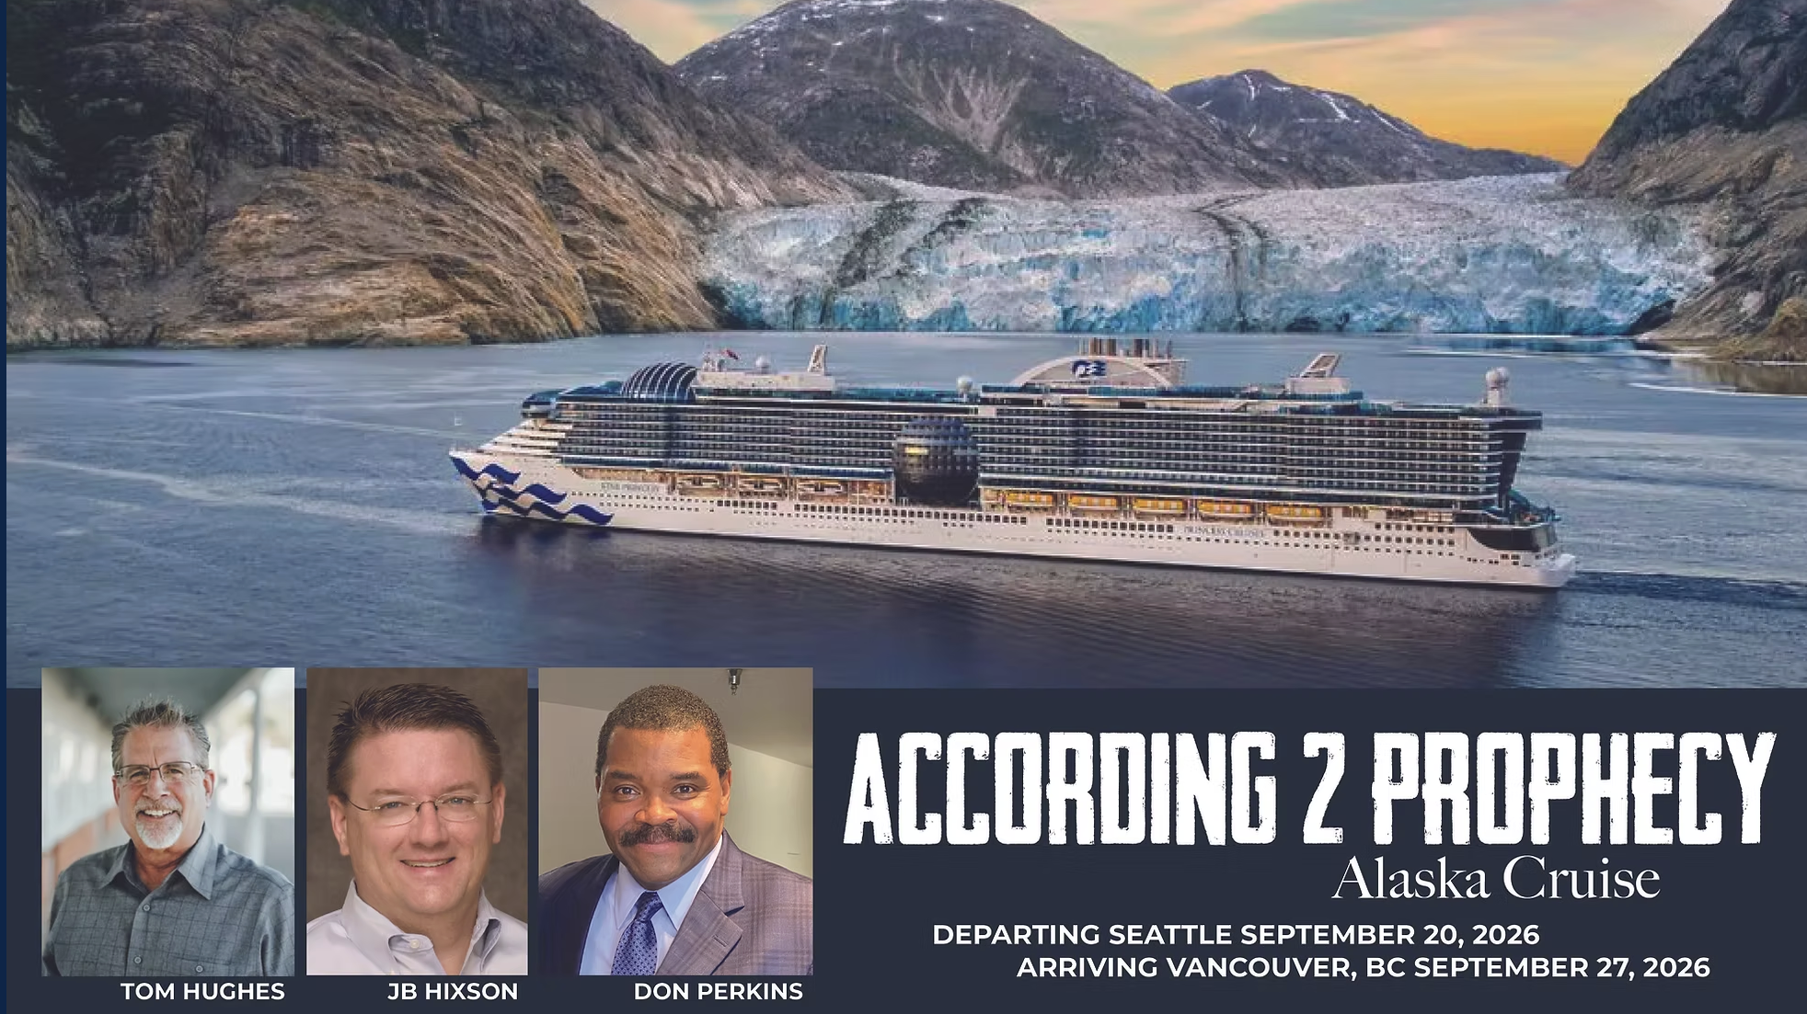


Slide 93


