Slide 1
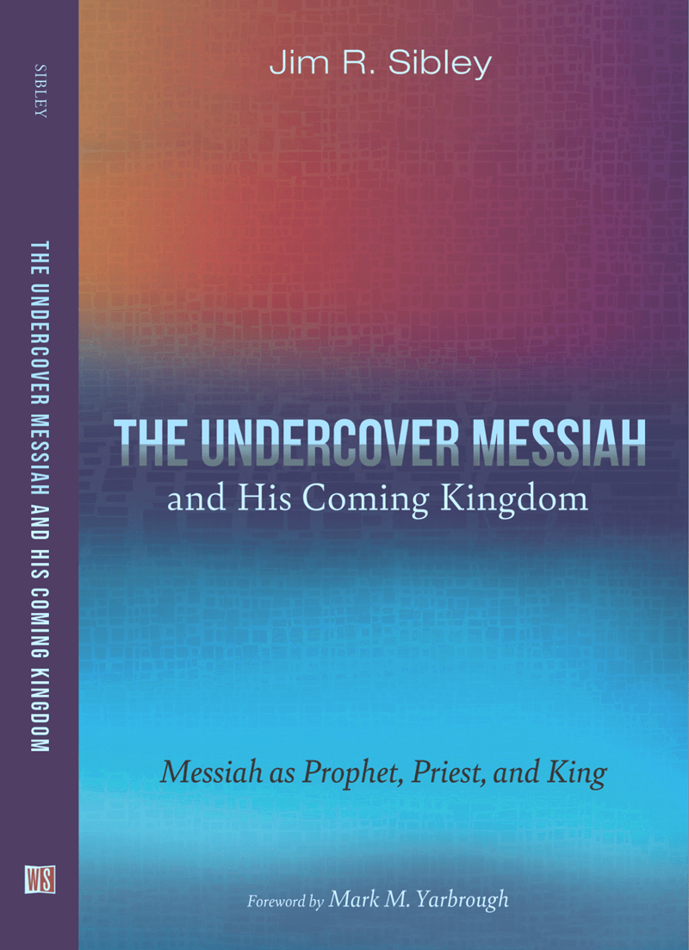
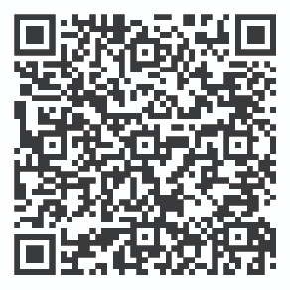
The Undercover Messiah
and His Coming Kingdom:
Messiah as Prophet, Priest, and King
Jim R. Sibley, PhD
Foreword: Mark Yarbrough,
President, Dallas Theological Seminary
40% Off, with Code: CONF40

